Slide 1
To MPLP or not to MPLP: That is the question with photographs, Part 1.
Gerald Chaudron, PhD, CA
Assistant Professor, Manuscripts
Special Collections
Mississippi State University Libraries
Notes:
Good morning. Thank you for coming to this first session of the meeting which will be a shared presentation. I’m Gerald Chaudron from the manuscripts division of the Special Collections Department here at Mississippi State University and I will discuss the usefulness of MPLP for photographs processing while Pamela Williamson of the University of Mississippi will look at the issues MPLP presents for digital archives.

Slide 2
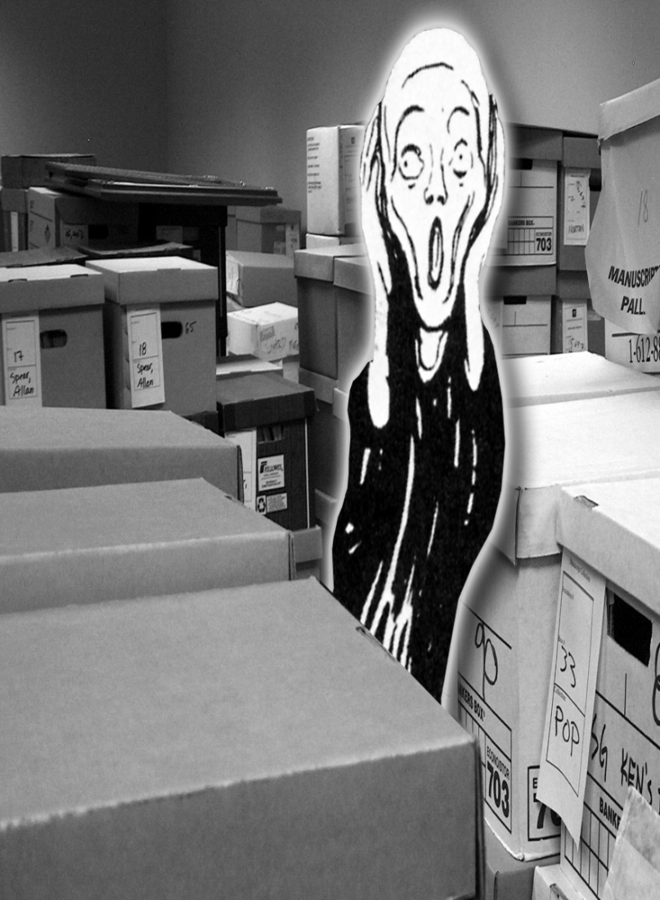
MPLP
Mark Greene & Dennis Meissner, ‘More Product, Less Process: Revamping Traditional Archival Processing’, American Archivist, 68 (2), 2005, pp. 208-263
Notes:
You might remember this cover from the 2005 issue of the American Archivist which featured Mark Greene and Dennis Meissner’s article “More Product, Less Process: Revamping Traditional Archival Processing” , the beginning of the MPLP revolution. The article looked critically at current archival processing practices and offered an alternative to address the growing problem of backlogs, particularly in regard to 20th century records.

Slide 3
MPLP
General recommendations
No arrangement below series level
Description should be at the same level as
arrangement
Minimal to no preservation
No separation of photographs
Notes:
Greene and Meissner conducted an extensive survey of processing practices and came up with the following general recommendations:
Arrangement and description should be at a higher level to enable faster processing: they suggested collection level was possible but no lower than series level should be considered. Series description should be sufficient to guide users to boxes or folders which might contain what they are looking for.
On the theory that archival repositories manage their environments sufficiently that their materials will not degrade very much, Greene and Meissner stated there is no need to remove metal such as paper clips and staples, interleaving and sleeving of items is unnecessary, and there should be no copying of newsprint.
It follows, therefore, that there is no need to separate photographs from manuscript collections either.

Slide 4
MPLP
Goal:
Maximize accessibility of collections to users by
eliminating processing backlogs
More efficient use of resources
Let future events drive further work
Provisos:
Most applicable to 20th century records
Level of processing may vary from collection to
collection
Notes:
MPLP is all about enhanced accessibility for users: A collection minimally processed and accessible to users is preferable to a collection undergoing more extensive processing or awaiting such processing, and unavailable for use in the meantime.
In exchange for access, the user then has to take on more responsibility in searching for the materials they seek.
The archivist can devote the time saved by not processing so extensively to addressing the backlog of unprocessed collections.
Only if preservation issues come up later, or demand warrants it, should more work be done on a collection.
However, it is important to note that while MPLP has now become a mantra in manuscript, photographic and other collections, Greene and Meissner were only suggesting, at least in the 2005 article, that MPLP was most appropriate for 20th century records. They also conceded that the level of processing may vary across collections.

Slide 5
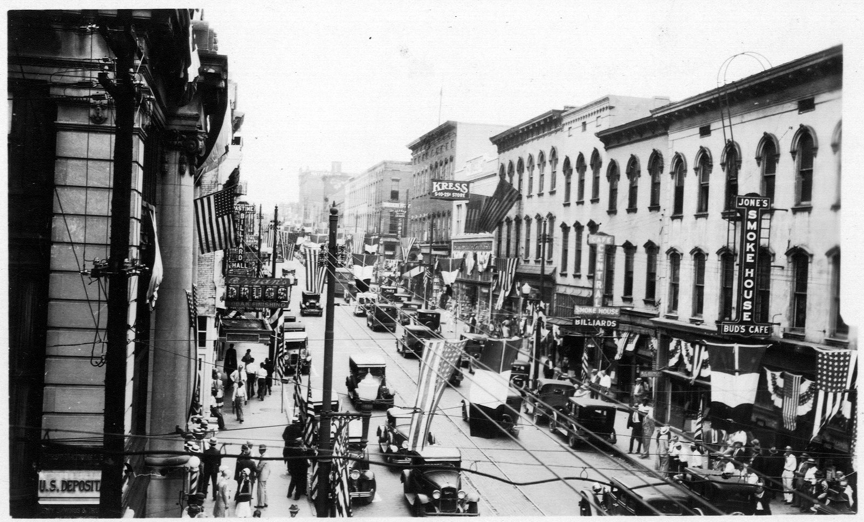
Washington Street, circa 1930
Notes:
Since this is a presentation about photographs I have included a few images just as relief from the other slides. These are from the Charles Johnson Faulk Papers which document Vicksburg during the 20th century.

Slide 6
MPLP and photographs
Anne Foster, ‘Minimum Standards Processing and Photograph Collections’, Archival Issues, 30(2), 2006, pp. 107-118
Initially considered MPLP at University of
Alaska, Fairbanks to process 300 linear foot
collection of scientific photographs
Notes:
Not surprisingly, archivists with photograph collections wondered if MPLP could work for their backlogs. An article published a year after Greene and Meissner’s article by Anne Foster outlined how the archives at the University of Alaska, Fairbanks, had employed MPLP to process a large collection of scientific photographs which had sat unprocessed for years because its very size defied attempts at traditional description. By describing the scientific purpose of the images rather than each individual photographs, the collection was processed quickly. This initial success led to a more general use of MPLP for photographs there.

Slide 7
UAF Draft Processing Guidelines-Baseline
Acquisition
Donor identification & pre-weeding
Numbering
Use numbers provided, or wait until used
Preservation
Don't sleeve, refolder only if brittle or absent, interleave only if clippings, organics, or
albumens
Do store negative collections in vault
Arrangement
Don't separate or weed
May create a series/may not be complete
Rely on donor arrangement or no arrangement for small collections
Description
Broad, standardized subjects
Place names, activities, some people
Notes:
These are the guidelines as outlined by Foster for handling photographs, MPLP style.
Rely on and encourage donors to provide identification i.e. metadata, and to weed the collection before its acquisition
Use the creator’s numbering system if there is one or else wait until someone actually wants to use them before numbering
Don’t do anything to preserve the images except if they are albumens or there are items of an organic or newsprint nature in the collection, but all negatives are put in the vault (it is not clear if this refers to cold storage)
No separating or weeding of images, series could be created if necessary but not to worry if they aren’t complete and if there is no donor arrangement don’t create one for small collections
Description should be limited to broad subjects such as geographic names, activities and people if they are the main subject

Slide 8
UAF Draft Processing Guidelines-Added Value
Appraisal
Fragility: Glass plates, nitrates, cabin finds
Pre-gold rush (1896) in primary date
Is accompanied by donation for more detail
Hot topics: minorities, ethnotechnology, global
warming
Use
Number upon ordering
High use = more preservation
Notes:
There were some exceptions to these guidelines, which Foster calls added value:
Glass plate photographs, nitrate stock, and ‘cabin finds’ which are items found in abandoned buildings where flora and fauna had come into contact with the images would be treated individually
Images predating 1896 would get more attention, as would collections which were accompanied by funds for processing, not surprisingly. Lastly any images related to topics of particular interest currently (she gives examples of minorities or global warming) would get more than the minimal treatment
If a copy of an image was ordered it was likely, Foster suggests, that more images from the collection or series would also be in demand and thus justified numbering ( I’m not convinced this assumption is necessarily true)
And, the more use a collection got, the more preservation would be considered

Slide 9
MPLP at UAF
Goal:
Make collections usable by applying minimum
processing standards necessary
Provisos:
May describe in more detail than arranged
Will number copies made from loaned images
Digitization requires item-level description
Notes:
Foster emphasizes that the objective is not to process photograph collections minimally solely to eliminate backlogs, in other words it is not institution-driven, but to make collections available to users. Thus the processing standard employed is whatever is necessary to provide that usability.
This might require more detailed description of collections than the arrangement suggests. Since one of UAF’s objectives is to broaden its collection by copying loaned images when it cannot acquire the originals, these copies are numbered. And if images are digitized that would certainly require item-level description.

Slide 10
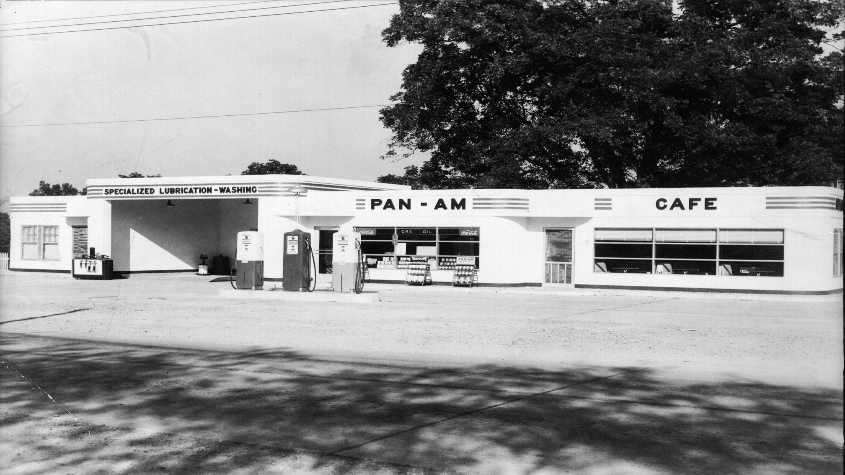
Pan American gas station, circa 1950

Slide 11
MPLP and photographs: The reaction
Processing cost savings result in higher costs for users
The cumulative effect of postponing weeding,
preservation may result in higher long-term costs for an
institution
MPLP may have the opposite effect to promoting more
accessibility as funders and administrators demand this
processing standard
MPLP may contribute to creating more ‘hidden
collections’ as collection-level descriptions act as a
disincentive to users
Notes:
Greene and Meissner’s article provoked a lot of discussion at the time, with some archivists deeming them the saviors of the archival world while others considered MPLP blasphemy and an undermining of the archival profession.
The debate still continues and some of the objections which are raised include:
The cost to users for insufficient appraisal includes their needing more time to search collections at an institution, which is often impossible
The cumulative effects for archives include needing more space to hold unweeded collections, and correcting preservation problems will be more expensive if delayed
Funders and administrators may require across-the-board application of MPLP, to include collections where more processing would actually be appropriate. Applying the same metrics to a collection of 19th century correspondence as 20th century organizational records, for example.
While users may be grateful to be able to have access to all collections through collection-level or series-level description, will those users be prepared to search through collections for the material they want if the subject they are interested in is not included in the description.

Slide 12
MPLP and photographs: The reaction
MPLP does not take account of the unique artistic
content of photographs
Photograph collections, like manuscript collections,
vary considerably in content, may have no original
order, have preservation issues and thus MPLP is
not universally applicable
MPLP places greater responsibility on reference staff
to find images for users since the collection or
series level description provides only limited
metadata
Notes:
More specific objections related to photographs include:
The original purpose of photographs may have been documentary but many images can be regarded as works of art or wider sources of information. A family portrait can offer information on clothing and demography for example.
MPLP is certainly not useful for photographic art collections.
Photograph collections can be varied in content, have no discernable original order and have preservation issues. Anne Foster has already noted the need to care for nitrates, glass plates or lantern slides. This makes the application of MPLP more problematic
Users will become even more reliant on the reference staff’s familiarity with collections to point them to images they are seeking. Does the time saving of minimal processing really offset the extra time spent searching for images by reference staff?

Slide 13
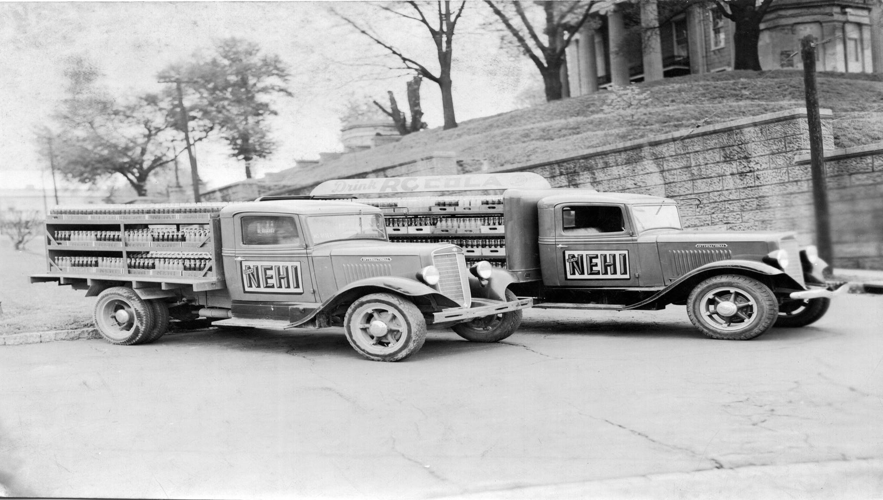
Nehi soda delivery trucks outside the Old Court House, 1930s

Slide 14
MPLP and photographs: Use
University of North Carolina, Chapel Hill
Large photograph collections: Rehouse, minimal
labeling, good storage conditions
Harvard University
Keep photographs with manuscript materials but
sleeve or buffer
New York University
Create order where none exists, describe to level
which directs users to individual images
Notes:
The University of Alaska is not the only archives using MPLP and that usage varies considerably:
The University of North Carolina at Chapel Hill is applying MPLP primarily to large photograph collections but it will still rehouse images
Harvard University is not separating images from its manuscript collections but it is sleeving individual items
New York University will create an order if there is none and describe to a level which directs users to individual images, which I am interpreting as full scope and content notes rather than folder lists

Slide 15
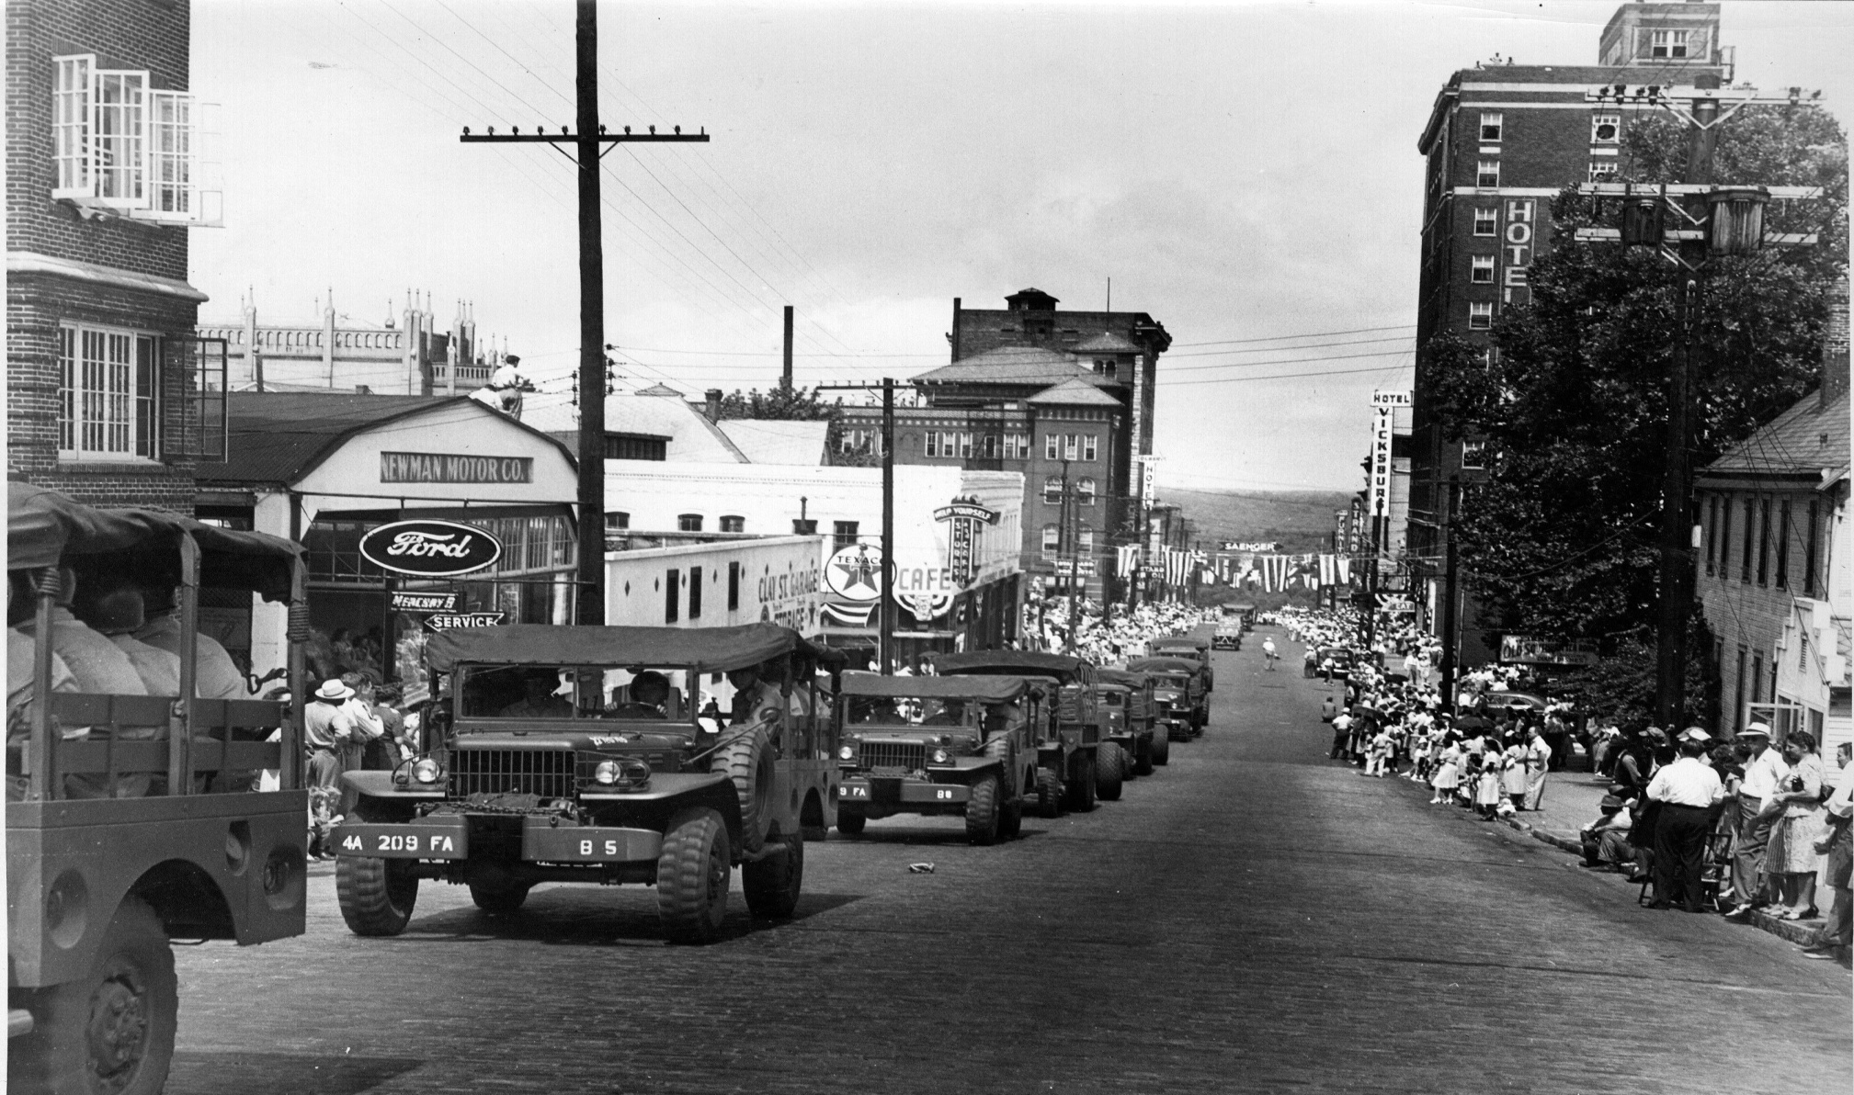
First July 4th parade since the Civil War, Walnut Street, 1946

Slide 16
MPLP : MSU Special Collections, Manuscripts
Using MPLP before term coined
All unrestricted collections (processed, in process or
unprocessed) are open if preservation allows
All collections get accession record with subject
headings, and preliminary inventory
Processing order based on potential demand,
preservation issues, donor relations, etc.
Notes:
Now that I have given some background to MPLP and its use with photographs I want to turn to how MPLP is used in the manuscripts division of Mississippi State’s Special Collections Department.
It could be argued that we have been using a form of MPLP for many years even if it was not called that until after 2005. All unrestricted manuscript collections, whether they are processed, in process or unprocessed are open to users if there are no preservation issues
All collections when they are accessioned get an accession record with some subjects terms and names and a preliminary inventory which provides sufficient access points for users until further processing is done. None of our finding aids are digital at the moment but we are now inputting our DACS-compliant finding aids into Archivist’s Toolkit and hope to put them online in the near future.
The order in which collections are chosen for further processing is governed by use or potential demand, donor relations, preservation issues, politics etc.

Slide 17
MPLP : MSU Special Collections, Manuscripts
Description to folder level
Original order for 20th century collections but
rearrangement if original order nonexistent or
inadequate
Retention of folders and labels for 20th century
collections, refoldering if folders deteriorating or
nonexistent, copying of newsprint
Notes:
We do not implement MPLP exactly as Greene and Meissner suggest. We describe to folder level but we will use the folder descriptions of the creator wherever possible. If there is no original order or it is unhelpful, rearrangement is necessary.
Again, we will use the creators folders and labels if they are in good condition but will refolder if not and we do copy newsprint.

Slide 18
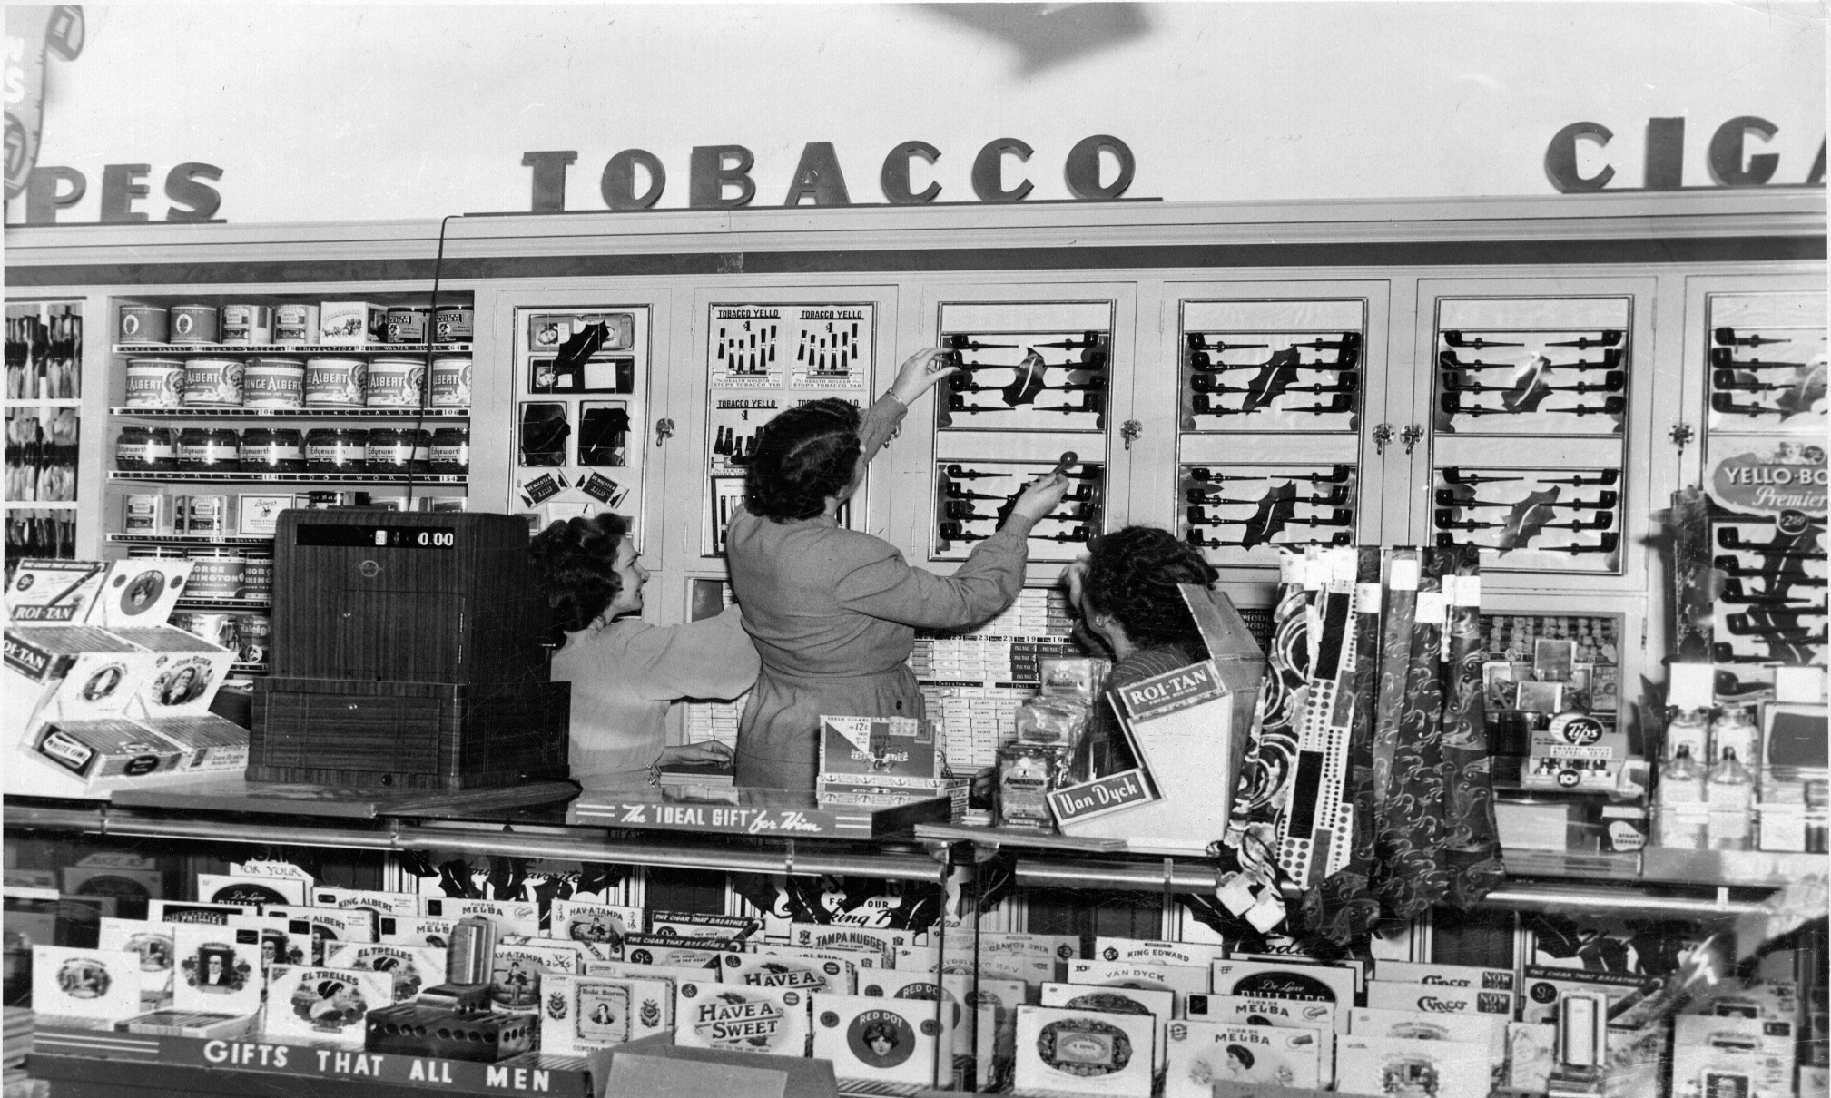
Walgreens cigar counter, 1946

Slide 19
MPLP and photographs: MSU
Photographs are separated to ensure adequate
  Identification
  Description
  Preservation
Notes:
Photographs are still handled in much the same way now as they were before the concept of MPLP was introduced by Greene and Meissner. That is, they are physically if not descriptively separated from their collections.
The coordinator of manuscripts, Mattie Abraham, and I pay more attention to photographs, partly out of concern for their preservation but also to give more emphasis to the images in our collections. However, it should be noted that for most of our collections photographs do not constitute a significant percentage of the content. Photographs are given item level descriptions in many cases and, if required, small series are created within manuscript collections
There are three reasons for separating photographs
Identification:
Where the number of images is small and scattered, they can be difficult to find if not described and arranged separately. In collections with only a small number of images compared to documents, a photocopy of each will remain with the associated document for reference purposes. Most users are content to see the copy rather than examine the original print or negative and that saves wear and tear.
Description:
The processor knows the collection best. The optimum time to describe photographs is during processing because revisiting collections is unlikely. That is not to say that we never reprocess but it is very unusual and is driven by demand. Describing at a lower level with sufficient subject headings is desirable because it means users and reference staff can find the images they are looking for more easily without having to handle all the prints
Preservation:
19th century photographs mounted on board, of differing sizes, are vulnerable if left in folders of correspondence which are in regular use. Modern prints can curl and reduced handling is just as desirable. Also assessment of any preservation issues is best done during processing to enable conservation if possible e.g. mold, tearing, adhesion due to damp, glassine sleeves, non-archival plastic slide holders. Some prompt low-level conservation at this stage may save considerable grief later on. A note is made of any potential issues that may need to be re-examined at a future date.

Slide 20
MPLP and photographs: MSU
General procedures:
Preservation:
Prints interleaved not sleeved:
Cost
Interleaf has brief description – date, subject,
photographer
Negatives put in envelopes, kept with collection prints
Photographs not normally removed from albums
Glass plates, cased photographs separated
Numbering:
Only if added to photo database
Notes:
There are some procedures we always carry out for photographs
1. Interleaving with acid-free paper is a preservation tool, mylar is too expensive as material for common use and from the processor’s point of view more labor intensive than interleaving. The paper also carries a description.
We don’t write information on a print for preservation reasons. It is easier to read the information on the interleaving in the processor’s writing than attempting to remove the image from the container and interpreting the creator’s scrawl on the back. The minimum metadata includes the date, subject and photographer if known.
We rarely have lot of negatives or nitrate stock so the negatives can be kept safely with the collection in envelopes
2. Photo albums will only be disassembled if in very poor condition or have little content. In the latter case, unless the album has some particular merit, saving it would take up precious space. The pages are copied before disassembling. Interleaving of album pages is dependant on the state of
pages. We do not want to bulk albums out if it will endanger the binding. Magnetic albums will be copied and the images removed if possible.
3. Glass plates and cased photographs are separated from other images for preservation purposes.
Photographs collections or series which we expect high use or which have been used several times have their metadata inputted into a database and thus numbering is required.
Items to be digitized will have their own numbers but these will not be extended to the whole collection or series.

Slide 21
MPLP and photographs: MSU
To use MPLP or not:
Appraisal and description governed by
size
content
expected use
Notes:
MSU uses MPLP with photographs but its application is on a collection by collection basis and is by no means uniform. A large collection, one well-organized by the creator or donor, or a collection of very similar content will lend itself to MPLP. A collection which is expected to have a high level of use will get more processing but we believe that processing generates demand. It is very difficult for users to appreciate the content of a collection if the description is minimal, in my view.

Slide 22
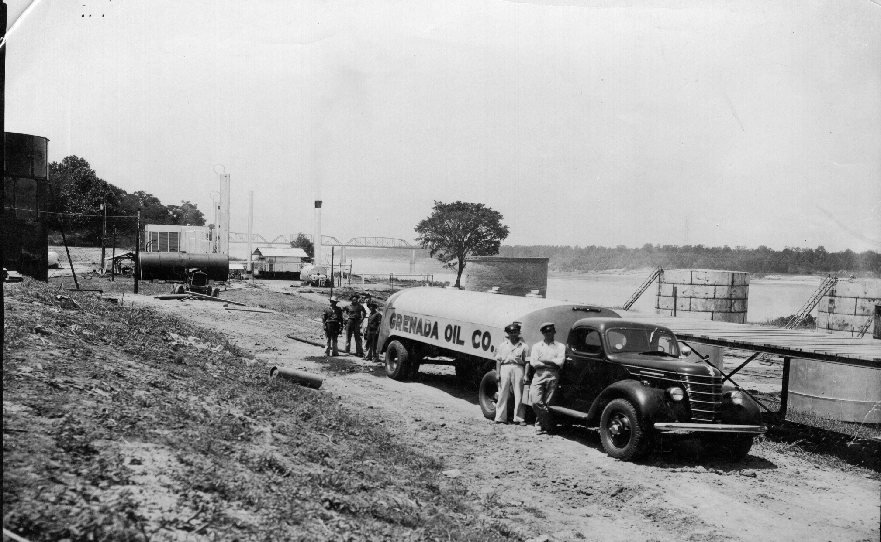
The first oil refinery in Mississippi, circa 1940

Slide 23
MPLP and photographs: MSU
Harris Barnes Papers - 161 cubic feet:
72,000 negatives, 57,000 prints, 51,000 slides
MPLP applied:
Used creator’s description
Separated documents from
photographic materials
Assessed preservation issues but mostly
kept in original housing
Slides kept in original drawers while rest
boxed
Counted for possible grant application
Notes:
I have talked about how the manuscripts division regards MPLP but I think it would be useful to give some examples of collections where MPLP principles formed part of the decision-making process regarding processing and then offer an explanation why MPLP was or was not applied.
The first example is the Harris Barnes Papers, one of the largest collections of photographs acquired by our division. It includes 72, 000 negatives, 57,000 prints and 51,000 slides.
Harris Barnes was a photographic journalist from Clarksdale who specialized in agriculture.
Using 7 student assistants, we processed the collection in 4 months.
Barnes used manila envelopes and photographic developers envelopes to house many of his images and the notations he wrote on them became the descriptions we used.
The few documents in the collection were separated from the photographs (its usually the other way around)
While the students were told to watch out for preservation issues (we did find some mold and damage from dampness) the original housing, the envelopes etc, was retained. The same applied to the slides which were in wooden drawers or photographic processors’ containers. Most of these envelopes and boxes were in the plastic storage containers used by Barnes himself but there were also plastic and paper bags of images. For easier storage in our stacks we chose to transfer them out of these containers into record cartons and this formed the basis of the arrangement.
A count was made for grant purposes. We do hope eventually to process the images more fully and give them better housing.
In the meantime, however, users have a quite detailed description of the contents without having to view every image. While there may be thousands of pictures of cotton, users can find cotton in Texas, or young plants, or harvesting just to name a few subjects within that broader field.

Slide 24
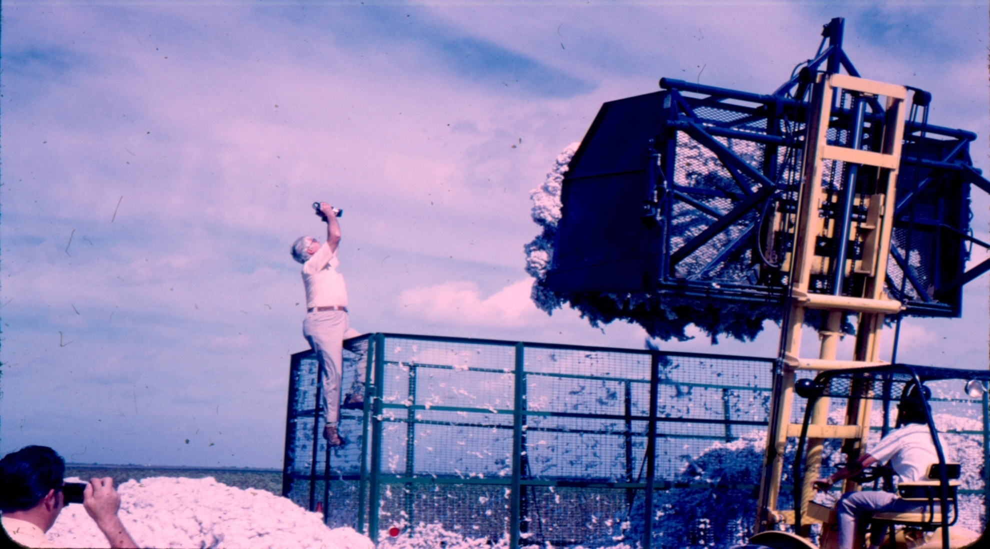
Harris Barnes, circa 1975
Notes:
I did not look at all the images but the family did ask for copies of any personal images which were in the collection. These were identified from Barne’s own descriptions and this shot was among them.

Slide 25
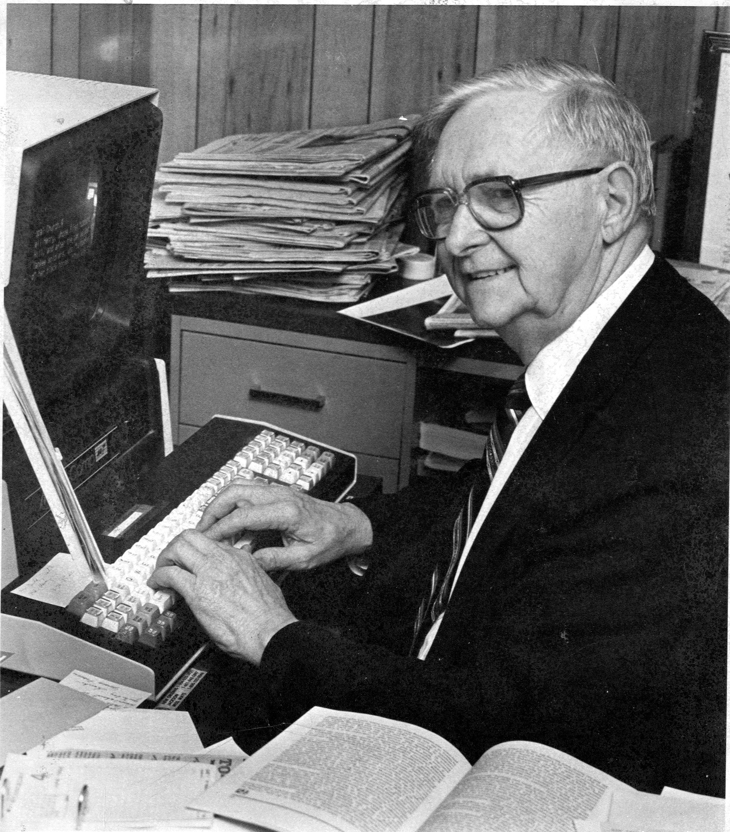
MPLP and photographs: MSU
Charles Johnson Faulk Papers – 7.5 cubic feet
2300 prints, 1700 negatives
MPLP not applied:
Original order alphabetical,
rearranged by subject
Notes:
The second example is the Charles Johnson Faulk Papers which contain 2,300 prints and 1,700 negatives. We could have applied MPLP here but chose not to.
Charles Faulk was the editor of the Vicksburg Evening Post who won the Pulitzer Prize in 1954 for the coverage of the previous year’s tornado which devastated his town. He often took the photographs which accompanied his stories. Faulk was responsible for the preservation of the glass plate collection of Vicksburg photographer J. Mack Moore now housed in the Old Courthouse Museum.
On acquisition, this collection’s images were in folders mostly in alphabetical order with a few subject folders.
Thus the ‘A’ folder would have a combination of prints of people with surnames beginning with the letter A, likewise for buildings or streets, as well as photographs of accidents, etc
Now these folder labels could have been retained and MPLP employed.
But while alphabetical order might have been adequate, searching the folders depended on knowing the name of a person, place or event according to Faulk’s definition
This seemed less than useful to me because of the images’ documentary value and I decided to rearrange the collection by subject to facilitate better accessibility. The larger number of subject terms allows a user to search more successfully than the previous arrangement .

Slide 26
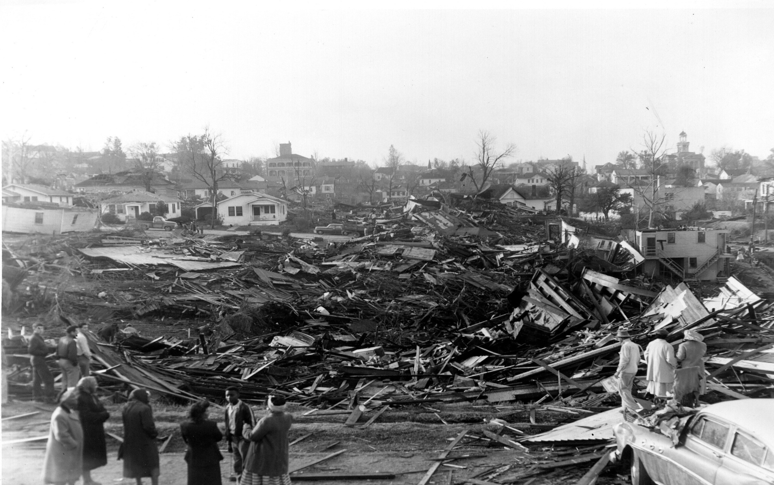
View south from Jefferson Street, 6/12/1953
Notes:
This is one of Faulk’s photographs of Vicksburg the day after the 1953 tornado.

Slide 27
MPLP and photographs: MSU
Hightower, Montgomery, Perkins, Castles, and Stiles Families Papers – 33 cubic feet
2,000 prints
MPLP not applied:
No original order,
arranged by family and individual
chronologically
Notes:
My third example is a personal photograph series. The Hightower, Montgomery, Perkins, Castles and Stiles Families Papers is a typical if larger family collection. It included manuscript material, costumes, artifacts and 2,000 photographs. It is an interesting group of photographs of 5 local families linked by the marriages of the female members.
At acquisition there was little original order and the photographs were dominated by snapshots. This one is of Meta and Hugh Hightower at Civilian Conservation Corps Camp Trask in Oregon, around 1941.
The photographs were in different containers: candy boxes, shoe boxes or just among correspondence, artifacts etc. Arranging them simply as a series with only family subjects may have been possible under MPLP. Many of the snapshots had limited metadata.
However, I did not consider MPLP very useful in this situation because the value to a user would have been severely limited and required a lot of searching through the images to find anything. The images were arranged by family and then by individual and place, with these subseries in chronological order. This took less time than expected once I became familiar with the families and very few images remained unidentified at the end. Most of the images had very little metadata such as name and date but the arrangement and description at least points the user in a direction which MPLP would not have been able to do.

Slide 28
MPLP and photographs: MSU
Conclusion
No universal application of MPLP to
photographs
Useful for large and/or well-ordered collections
To give sufficient access to photographs
requires more intensive appraisal than MPLP
allows
Notes:
In conclusion, I suggest that there cannot be a universal application of MPLP to photographs since there is so much variation in the content.
MPLP is most useful for large collections or well-ordered collections
But to give more sufficient access to photographs requires more intensive appraisal than MPLP allows

Slide 29
MPLP and photographs: MSU
Benefits of processing to folder and item level:
Easier access by users and reference staff
Address preservation issues now
Storage conforms to our requirements
Weed duplicate images
Identify significant images
Use processor’s knowledge to identify
digitization candidates
Notes:
So what are the benefits we have seen to processing photographs to the folder or item level
Users can access the photographs much more easily because of the fuller descriptions and this is also of great assistance to reference staff. Use also increases
2. Preservation issues can be addressed now which means fewer images are lost, the conservation required is less and not as costly, and damage does not spread to other images
3. Like many archives, we have storage constraints and by rehousing collections and weeding duplicates we are better able to manage our stacks. It is also assists in the preservation of the images.
4. The identification of significant images is simpler and we are able to locate images relating to important historical and local people, places and events, minorities, agricultural practices etc which we would like to highlight
5. We have also found that lower level processing makes it easier to identify candidates for digitization but that is all I want to say on that subject so I don’t encroach on Pamela’s presentation

Slide 30
Parade, Mississippi State College, circa 1940
Notes:
I want to end by showing two images which were found in collections which at least partly justifies item-level description. The first comes from the Harris Barnes Papers which I mentioned previously. It shows a parade on the MSU campus and is one of a number of images taken around 1940 by Barnes when he was a student here. The collection had very few images of non-agricultural subjects or ones that predated the 1960s. This group of brittle negatives was found among some personal items in an unidentified envelope which minimal processing would have overlooked.

Slide 31
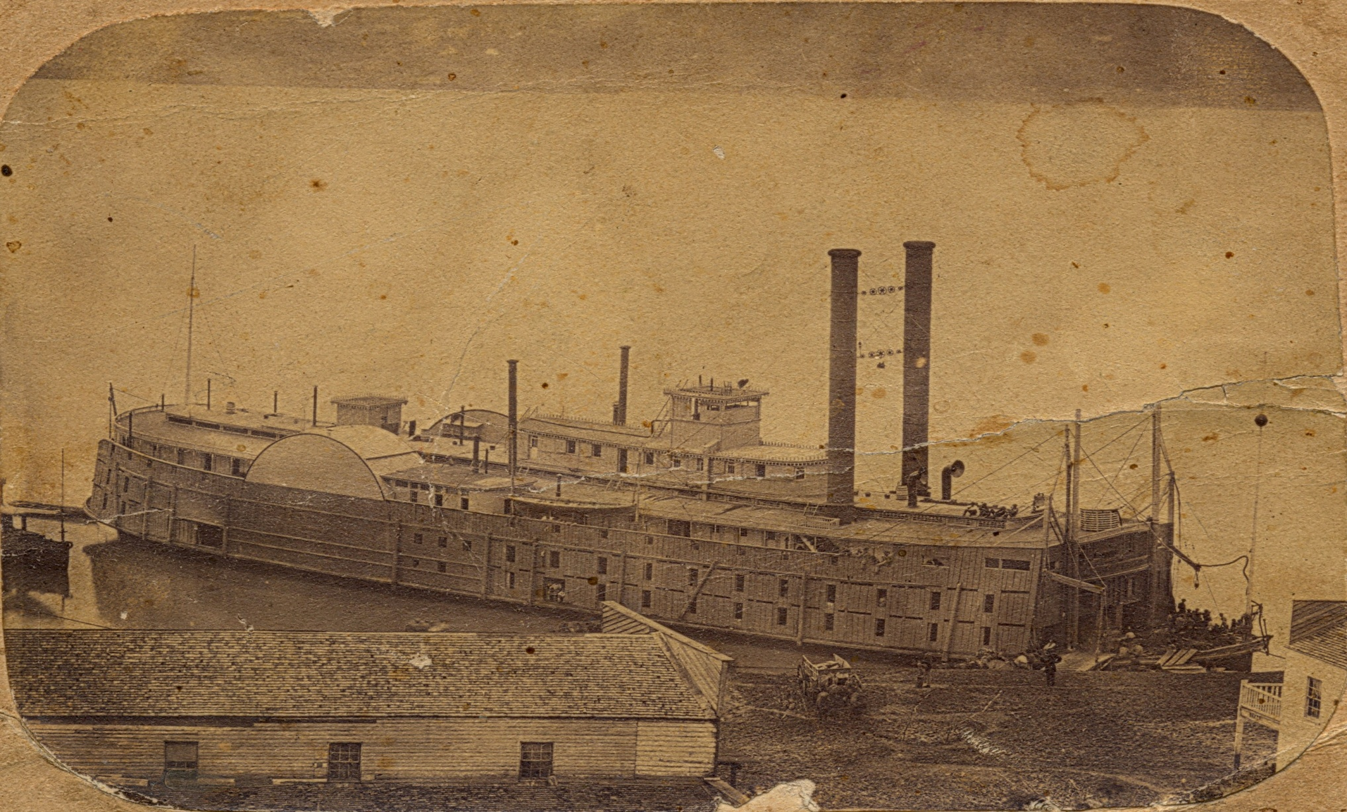
U.S. steamship ‘Baltic’, M.M.B., Vicksburg, circa 1864
Notes:
The second image is from the Charles Johnson Faulk Papers and was a particularly exciting find. It shows the Union packet steamer Baltic moored at Vicksburg around 1864. This armored transport served with the Mississippi Marine Brigade during the Civil War and is the only image I have discovered of one of its ships. Operating in Tennessee, Mississippi and Louisiana from 1862 the Brigade was supposed to be a river-based force to support army operations but it actually did little more than harass civilians and was disbanded in 1864. The print was in an envelope from a photographer operating in Kansas with no identification pertaining to the image, within a folder of prints labeled 1930s and 1940s. Again, it would certainly have been missed by MPLP processing.
I am not suggesting that every photographic collection deserves item-level processing on the off-chance something important may lie within. MPLP is an effective tool but we choose to use it judiciously. Our experience here at Mississippi State has confirmed that an efficient processor can arrange and describe photographs at a lower level than MPLP recommends without taking an inordinate amount of time and to the benefit of users. Thank you.

