Slide 1
On The Run with
Fugitive Literature
Teaching, using, storing and accessing
“hidden” literature

Slide 2
What is fugitive literature?
Ephemera
Newsletters
Souvenirs
Posters
Educational Documents, mostly produced by ERIC
Pamphlets
Slip laws
Travel Brochures
Comics and graphics
Other gray literature

Slide 3

Teaching with Pamphlets
Information is “Just in Time.”
Quickly accessed
Quickly read
Presents facts in “bullet” form
Presents facts without heavy background
Can be paired with books for more detailed information

Slide 4
Teaching with Pamphlets
Colorful
Eye catching
“Read me first”
Low cost
Government Documents can be photocopied in color
Distills heavy topics to an easier level

Slide 5
Teaching with Pamphlets
Information cannot be found elsewhere
  We select a pamphlet because we could not find information in another source.
Provides a different approach to topic
  Some items in pamphlets show a side of the topic that is not in books or journals.

Slide 6
Constitution Day Programs
The closest weekday to September 17th
Encourages reading the U. S. Constitution as a whole document
The Constitution is a document open to interpretation
Portable, pocket Constitution is a give-away
  Available through League of Women Voters

Slide 7
Yellowstone National Park
You can teach conservation/environ-
ment
  Migration of bison
  Fire Management
  Grizzly bears
  Teaches critical thinking as students think about how to use information
Teaching younger children (Grades 3 – 8)
  Combine with unit on Theodore Roosevelt
  Combine with Turn-of-20th Century ideals
  Teaches critical thinking as students think about how to use information

Slide 8
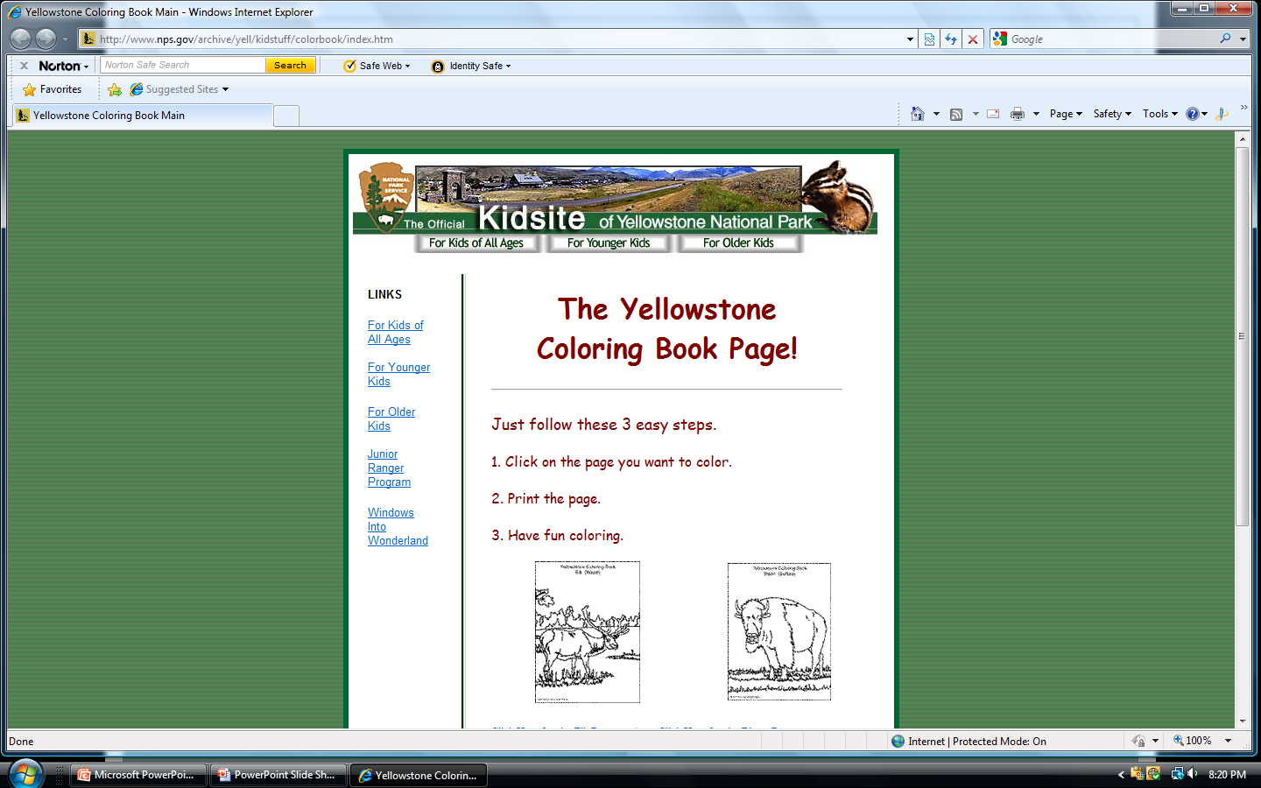
National Park Service
National Park Service

Slide 9

Civics and Citizenship Toolkit
A collaborative effort
U. S. Citizenship and Immigration Services
Institute of Museum and Library Services
U. S. Government Printing Office

Slide 10
Civics and Citizenship Toolkit
Social Services workshops
ESL classes
Adult Learner Programs at School Districts or Community Colleges

Slide 11
“Helping your child . . .”
No Child Left Behind
Parent Education
Can be used with other documents
Can be used at:
  Education Fairs
  PTA meetings
  Public Library Programs

Slide 12
Social Security Pamphlets
Bullet statements
Easy to read
Can be referred to many times
Clarifies “big” policy

Slide 13
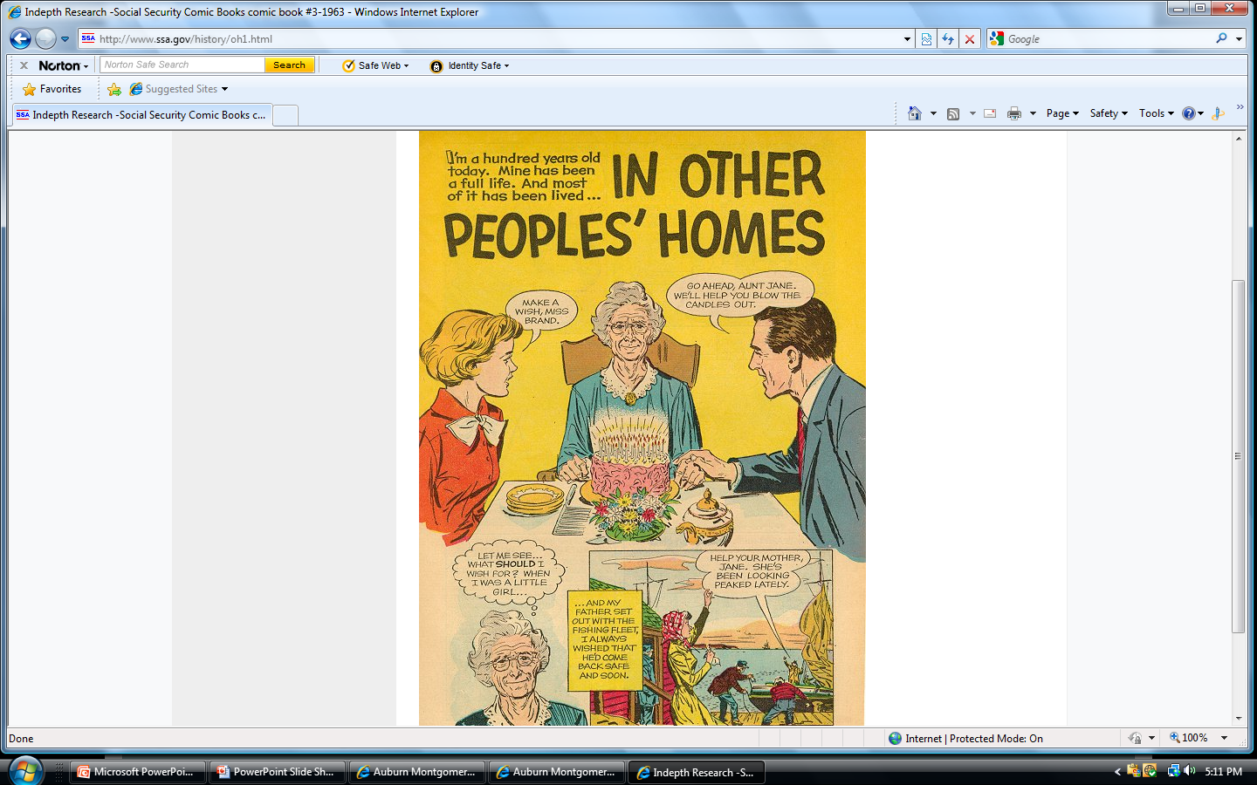
Social Security Graphic

Slide 14

Know your digital collection
Be prepared to match your digital collections with book collections, netLibrary, journal collections and web accessible books and digitals.

Slide 15
Pamphlet usage
As we increase the usage of printed pamphlets, we justify the increased use of digital pamphlets.
If we teach or present with pamphlets, we increase the need to store, retrieve and access pamphlets.

Slide 16
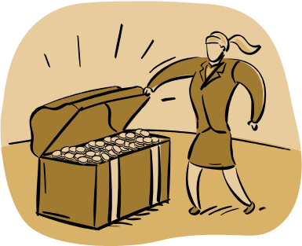
How to store pamphlets
Closed stack
  Staff member uses call slip and retrieves pamphlets
  Many of these pamphlets are valuable and vintage
Vertical file or Pamphlet file
  Encourages self-service use

Slide 17
Vertical File
If records are self-service, spruce up that pamphlet file!
  Color code items
  Use finding aids
  Use contextual notes
We want to organize our pamphlet file in an appealing way
  For more use!
  Make it the pride of the library

Slide 18
Finding aids
Both methods need excellent finding aids
Control Records (Inventory)
  Help staff discern which box items are stored in if stacks are closed.
Contextual notes
  State how the work is significant
  Give detailed information that is not in control record

Slide 19
Yet, another way . . .
Shelve pamphlets in with books and journals.
  This method is preferred if you are adding all literature to a single catalog.
Pamphlets and books will be interfiled on shelf
  Difficult to find sliding pamphlets

Slide 20
Red Flag
No Child Left Behind Pamphlets are cataloged in the same series.
  If they are filed by subject, they will be interspersed throughout the entire Department of Education.

Slide 21
Red Flag
Toolkits
  Check all contents
  Check each title, pagination, author’s spelling, subject heading
Checking all inventory for title and pagination is editing the record

Slide 22
Cataloging pamphlets can be fun
Customize the SuDoc or Library of Congress or Dewey number to suit your library’s needs
Use your catalog as a guide to your collection
Know your collection

Slide 23
Encoded Archival Description
Grammar
  Adjectives
    Just as we use descriptors in grammar, we will use our language skills to write descriptive captions
Usage
  Adverbs

Slide 24
Fun activity for writers
Brush up on your grammar and usage!
  EAD is fun for grammar and usage buffs
If you enjoy writing, you will love these descriptors
  These explain why the digitized pamphlet is significant

Slide 25
Fun Activity for Geographically gifted
If you enjoy map searching, GPS searches or geocaching, you will love EAD
You will describe where the document or photo is placed

Slide 26
Fun activity for people who study dates
If you like to discover time periods, you will love EAD
You will discover when photograph was taken and place time in context.

Slide 27
EAD
Is flexible and can work with both MARC record and Dublin Core
Uses XML markup language
Is descriptive tag, not a cataloging schema
Will link electronic resources and enables interoperability

Slide 28
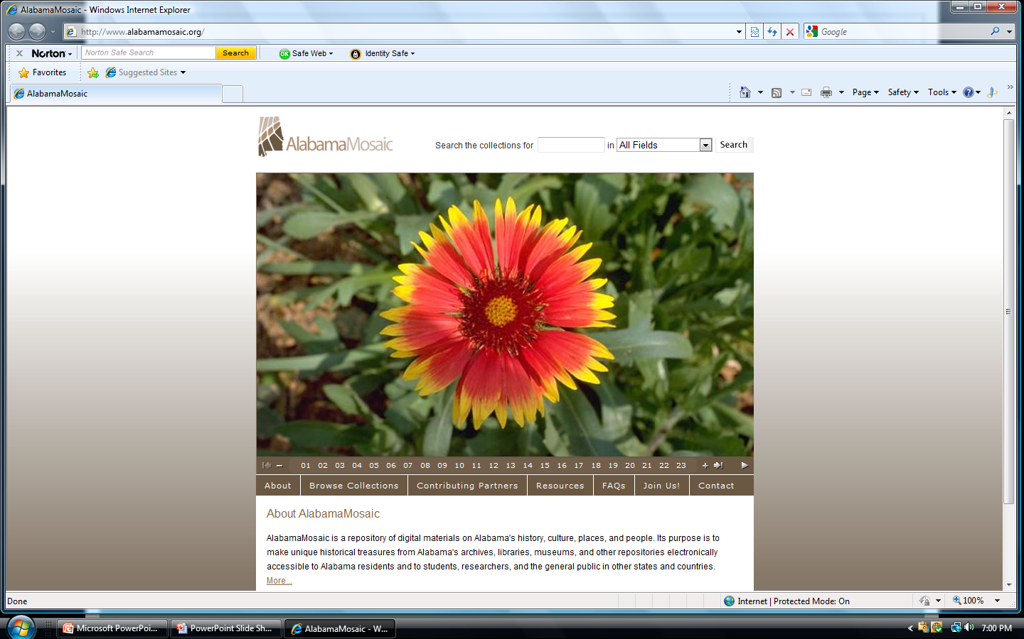
Alabama Mosaic

Slide 29
A Good Fugitive is Hard to Find
How do we find fugitives?
  Use catalog as a guide.
  Use finding aids.
  Follow links.
  Know digital collections.
  Fugitives are “hidden” in databases.

Slide 30
How do we Find Educational Documents?
Educational Resources Information Center (ERIC)
Educational documents are on microfiche
  Difficult to use
  User does not know until he/she arrives that some are misshelved or never arrived!
  There must be a better way

Slide 31
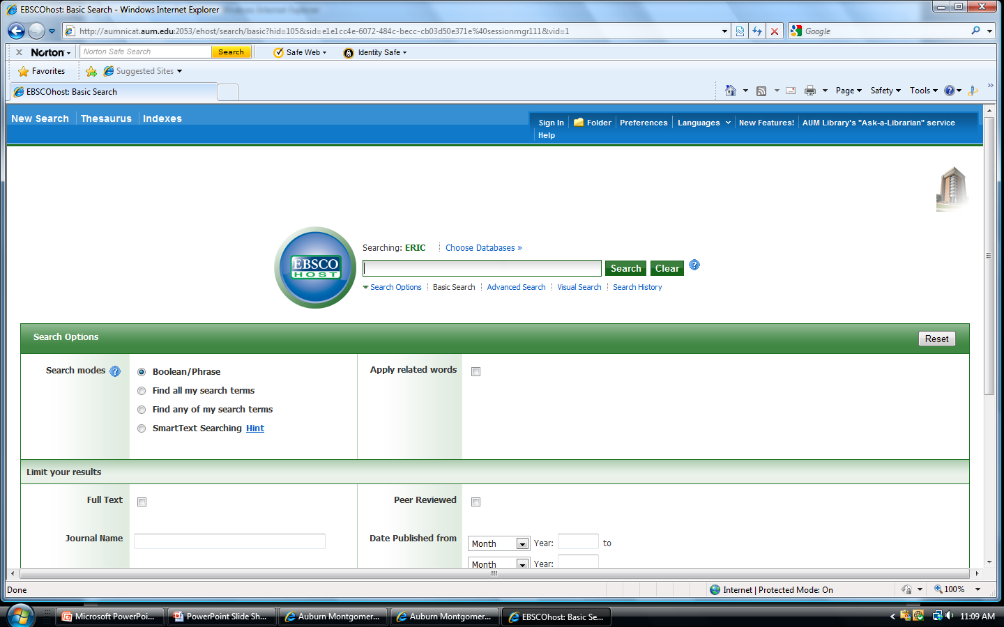
ERIC database

Slide 32
ERIC Database
66% of all ERIC documents have been digitized and are on the database
Can be accessed through Magnolia and MELO
  Check the database before you travel to repository

Slide 33
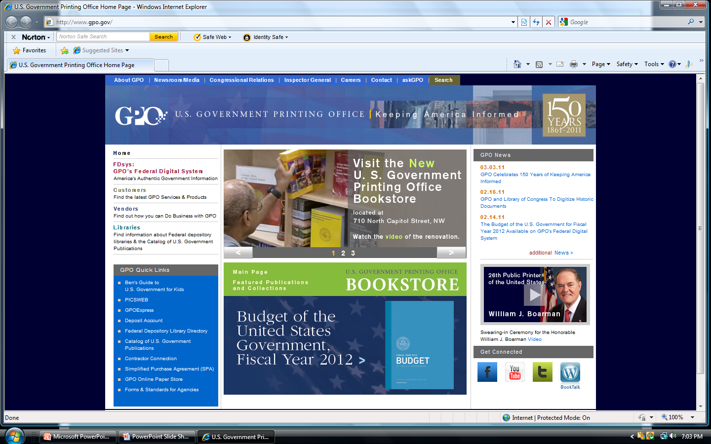
Federal information and more

Slide 34
Fugitives are found!
There are many ways to use fugitives.
There are many ways to access fugitives.
Using fugitives drives our need to digitize.
Correct, creative storage + knowledge of collection encourages patrons to use and apply fugitives.

