Slide 1
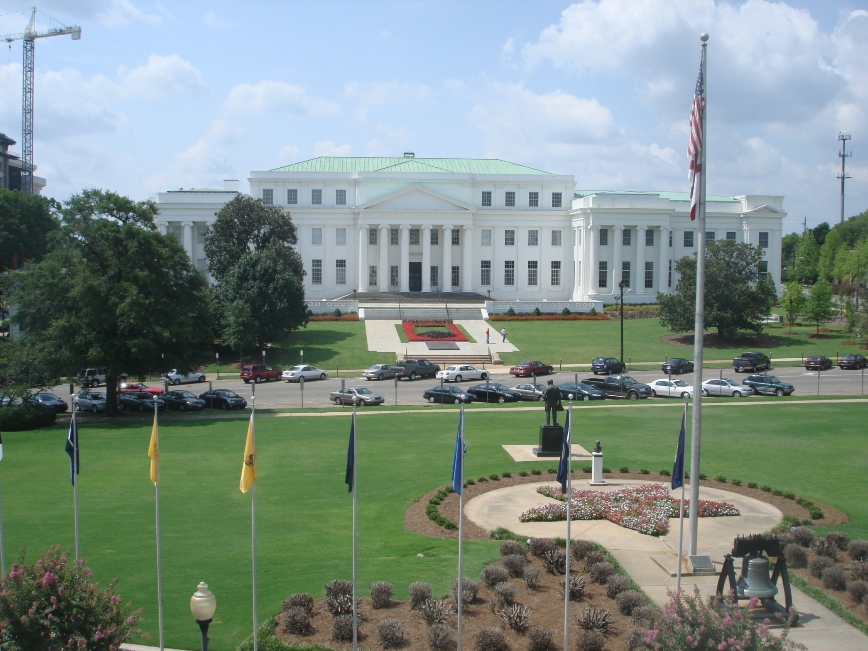

Slide 2
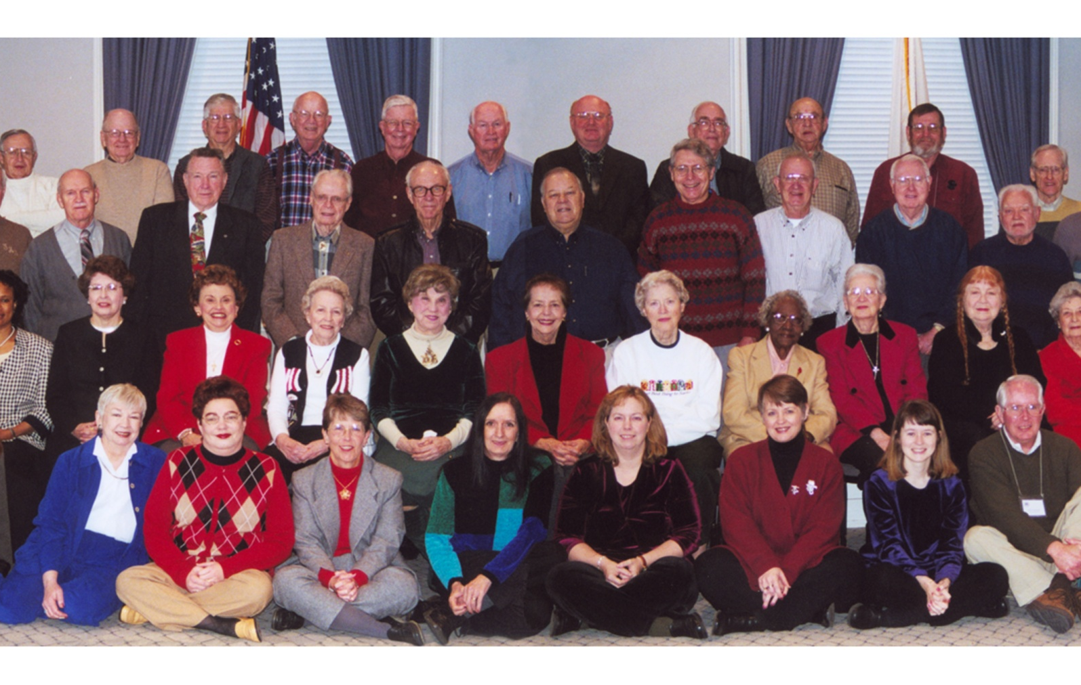
Alabama Archives – Volunteer Program
Volunteer Recognition – January 2003

Slide 3
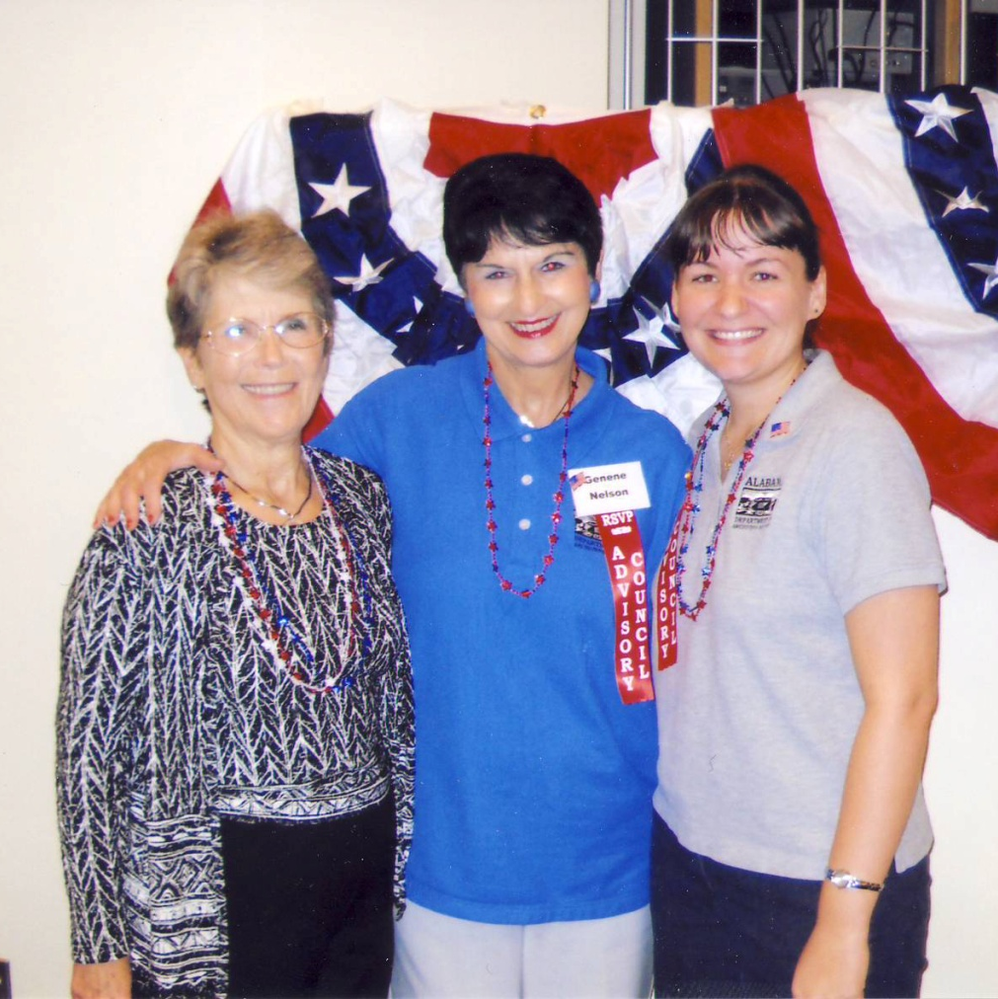
Volunteer Program Started in late 1980S
Former Volunteer Coordinators
Patricia Sweet
Genene Nelson
Tabitha Barber
New Coordinator Kelly Hoomes
Notes:
Still have some from original group – Eva Slay

Slide 4
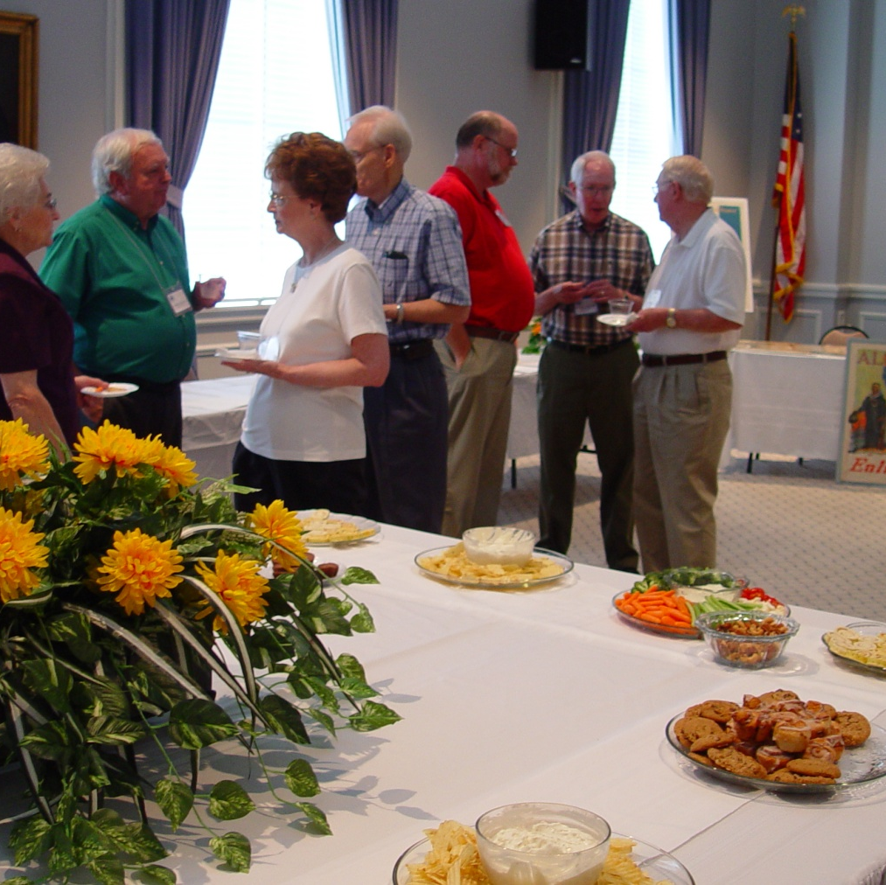
Volunteer Open House
Invitations
Visits to Maxwell
Application Form
Notes:
Current volunteer number is 117
Average 50-70 serving regularly each month for 500 hours of service

Slide 5
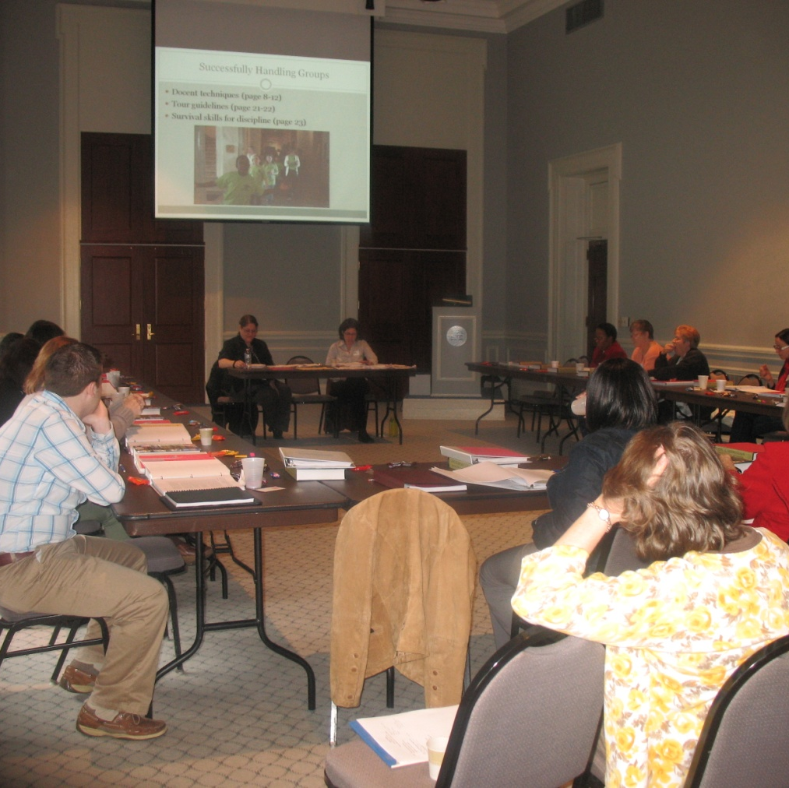
Docent
Training
Manuals
Job Descriptions
Volgistics
Notes:
Medical Release forms
Internet Usage forms

Slide 6
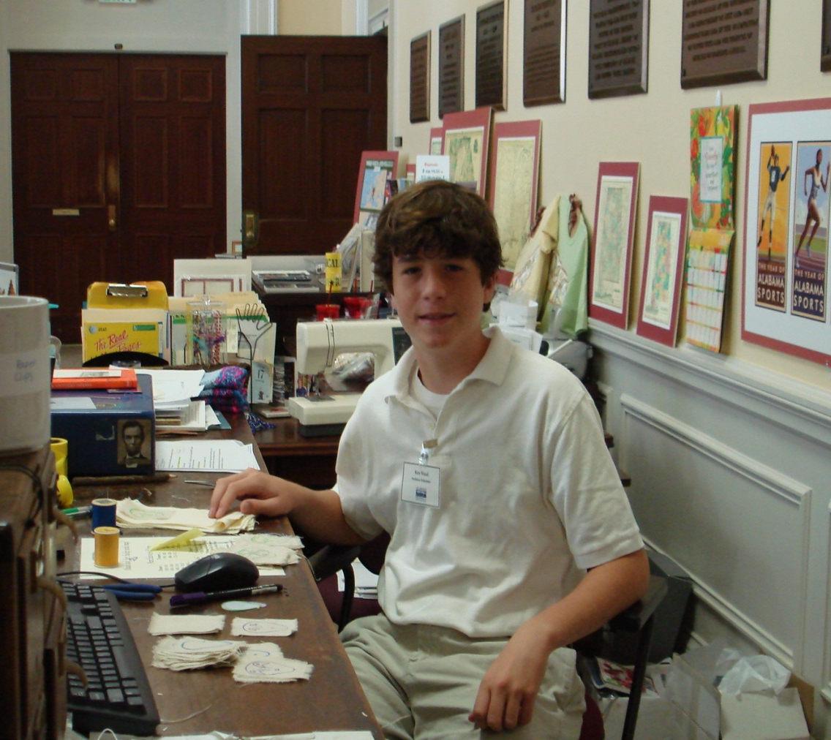
Junior Volunteers
Notes:
Parent/Guardian Release Form
CONTRACT!!!!!

Slide 7
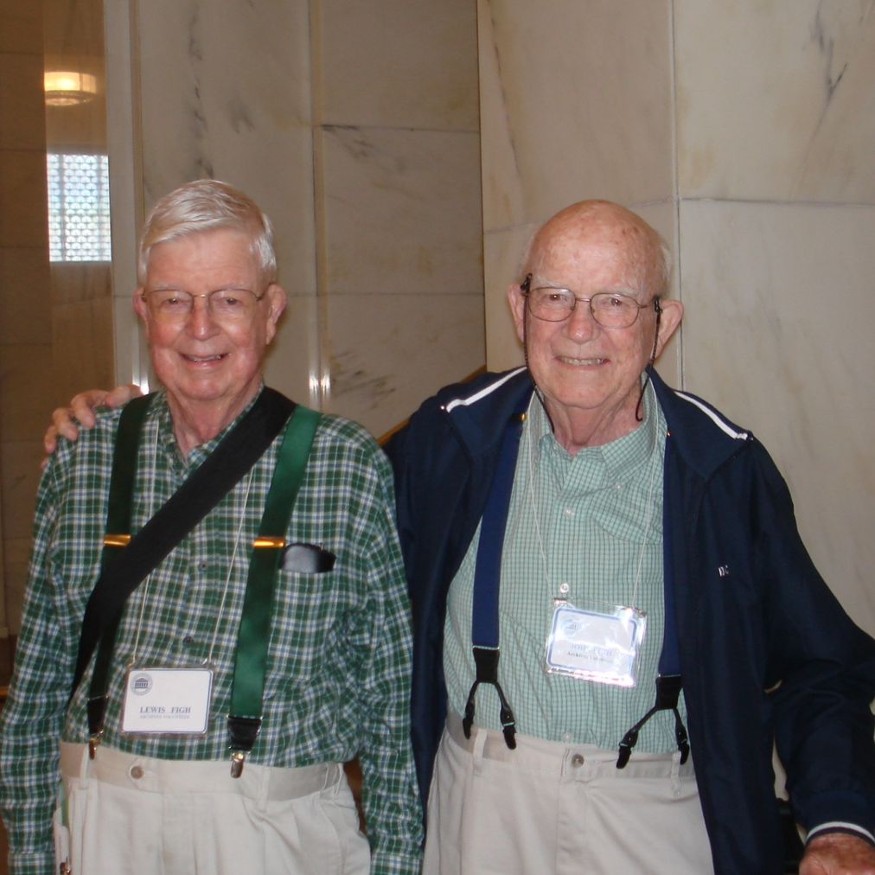
Senior
Volunteers
The Figh Brothers

Slide 8
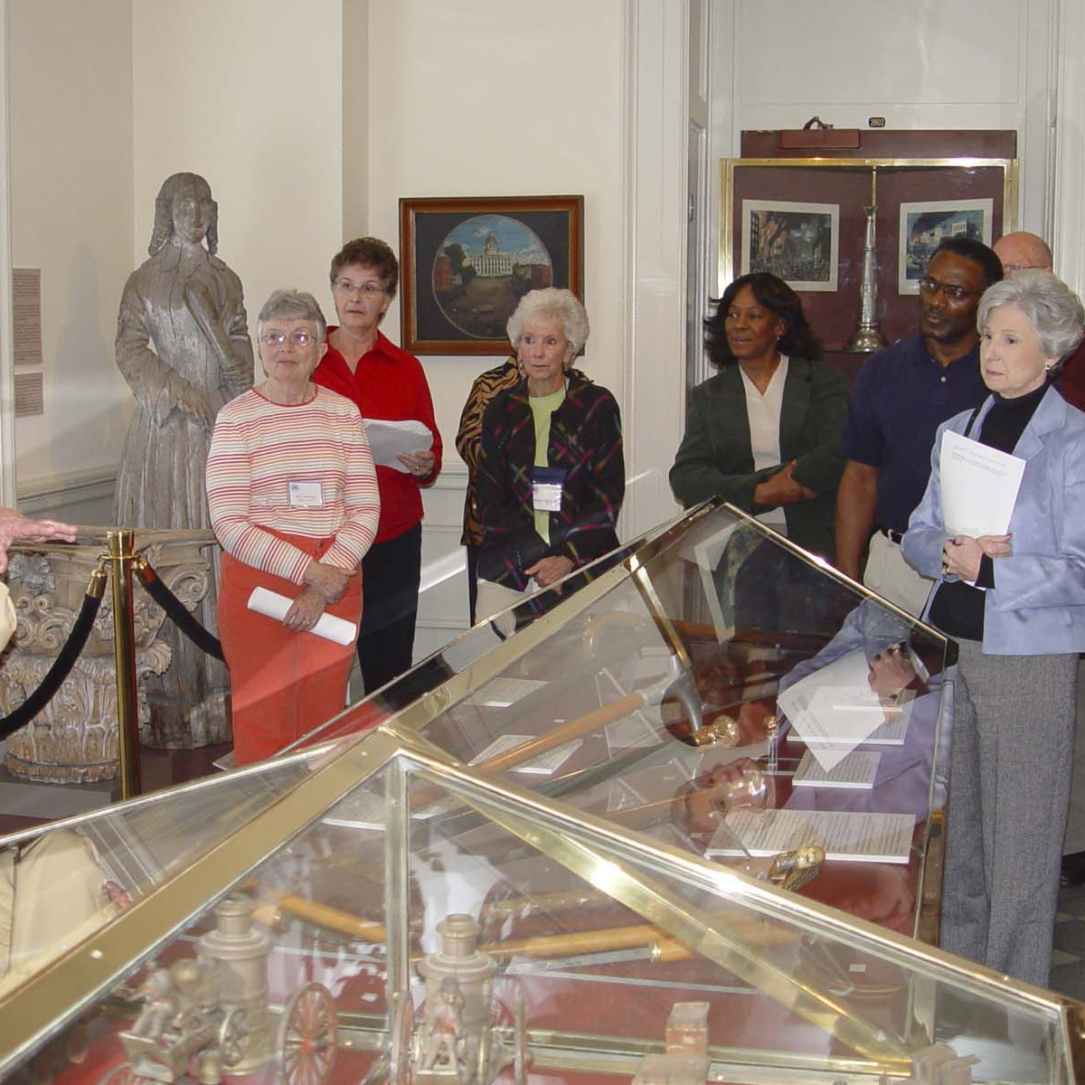
Docents
Special Events
Architreats
Grand Openings

Slide 9
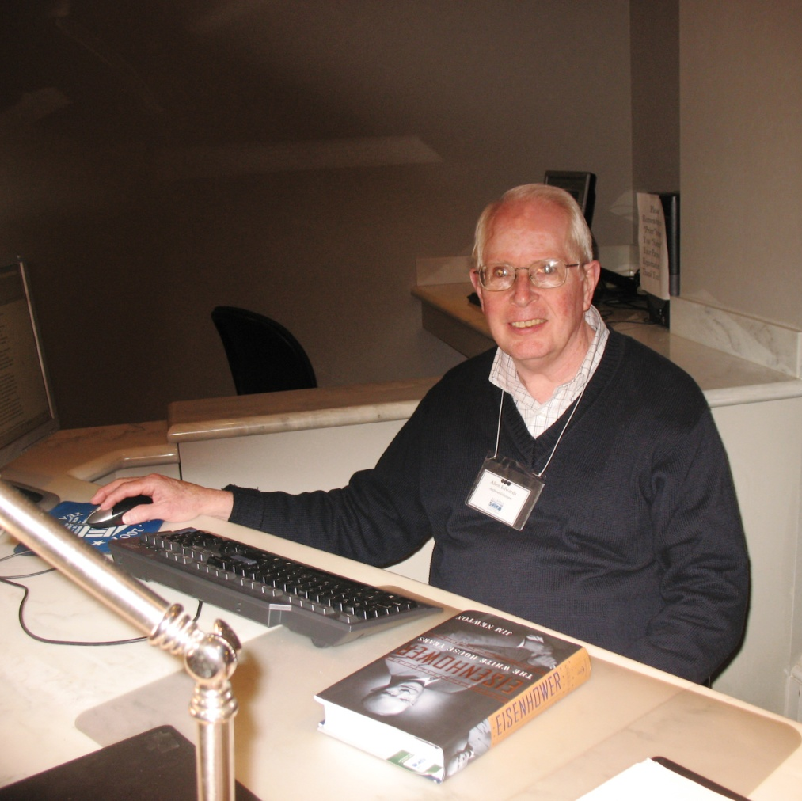
Patron Registration
Answer Research Letters

Slide 10
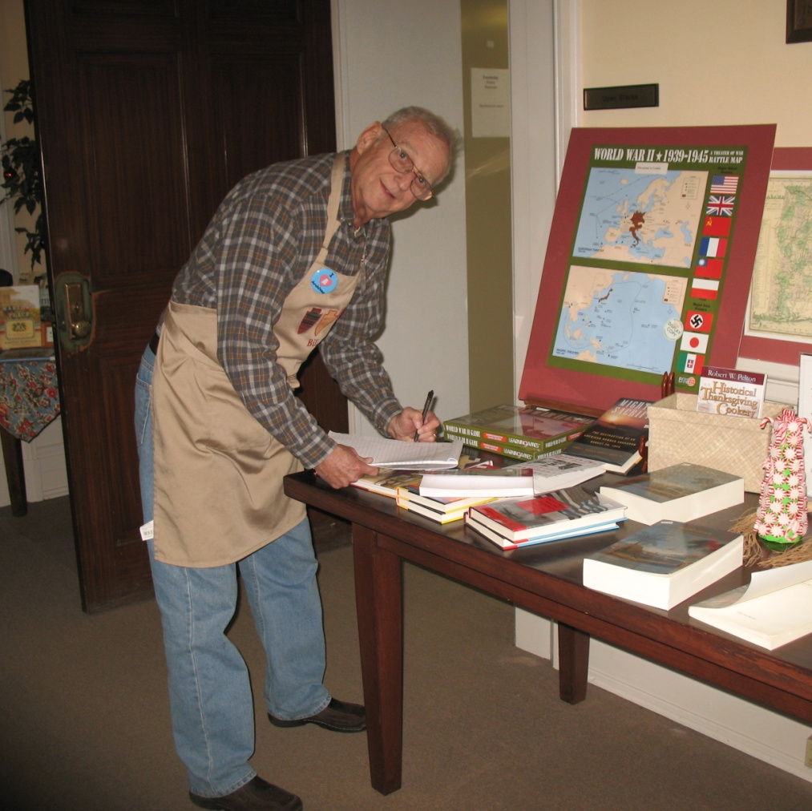
Gift Shop
Welcome Desk in Lobby

Slide 11
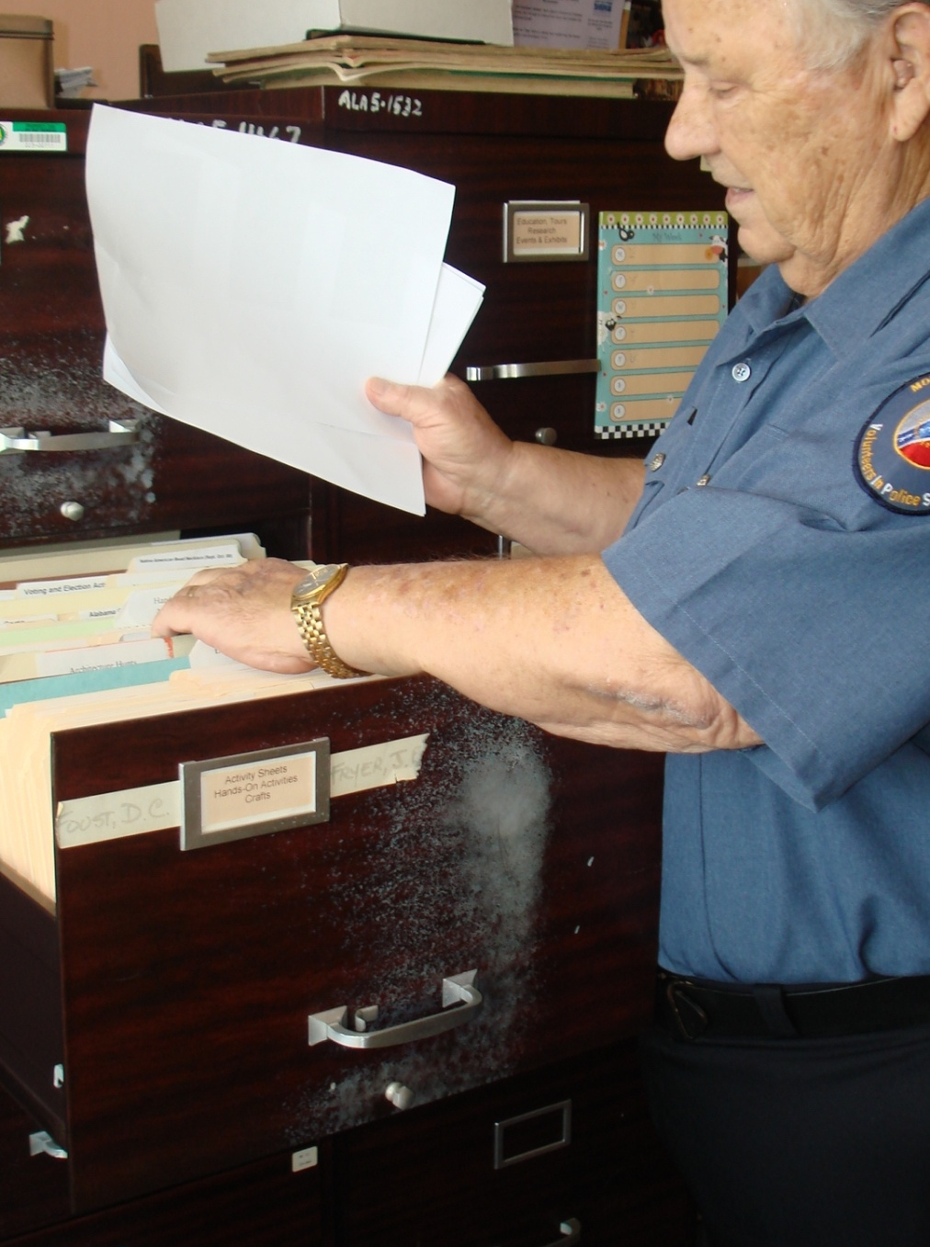
Encapsulation
Processing
Data Entry

Slide 12
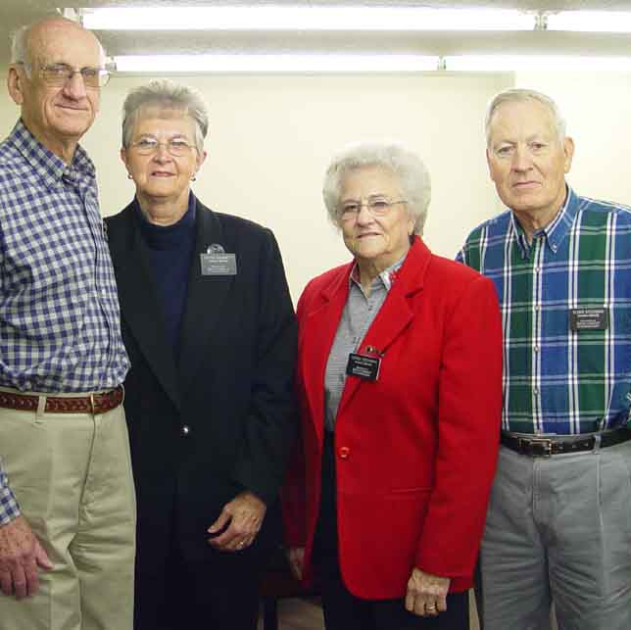
GSU
VOlunteers
From mid 1980s to 2009

Slide 13
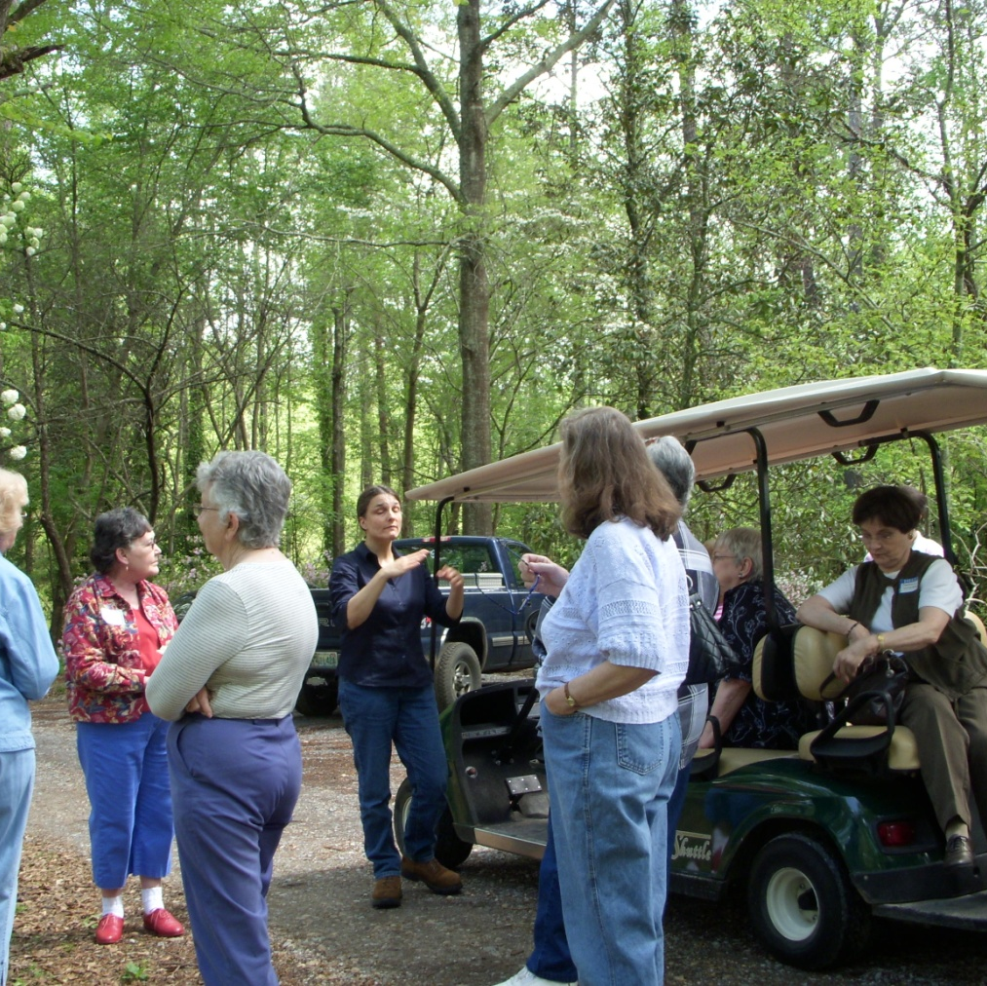
Volunteer Enrichment Trips
Lanark 2008
Notes:
Lanark is the historic house and gardens at the Alabama Wildlife Federation headquarters in Millbrook. It is also the site of the Alabama Nature Center.

Slide 14
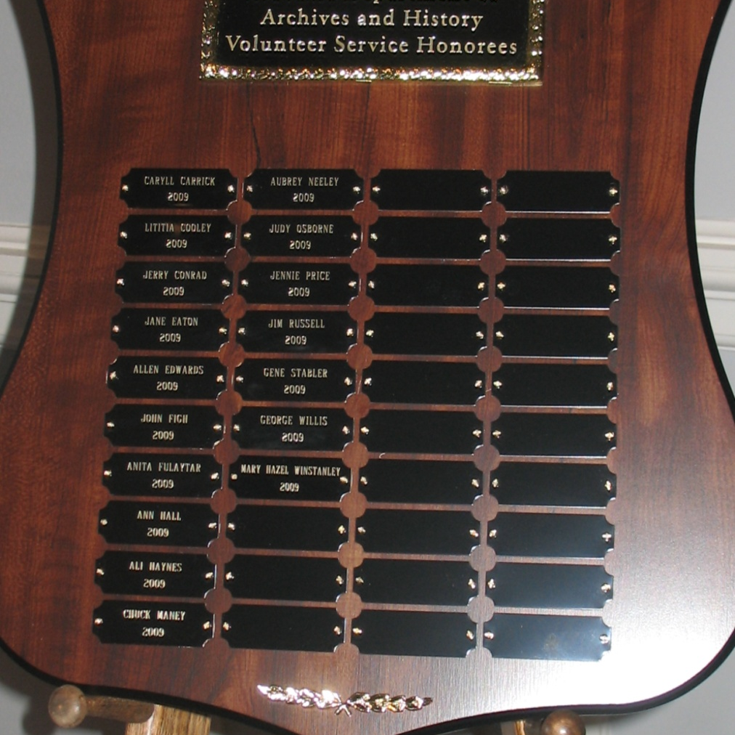
Annual Volunteer Recognition Program
Track Hours
Newsletter

Slide 15
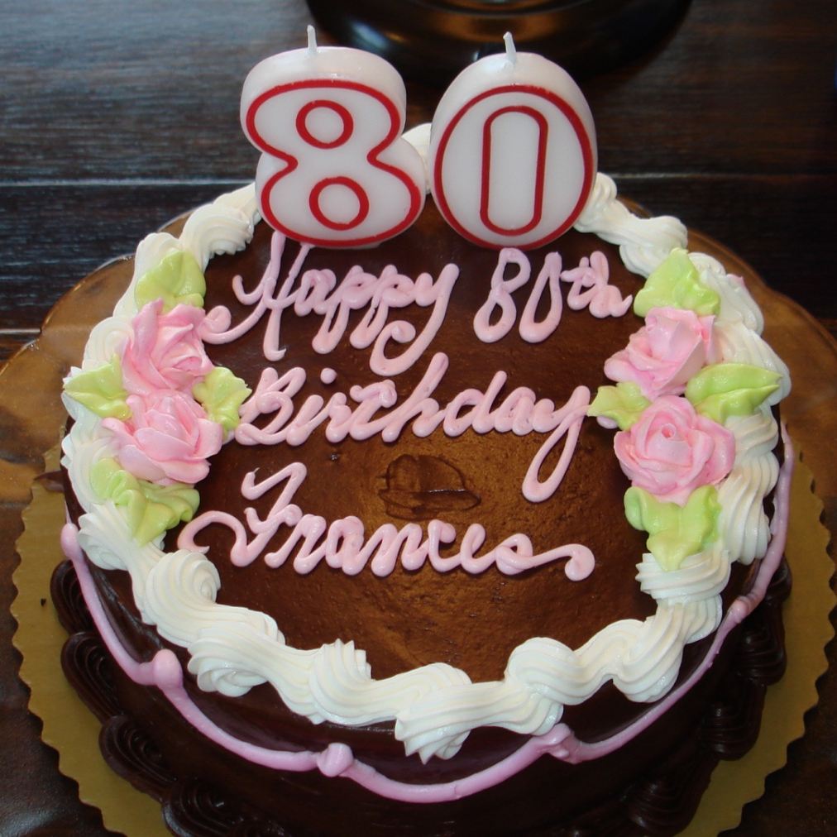
Fun
Birthday Recognition

Slide 16
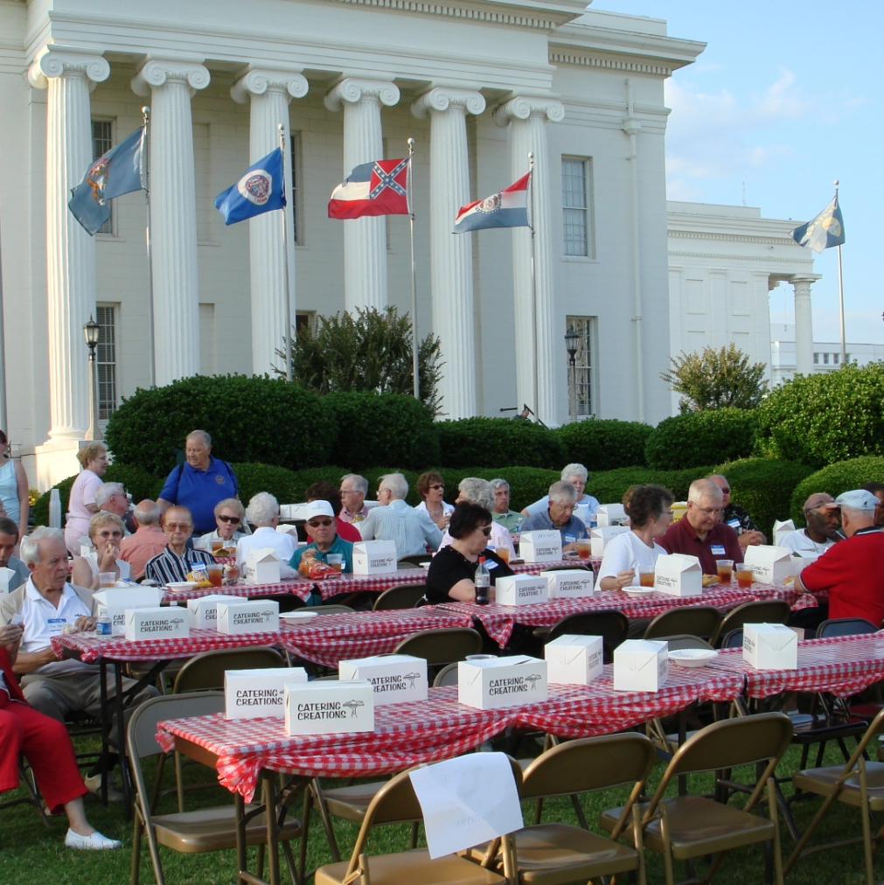
Annual Symphony Concert

Slide 17
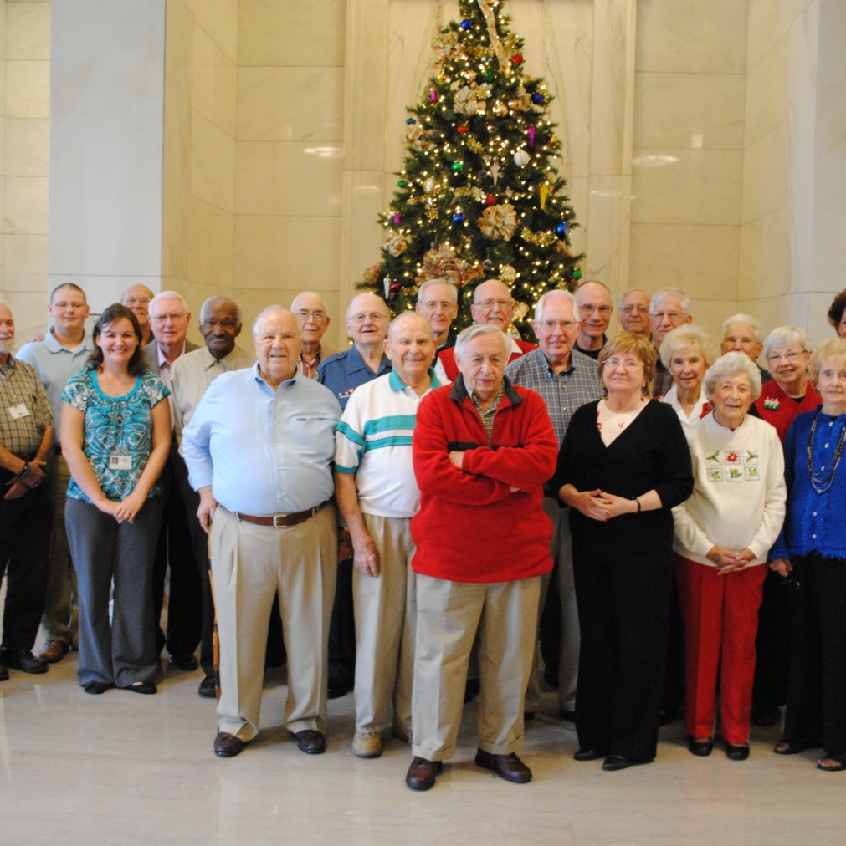
Holiday
REception

Slide 18
Issues
Volunteers do require staff time
  Training
  Oversight
Full-time Volunteer Coordinator
  Loss of staff – division coordinators handle things such as birthday cards but still turning into more time than anticipated
Changing Economy affecting volunteer pool
Curtailment of enrichment program and symphony picnic
Shift in requested assignments – more behind the scenes now

Slide 19
Other Comments
Most disappointed in number of volunteers trained who do not work out
Volunteers generally do what they are asked to do
Most important aspect of the work is fostering relationships – among volunteers, among staff and volunteers, and among visitors and volunteers
Prioritize

Slide 20
I volunteer at a lot of places but I feel most cared about here….
K. Carrick on volunteering at ADAH

Slide 21
The ADAH program is very consistent therefore, very successful!

Slide 22
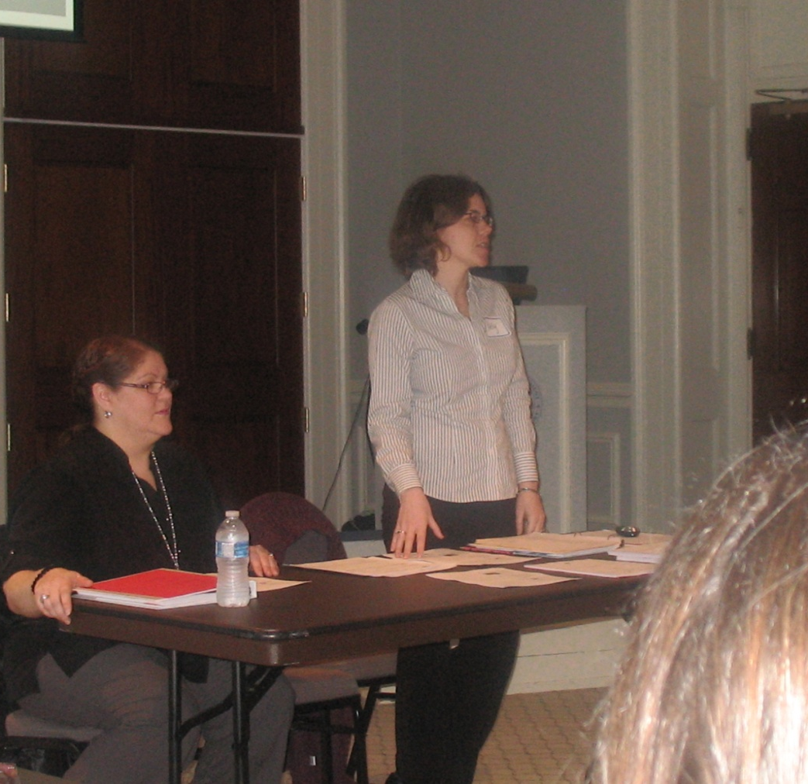
New Volunteer Coordinator
Kelly Hoomes
ADAH
P.O. Box 300100
Montgomery, AL 36130-0100
334-353-4702
Kelly.hoomes@archives.alabama.gov
http://www.archives.state.al.us/volunteer/volunteer.html

