Slide 1
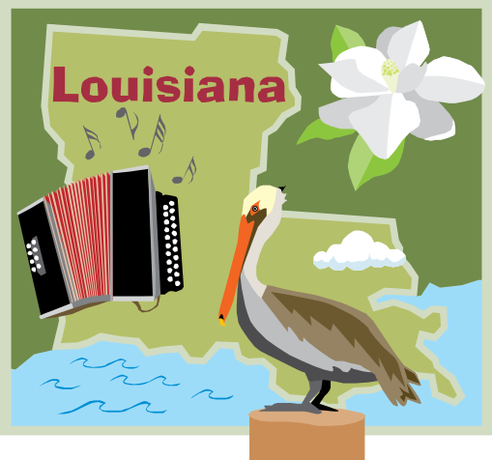
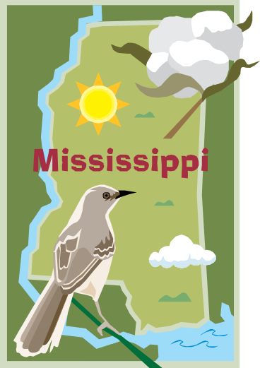
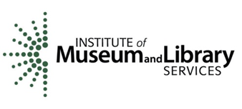
Connecting to Collections
Preservation of Cultural Heritage Resources in Louisiana and Mississippi
Laura McLemore, C.A.
LSU-Shreveport Archives & Special Collections
And
Tom Clareson, Senior Consultant for Digital & Preservation Services, LYRASIS
April 26, 2012

Slide 2
Connecting to Collections
Statewide Planning Grants
Statewide Implementation Grants

Slide 3
Connecting to Collections
Created by the Institute of Museum and Library Services
Connecting to Collections: A Call to Action: Connecting to Collections is a national initiative to raise public awareness of the importance of caring for our treasures, and to underscore the fact that these collections are essential to the American story.

Slide 4
What is LA LAMPP?
Louisiana Libraries, Archives, and Museums Preservation Project
Collaborating Partners:
    Louisiana Archives and Manuscripts Association
    Louisiana Association of Museums
    Le Comité des Archives de la Louisiane, Inc.
    LYRASIS

Slide 5
Louisiana’s Connecting to Collections Program
Analysis of the Statewide
Preservation Needs Assessment Survey and Future Directions

Slide 6
Survey Demographics
Survey in field October 2010-February 2011
83 responses – 24% return rate
Top institution types responding:
  Academic libraries
  History museums
  Public libraries
  Government Archives
  Other institution types (historical societies, scientific organizations)

Slide 7
Biggest Preservation Problems
Lack of storage space and shelving
High humidity/mold
Lack of budget/funding for preservation
Lack of environmental control
Lack of staff to complete preservation projects
Obsolescence and deterioration of audiovisual formats

Slide 8
Preservation Training
Current leading educational resources
  Workshops
  Print materials
  Electronic materials (journals, listservs)
Potential barriers to training
  Travel costs
  Registration costs
  Unavailable in region
  Can’t spare staff time
Potential solutions: Workshop series available in multiple regions; distance education

Slide 9
Preservation Training Topics
Disaster preparedness, care and handling, reformatting, and preservation management policies seen as most popular areas of need/urgent need
Potential solution: develop and/or adopt curriculum to be offered at multiple sites across the state

Slide 10
Preservation Policies—The good and the bad
The Good: Institutions are undertaking a wide variety of preservation actions
The Bad:
Lack of written long-range preservation plans
Lack of onsite preservation surveys performed
Written policies and procedures, disaster plans both lacking
This is a national problem!
Potential solution: Provide model plans and policies; policies as workshop outcomes; coaching; consulting.

Slide 11
Disaster Planning
39% have a plan
34% have no disaster plan
19% are developing
8% don’t know
These findings are better than national trends discovered through the C2C program, but there is still room for improvement.

Slide 12
Preservation Service Interest
Biggest areas of interest:
State-sponsored preservation workshops
On-site visits by preservation professionals
A place to contact for preservation information
Ongoing state-supported preservation grants
Help with general preservation/conservation surveys

Slide 13
Preservation Partnering
Much more prevalent already in Louisiana than other states surveyed!
  Louisiana’s Archival Training Collaborative
  ArkLaTex Archivists’ Group (Includes libraries)
  LOUIS collaborative digital projects
Interest in new programs, including:
  Collaborative Grant Projects
  Mutual Assistance for Disaster Response
  Collaborative Exhibitions
Building on current collaboration is at the core of any implementation plan.

Slide 14
Inventory and
Intellectual Control Issues
When asked for an inventory of items held by material type, a majority of responding institutions did not know the quantity of the materials they held, especially in specific formats.
However, a majority of institutions said that most of their collections had been cataloged or processed.
Need to gain control of specific material types, and types of institutional collections

Slide 15
Digital Findings
Photographs, documents, video/audio, and books are the formats most often owned as born-digital materials and most often reformatted/scanned.
70% do not have a plan in place for preserving their digital collections. Strong need for education on this topic.
Another concern: Offsite storage of digital backup files needed. Distributed digital preservation projects?

Slide 16
Key Findings -- Funding
Most (67%) have preservation funding from the institution’s own budget. This is a double-edged sword!
Over 50% have not made grant applications for preservation funding in the past 3 years; but many have
When utilized, important external preservation funding sources include: donors, federal grants, and foundations
Those not applying lack staff time to complete grants; lack information about funding sources; need more project planning assistance.
Solutions: This is an area where continuing assistance and education is needed.

Slide 17
Comments from the Surveys
We would like to have a statewide policy or plan of action for pre-contracting with disaster relief companies.
We need guidance in how to communicate the preservation needs of our historical collection to members of our larger organization.
We would like the State Library to be funded at an adequate level which would allow them to resume staff training such as book repair, etc.
Interest in statewide consortium/collaborative lab for digitizing video; audio.

Slide 18
Mississippi C2C
Survey Demographics
In field October-November 2011
Project Task Force assistance helpful in ensuring response rate
115 responses – 25.5% return rate; over 51% when considering regional public library systems answering for all branches.
Top institution types responding:
  Public libraries
  Academic libraries
  General museums
  Historical Societies
  Plus many other institution types…

Slide 19
Biggest Preservation Problems in Mississippi C2C Survey Results
Lack of budget/funding for preservation
Lack of staff to complete preservation projects
Environmental/HVAC problems
Lack of/improper storage space
Lack of general space within the facility
Lack of staff time to work on preservation activities

Slide 20
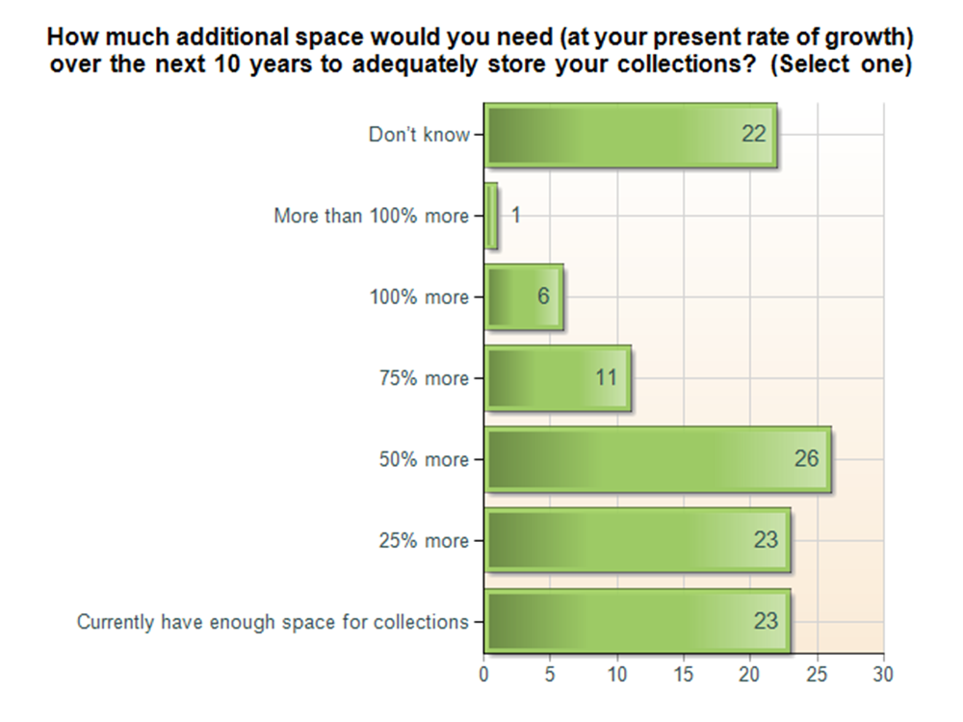
MS: Space Needs for Preservation

Slide 21
MS: Preservation Training Locations
Clear leaders:
  Jackson (48%)
  Hattiesburg (29%)
  Oxford (23%)
Other potential sites
  Tupelo
  Columbus/Starkville
  Southaven
  Cleveland

Slide 22
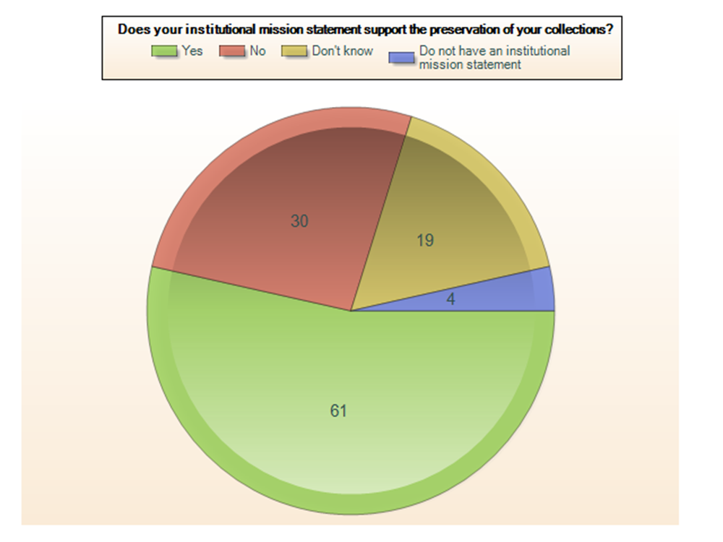
Preservation as part of Institutional Mission Statement in Mississippi

Slide 23
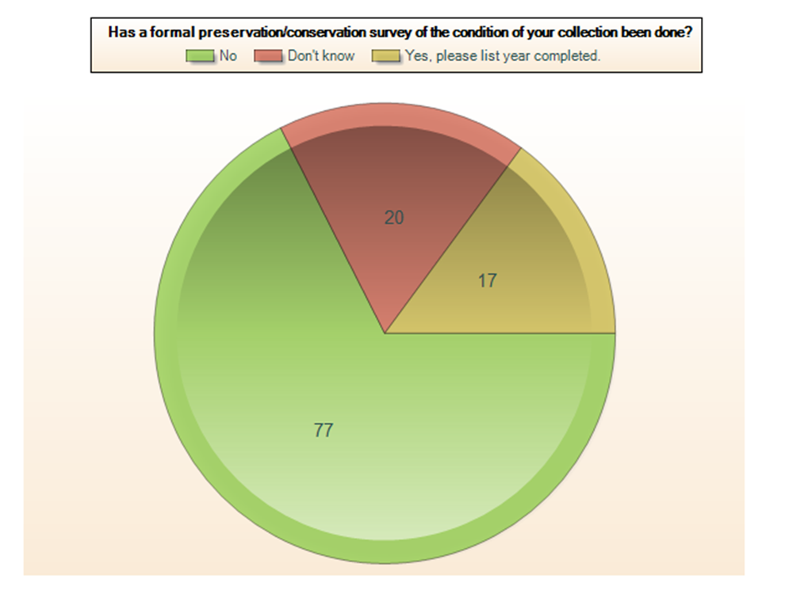
Mississippi: Need for Onsite
Preservation Surveys

Slide 24
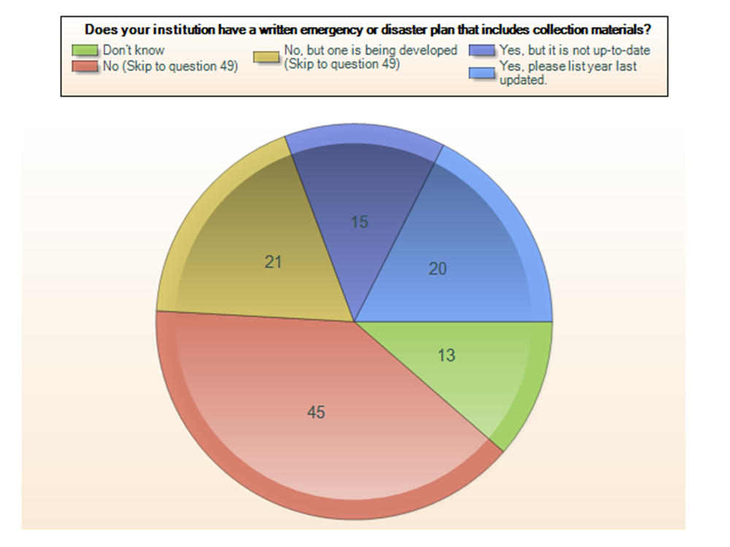
Disaster Plans in
Mississippi Institutions

Slide 25
MS Disaster Planning Status
38% have no disaster plan
19% have a plan
19% are developing
12% don’t know
There is room for improvement. State participation in LYRASIS RERN Program began April 2012

Slide 26
Mississippi: Inventory and
Intellectual Control Issues
A slight majority of institutions said that a majority of their collections had been cataloged or processed.
Some institutions need to gain control of specific material types, and types of institutional collections. Circuit-riding inventory/processing assistance or archivist?

Slide 27
Digital Findings -- Mississippi
Video/audio, photographs, sound recordings, books,amd documents, are the formats most often owned as born-digital materials and photographs and documents most often reformatted/scanned.
86% do not have a plan in place for preserving their digital collections. Strong need for education on this topic.
Another concern: Offsite storage of digital backup files needed. Discuss potential distributed digital preservation projects.

Slide 28
If Mississippi institutions gained new funding for preservation…
Digitization
Cataloging/inventory
Storage supplies/materials
Professional conservation treatment of collection materials
Staff training

Slide 29
Mississippi C2C Onsite Visits and Reports
Nearly 20 Preservation Site Survey Visits, October-November 2011
Visits to Libraries, Museums, Historical Societies, etc.
Brief 2-3 hour visits and 2-3 page “reports of key findings”
Pre-questionnaire and post-visit report trends analyzed

Slide 30
Findings from Pre-Visit
Survey Questionnaires -- Mississippi
Lack of preservation planning documents
Lack of current disaster plans
Few with regular Fire Department Inspections, Fire Drills
Concerns about environmental controls and water leakage
Lack of cataloging/inventory control

Slide 31
MS On-Site Survey Findings
Need to develop Collection Policies and de-accession practices
High visible and ultraviolet light readings
Water leaks
Focused need on care of photographic collections; photo digitization
Need for further work on disaster planning, training for disaster preparedness/recovery
Some security concerns expressed

Slide 32
MS On-Site Survey Findings
Assistance needed in preservation/conservation funding development; interest in exploring:
  National Endowment for the Humanities Preservation Assistance Grants (PAGs)
  Institute of Museum & Library Services/Bank of America “American Heritage Preservation Grants”
Assistance needed in recruiting student interns/workers to cultural institutions

Slide 33

Potential Next Steps for Louisiana and Mississippi Connecting to Collections Initiatives

Slide 34
IMLS C2C Implementation Grant
Gulf States Connecting To Collections Preservation Initiative
Application deadline: Feb. 1, 2012
Scenarios for Award: 2-5 C2C Implementation Grants Awarded in September 2012
Request: $206,404.00 over 2 years

Slide 35
Gulf States Preservation Alliance
Mississippi Department of Archives and History (MDAH), Society of Mississippi Archivists (SMA), Mississippi Library Commission (MLC), and Louisiana Archives and Manuscripts Association (LAMA), LSU-Shreveport Archives and Special Collections (LSUS)
Two-year (2012-2014) bi-state preservation education and assistance project to directly address findings of the Heritage Health Index for Louisiana and Mississippi.
Based on the planning framework jointly developed by the two states.

Slide 36
HHI Recommendations
Provision of safe conditions for collections
Development of emergency plans
Assignment of responsibility for caring for collections to institutional staff
Broad public/private support for collection stewardship

Slide 37

Implementation Activities
Workshop Series
Two workshops in each state on digitization
One seminar in each state on preservation of digitized and born-digital material
Two “Inventory and Assessment” workshops in each state for staff of libraries, archives, and museums on inventorying and assessing cultural heritage collections
Two grant writing workshops in each state
Funding of NEDCC Collections Care Webinars for up to 100 participants in each state.

Slide 38
Implementation Activities
Alliance for Response
A national program on cultural heritage and disaster management. Through a series of local Forums, it builds bridges between the cultural heritage and emergency response communities before disasters happen. The Forums lead to new partnerships, policies, and cooperative planning efforts.
A series of forums over two years to establish a Heritage Preservation Alliance for Response between coastal cultural heritage institutions and emergency response communities, building on the Louisiana Emergency Response Network.

Slide 39
Implementation Activities
Environmental Monitoring
Environmental Monitoring Purchase of hand-held monitors and dataloggers to be loaned to cultural heritage institutions.
Reading of datalogger results (ongoing) and consultation services (for two years).
Equipment now available for loan

Slide 40
Available Now!
Environmental monitoring equipment is available for loan.
Contact: Laura McLemore, C.A.
LSUS Archives & Special Collections
Noel Memorial Library
laura.mclemore@lsus.edu
318-797-5378

Slide 41

Questions and Discussion
Notes:
Any questions?

Slide 42
Project Consultant
Tom Clareson
Senior Consultant for Digital
& Preservation Services
800.233.3401 or 614.439.1796
tom.clareson@lyrasis.org

