Slide 1
The Legacy Challenge:
Reprocessing Large Manuscript Collections
Gerald Chaudron
Processing Archivist
Manuscripts Division, Special Collections Department,
Mississippi State University Libraries
April 27, 2012
Notes:
Good morning. My name is Gerald Chaudron and I am a processing archivist in the Manuscripts Division of the Special Collections Department, Mitchell Memorial Library at Mississippi State University. This is the first of three presentations on the topic of Real World Processing: The Challenges of Academic Library Collections. My topic concerns larger older collections which have been processed but have had later accretions.

Slide 2
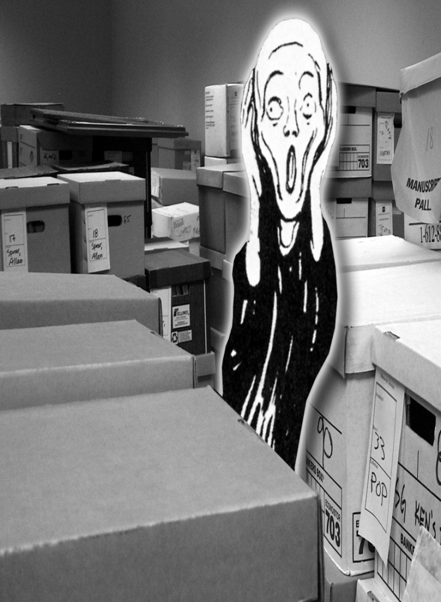
The Legacy Challenge:
Reprocessing Large Manuscript Collections
Notes:
Archives have seen much change in the last decade or so as new theories have been put into practice, archival management software has been introduced, and the demands of the Internet force us to look at how we provide access to all our collections, some of which may have been processed many years ago. We certainly face the problem of retrospective conversion in the Manuscripts Division as we enter our finding aids into Archivists’ Toolkit and endeavor to put them online. This has led us to question whether some reprocessing is necessary because the older finding aids describe collections arranged to different standards from today, have minimal information or are simply calendars which don’t fit easily into our format for AT. Another problem is accretions to older collections, especially large ones.
Reprocessing is something most archives do despite the impact of Greene and Meissner’s More Product, Less Process theory. A quick trawl of the Web finds many examples of archives announcing reprocessing activities. Thus while Greene and Meissner may consider reprocessing as an unacceptable use of resources, archives are still doing it in order to make a collection’s arrangement and description consistent and easier for the archivist and user to use. Thus the Scream illustration from a 2005 American Archivist cover may be archivists looking at older collections, processed or not, or it could also represent Greene and Meissner as they view what we archivists are actually doing.

Slide 3

The Legacy Challenge:
Reprocessing Large Manuscript Collections
Notes:
In this presentation I want to discuss two large collections previously processed which were reprocessed because of accruals. I should say at this point that reprocessing is not considered for collections which are still growing. In those cases, each accretion is described separately and almost treated as a separate collection. There seems little point in attempting to integrate the accretions into a collection, if that is even desirable, until the collection has attained its final extent.
It is not necessary to reprocess all collections with accruals and we do not reprocess routinely. What options other than reprocessing could be used? The accretion or accretions can simply become another collection, or another series in the existing collection, if the arrangement allows. The drawbacks are that not every user will know to look at multiple finding aids or to read through a whole finding aid to find materials that may have been added at the end. Or, the accretions can be integrated intellectually into the arrangement with no need to physically rearrange the collection.
But, on occasion, reprocessing collections to integrate accretions might be desirable. Particularly where the accretion or accretions are large, is it helpful to the user to try to graft them on to an old inventory which looks very different?

Slide 4
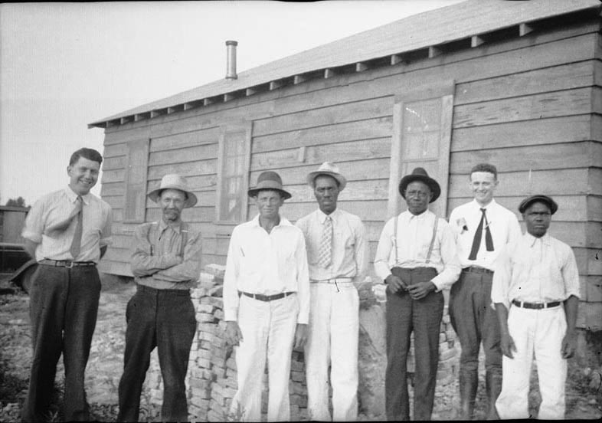
Reprocessing Large Manuscript Collections
Allen Eugene Cox papers
60 cubic feet
7 accretions, 1967-1996
Large number of clippings, publications
Well used
Delta Cooperative Farm, Hillhouse, Mississippi, 1937
Notes:
The first collection I want to talk about is the Allen Eugene Cox papers. As you can see it is a large collection which came to Special Collections in seven donations between 1967 and 1996. Gene Cox was involved with the mixed race Delta Cooperative Farm which began in Bolivar County, Mississippi in 1936 and became the resident director of its successor in Holmes County until forced to leave Mississippi by local whites in 1956. Based in Memphis, Cox continued to be involved with civil rights, trade union and church organizations in the South for the next thirty years. Among the documents related to his activities are extensive files of news clippings and publications which he used to chronicle race relations, politics, economic and religious issues from the 1950s to the 1980s. The collection has received considerable use and we anticipate this will continue and grow since processing was completed at the end of 2011.

Slide 5
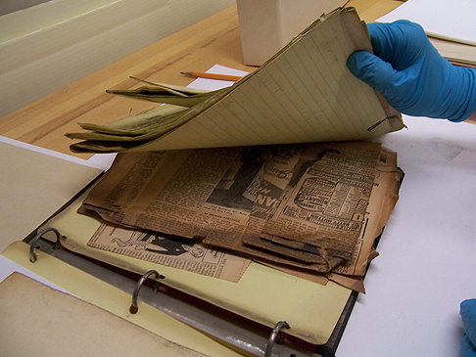
Reprocessing Large Manuscript Collections
Allen Eugene Cox papers
Arrangement and description of first 6 accretions retained
Problems:
Final addition disorganized and description inconsistent
Old folders replaced
Clippings copied
Notes:
Though a Protestant minister by training, Cox was a bookkeeper by trade and thus much of the collection was meticulously organized. Within each of the first six accretions the documents were foldered and arranged alphabetically. This arrangement is consistent over the accretions, with similar subjects, and thus did not require rearrangement. The accretions became the series and the folder titles were retained. Thus when originally processed, the contents of the first accretions to 1978 were described by listing the type of material in each folder and indeed some of the correspondence was calendered.
The collection has had considerable use but the clippings presented a challenge. Another problem was the large number of publications in the folders which were not always in the description. Finally, the last addition of about 17 cubic feet, received after Mr Cox’s death was disorganized with some folders which he had removed from earlier accretions because he wanted to restrict access, and many others which contained a mix of materials which he had never gotten around to sorting. And there were boxes of clippings and financial records. That series presented a daunting prospect to any researcher since there was only a list of folder titles, either Cox’s or assigned.
Two decisions were made before considering any reprocessing of this collection. Firstly, the folders in the collection were old, acidic, and deteriorating. They needed to be replaced. Since each accretion had been processed separately, there were partly empty record cartons at the end of each accretion. As the folders were replaced, the containers’ contents were consolidated, saving space.
Secondly, the folders of clippings were both the collection’s greatest asset and also its biggest problem. Clippings of different sizes, sometimes taped together or with publication information taped on, were frustrating to use and in danger of being lost, misplaced and damaged, not to mention their acidity. Contrary to MPLP principles it was decide to copy the clippings onto letter or legal size paper depending on the clipping size with several small clippings copied onto one page where possible. The copied clippings would be easier to use and be preserved, and importantly would take up much less space. One student worker working approximately 15 hours per week took 2 years to do the copying and refoldering.

Slide 6
Reprocessing Large Manuscript Collections
Allen Eugene Cox papers
Reprocessing user-driven to enhance access; also to save space
Listed publications in all series
Last series
- rearranged
- removed folders returned to original series
- clippings sorted
- financial records sampled
Notes:
Any reprocessing decision is not to be taken lightly . We all battle staffing and resource constraints which mean that revisiting collections is unlikely. But as Robert Cox at the University of Massachusetts has noted, revisiting or reprocessing collections is a legitimate part of our job as archivists. Content can be added, new information is gained and usage patterns may change. All can justify further work on a collection after it is processed.
In my original plan for the Cox papers, I had not wanted to do more than note where the bulked out folders of clippings had been subdivided once they were copied. The last series was disorganized but I intended to do no more than some minimal rearrangement to make access easier. That plan changed after I tried to assist a researcher navigate the collection and noted his frustration at not being able to find civil rights publications easily, and both of us having serious difficulty ascertaining whether the final accretion did indeed have anything useful for him.
This led to two more decisions: the first was to go back and list the publications in the folders of the first 6 series. Since we were putting the Cox finding aid online, users both in the reading room and remotely can find the hidden content.
The second decision was to reprocess the last series. The folders which continued Cox’s arrangement were maintained. The boxes of loose clippings were sorted by subject, the loose publications were listed and the duplicates, sometimes in the dozens, were weeded to save space. Mr Cox had removed some folders from the earlier series because he wanted to restrict access to them. Most of those folders were in the last series but to maintain context I decided to return them to their original series as recorded in the old inventory. The bundles of personal financial records were sampled and the rest discarded.

Slide 7
Reprocessing Large Manuscript Collections
Allen Eugene Cox papers
Reprocessing results
Saved 12 cubic feet of space
Finding aid has useable inventory and publications are no longer hidden
Preservation addressed
EAD finding aid online
Notes:
Did the results justify reprocessing the Cox papers? I believe so.
The space savings alone were considerable. The finding aid now has a useful inventory for each series and the publications are no longer hidden.
The large number of clippings throughout the collection constituted a ticking preservation time bomb which we felt we needed to address sooner at some cost rather than later at a much larger cost. And finally we were able to put up an EAD finding aid which, if not totally consistent with what we would produce for a new collection, mostly conforms to our format.

Slide 8
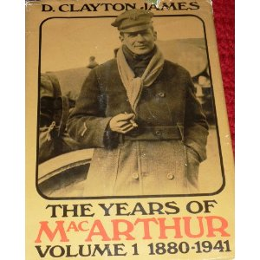
Reprocessing Large Manuscript Collections
D. Clayton James papers
24 cubic feet
5 accretions, 1971-1980
Substantial number of folders removed, 1986, 1988
Accretion (including most removed folders), 2005
Last accretion, 2007
Notes:
The second collection I want to discuss is the D. Clayton James papers. Dr James was a history professor at Mississippi State University from 1965 to 1988 and an authority on General Douglas MacArthur, writing an acclaimed 3-vol. biography . Beginning in 1971, James began donating the research materials from his various books and articles to Special Collections. These comprised many folders of copied documents from repositories all over the country and transcripts of interviews. However, in 1986 and 1988 he withdrew a large number of MacArthur-related folders to assist him in his writing. Following his death in 2004, most of these folders were returned in the 2005 accretion along with more material, and one more accretion was received in 2007.

Slide 9
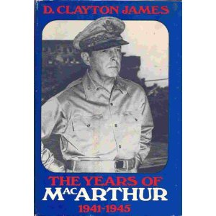
Reprocessing Large Manuscript Collections
D. Clayton James papers
Only small collection remaining with limited finding aid
Pre-1986 finding aid mainly lists of materials
Processing large accretions necessitated reprocessing much smaller existing collection
Notes:
The original finding aid for the James collection had just added lists of materials as the accretions arrived but another version was produced after the withdrawals of material to reflect the reduced size of the remaining collection. The series on MacArthur only comprised the manuscripts and galleys of the first two volumes of the MacArthur biography plus some copied newspapers and memoirs. Our problem was to decide whether to reintegrate the returned folders into the collection along with the final two accretions. The pre-1986 finding aid with its lists was only helpful in determining which folders had or had not been returned. Indeed, the size of the last accretions, around 19 cubic feet, was more than twice what remained after 1988. Thus it made sense to process the accretions according to our new standards and reprocess the rest of the collection to that same standard, integrating both at the same time.

Slide 10
Reprocessing Large Manuscript Collections
D. Clayton James papers
Reprocessing results
Brought the whole collection up to the same standard of arrangement and description
Created logical series
Included useful list of research materials on 35mm film
Enabled easy conversion to EAD
Notes:
Again the question must be: was reprocessing justified?
Certainly the last accretions could have been added as series but their arrangement and description would have been different from the existing collection and would have been confusing to researchers. The standardized finding aid allowed logical series to be created. Reprocessing found not only inaccuracies in the old finding aid but a paper list of research materials on 43 rolls of 35mm film was digitized and included as an appendix to assist users. Finally, the new finding aid enabled easy conversion to EAD last year. The latter consideration has increased in importance as we move our finding aids online. The Cox and James collections both had the issue of what to do with accruals but the challenges and the reasons for reprocessing were different.

Slide 11


Reprocessing Large Manuscript Collections
Conclusion
Reprocessing: the dilemma
- justify the decision
- select method
Reprocessing must enhance access
Reprocessing is often user driven
Keep good records of reprocessing decisions
Notes:
In a 2006 article Sammie Morris and Pam Hackbert-Dean of Purdue University noted that many archivists face the dilemma of whether to reprocess collections, and even how to reprocess them. While it is a common problem and is discussed on listservs regularly, there is little in the professional literature on the subject to guide us. Complicating matters is the guilt some may feel about even considering reprocessing when the mantra of MPLP states less is more: get rid of the backlogs and move on.
My experience at MSU Special Collections is that reprocessing does have its place. While it may be easy to add an item or folder to a processed collection without needing to do more than update the inventory, large accretions are more of a challenge. In many cases physical rearrangement is unnecessary. Intellectual integration will be sufficient, necessitating only the revision of the finding aid. Nevertheless, reprocessing should not be routine since each collection is unique. Every collection must be assessed individually to determine whether reprocessing is justified and if so, what method should be used. The goal should be enhanced access for users rather than simply convenience for the archivist or satisfying an urge to tidy up collections.
In fact, reprocessing may well be a response to increased use of a collection or a method to increase use of an underused collection which is poorly arranged and described. As I have said, each finding aid which is put online is reviewed to see whether any reprocessing is required to make access easier. Keeping an open mind about revisiting collections is better than rigidly following any methodology. In any case, how the reprocessing is carried out and the decisions made must be documented. Not only do you need to justify the work to your administration but you may need to track any rearrangement should future users use citations from past researchers.

Slide 12
Reprocessing Large Manuscript Collections
Sources:
Cox, Robert S. Maximal Processing, or, Archivist on a Pale Horse, Journal of Archival Organization, Vol. 8, No. 2, 2010, pp.134-148.
Greene, Mark. A. & Dennis Meissner. More Product, Less Process: Revamping Traditional Archival Processing, American Archivist, Vol. 68, No. 2, 2005, pp. 208-263.
Morris, Sammie L. & Pam Hackbert-Dean. Case Studies in Managing Collections that Grow, Libraries Research Publications, Paper 15. http://docs.lib.purdue.edu/cgi/viewcontent.cgi?article=1019&context=lib_research (Accessed 3/11/2012)
Notes:
Thank you.

Slide 13
Reprocessing Large Manuscript Collections
Gerald Chaudron PhD, CA
Assistant Professor, Manuscripts
Special Collections Department
Mississippi State University Libraries
P.O. Box 5408
Mississippi State, MS 39762
662-325-3071
gchaudron@library.msstate.edu

