Slide 1
Marrying Memories:
Wedding Traditions in Delta Collections
Cynthia M. Beardsley, Emily E. Jones, & Margaret A. Swanson
Delta State University

Slide 2
What is the Mississippi Delta?
Geography
Culture

Slide 3
The Yazoo-Mississippi Delta
18 Mississippi Delta Counties:
Desoto
Tunica
Tate
Panola
Quitman
Coahoma
Bolivar
Sunflower
Tallahatchie
Leflore
Humphreys
Washington
Sharkey
Issaquena
Yazoo
Homes
Carroll
Warren
Notes:
The Yazoo-Mississippi Delta begins south of Memphis, Tennessee, and extends to approximately Vicksburg, Mississippi. Bounded by the Yazoo drainage on the east and the Mississippi River on the west, the area popularly called “the Delta” encompasses some 7,000 square miles of alluvial floodplain. To the east of the Delta are the uplands and hills….political and cultural division between the “hills” and the Delta
The Yazoo-Mississippi Delta is approximately two hundred miles long and seventy miles across at its widest point

Slide 4
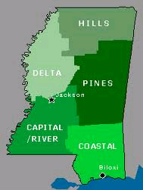
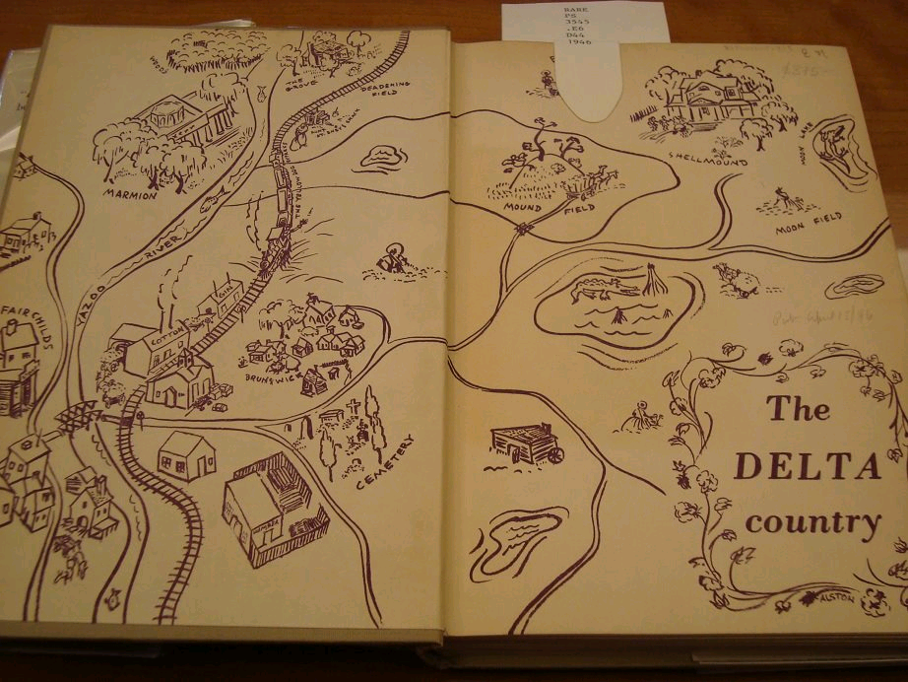
The Mississippi Delta…more than just geography.
…the last refuge of the mythical south…

Slide 5
The Delta Wedding
There were ever two events which stirred the Delta from the top of its levee, the highest point, to its cypress knees in the swamps - an election and a wedding. A Delta wedding was something to remember. There were, of course, as some will tell you, other exciting happenings like a revival with its big top tent and sawdust trail, especially if Brother McIntire happened to be the reviver. Then in the fall, when cotton picking money jingled in thread-worn pockets, came the show boats - floating palaces to us along the River -

Slide 6
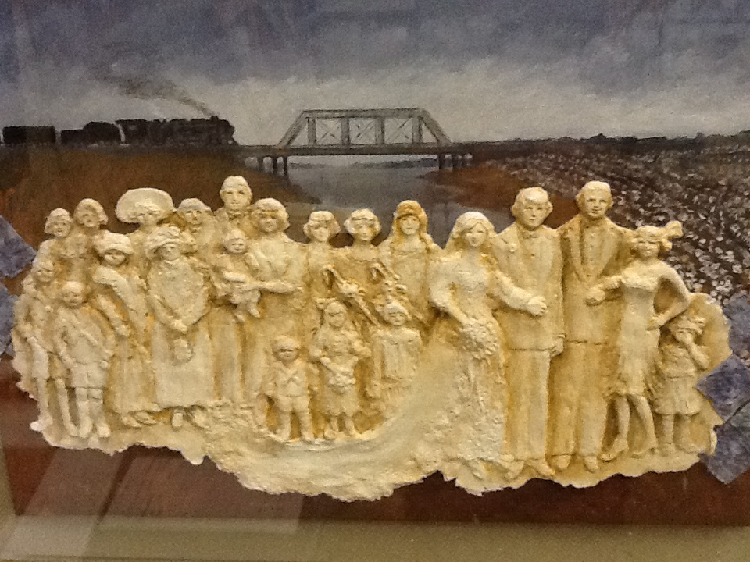
Delta Wedding II
Rita Halbrook
Courtesy of The Museum of the Mississippi Delta

Slide 7
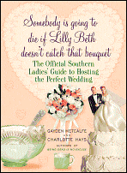
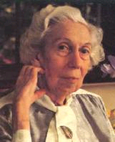
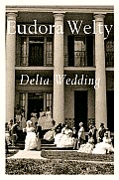
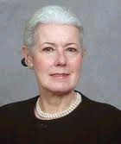
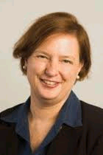
Delta Weddings In Literature
Delta Wedding, published in 1945, set in 1923
Somebody is going to die
if Lilly Beth
doesn’t catch
that Bouquet,
Published in 2007
Themes:
  Seasons/Schedules
  Matriarchy
  Outsiders
    “you’re not from here are you?”
    “who are your people?”
Notes:
Seasons: Dabney gets married during planting season—shocking because usually the agricultural cycle dictates weddings—after planting or before harvesting
“Oh, Pap’s really proud of Dabney, no matter how he groans, because she won’t wait till cotton picking’s over, said Shelley.” (13)
Same still holds true with Metcalfe & Hays: less about agricultural seasons and more about football, hunting, and teaching schedules
Sillers Odgen: In Rosedale, the weddings were always on Tuesdays or Fridays because those were the days the Kate Adams landed.
Outsider: Class
Welty: Dabney marries someone outside her social class and from outside the Delta.
The Fairchilds fervently resist the impending change, and such resistance is found most frequently in their attitude toward outsiders to the Delta, generally, and to the family, specifically. The family categorizes everyone, both implicitly and explicitly, as either an outsider or an insider. Their power to exclude outsiders has a range of effects.
Troy’s position as a geographical and philosophical outsider and as a Fairchild employee complicates the Fairchilds’ acceptance of him into their closely guarded ranks.
A “Delta person” a regional identity that Welty exposes as conflated with aristocratic whiteness—unique from a hill country bumpkin like Troy
Metcalfe & Hays:
The Delta bride frequently searches the world over—at least as far as Jackson or Memphis—for her ideal husband and then chooses the boy next door
Boys from outside the Delta sometimes don’t understand us, and, when they visit, they get culture shock.
One of the best ways to find the right man is to marry Mother’s best friend’s son. This ensures “a similar background.” That is Delta for “of the same social class.”
Budget:
Welty: in the Delta the word budget smacked of “unbecoming niggardliness and skimpiness; a thin cake baked without a fat abundance of eggs and butter.”
Cake cost $35.00 and came down on the train from Memphis
Metcalfe & Hays: rather go to the poorhouse than have a bad wedding
We are competitively crazy in the Delta
Weeping cake; cakes from Memphis and Atlanta—flown and driven in had to be fixed by local bakers because of disasters.
Matriarchy:
Welty: story about the women; the women rule the family; weddings are the province of women because they are a family matter
Metcalfe & Hays: Mother is deeply involved in a daughter’s search for the right young man
A Delta mother, even today, wants a bridegroom from a fine family with old money (or, failing that, a rich family with lots of shiny new money).
One of the best ways to find the right man is to marry Mother’s best friend’s son. This ensures “a similar background.” That is Delta for “of the same social class.”
The mothers’ entrance into the church, breathlessly awaited by all, far outshines the groom’s. If able, the Delta mother builds her entire house around her eldest daughter’s wedding, even if the daughter hasn’t been born when the first brick is laid and the first Ionic column reaches for the heavens
The Delta wedding is the apotheosis of all the mother’s dreams—and, of course, all her social ambitions. A father, whose role, as one local matron put it, is to sit up, to pay up, and to shush up, is expected to behave like a good child: seen but not heard.

Slide 8
As with so many instances in life including Delta Weddings, there is often method behind the madness…

Slide 9
Delta Weddings Preserved
Methodology
Findings
Limitations

Slide 10
Methodology
Why Delta weddings?
Which repositories?
Collection evaluation
Secondary sources
Notes:
Originally we were interested in studying the roots of music—classical, rock, blues, jazz—and how the MS Delta was home to these roots, but we quickly realized that this topic was best left scholars with a background in music. We decided on Delta Weddings because we all have ties in the Delta and one of us has even had a Delta wedding. Furthermore, we discovered there was very little scholarship written on Delta Weddings, so we thought we would focus on the history, culture, and ritual of Delta Weddings. Delta weddings are unique, just as the Delta itself is unique. We decided to focus on how this distinctive part of Delta culture is preserved in local Delta repositories. We also purposely left our topic very broad because we didn’t know what we would find and we didn’t want to stymie our research efforts by putting specific requirements on our searches. We were looking for anything on weddings regardless of race or ethnicity, as long as it fell within the 18 Delta counties. Search terms included: wedding, churches, vows, nuptials, and in a few rare instances, names of people. Again, trying to cast a broad a net as possible.
So how did we decide which repositories we would examine? First, we turned to our University Archivist, Emily, and had her determine, based on her past experience with other archives, the best places we should look. After creating an initial list, we then factored in professional leave time, driving time, and other time/cost factors that would influence our ability to effectively research at certain locations. In the end, we established this list: SHOW MAP. We divided the locations between the three of us. Some locations only had one researcher while others had all three of us. We included several different types of repositories: public library, public museum, and university archives.
Collection evaluation:
Before we began physically researching at the repositories, we created a basic collection evaluation form that would ensure that, despite different researchers, we would gather some uniform information about each location.

Slide 11
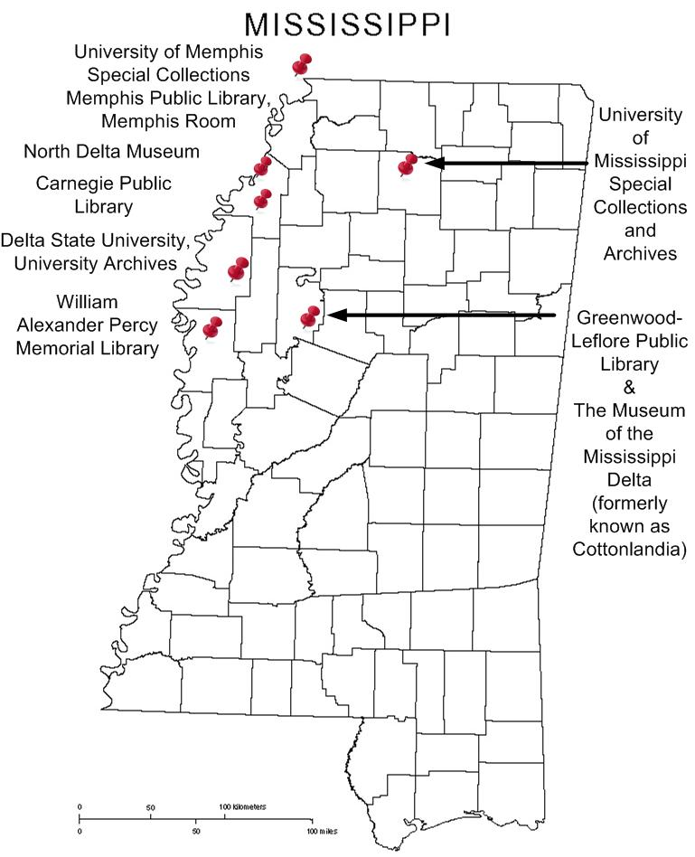

Slide 12
Methodology
Why Delta weddings?
Which repositories?
Collection evaluation
Secondary sources
Notes:
Collection evaluation:
Before we began physically researching at the repositories, we created a basic collection evaluation form that would ensure that, despite different researchers, we would gather some uniform information about each location. SHOW FORM.

Slide 13
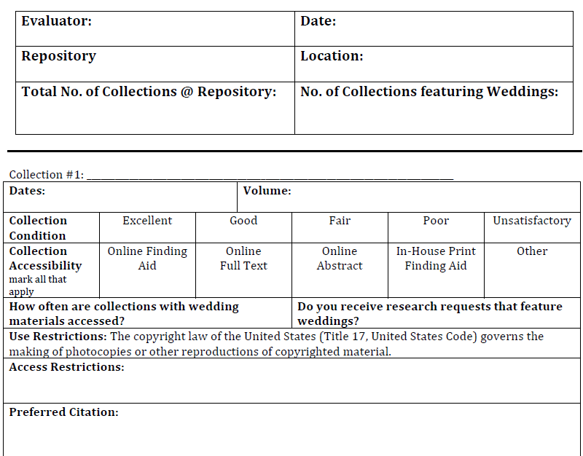

Slide 14
Methodology
Why Delta weddings?
Which repositories?
Collection evaluation
Secondary sources
Notes:
Secondary sources:
As part of our research, we also did a search of the Roberts-LaForge Library OPAC to see if any secondary sources might assist us in our examination of Delta wedding culture. We performed a keyword search using “wedding” as our search term. The search returned 272 results. Of these 272 results, we kept only those books pertaining directly to weddings—we discarded videos, music, and fictional works. We had 45 remaining titles. SHOW PIE CHART. We divided the remaining titles into three main groups: how-to guides, informational, and scholarly. You can see from our pie graph that the largest category, by far, was the informational books. After this breakdown, we examined the scholarly books to see if any discussed the MS Delta. We found that only one work discussed MS Delta weddings—and that was the literary criticism book on Eudora Welty’s fiction. No other source addressed Delta weddings.

Slide 15
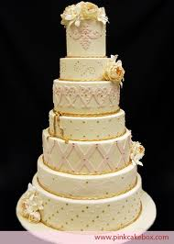
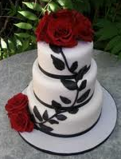

Secondary Sources
OPAC Search Term “Wedding”
24% How-To
29%
Scholarly
47%
Informational

Slide 16
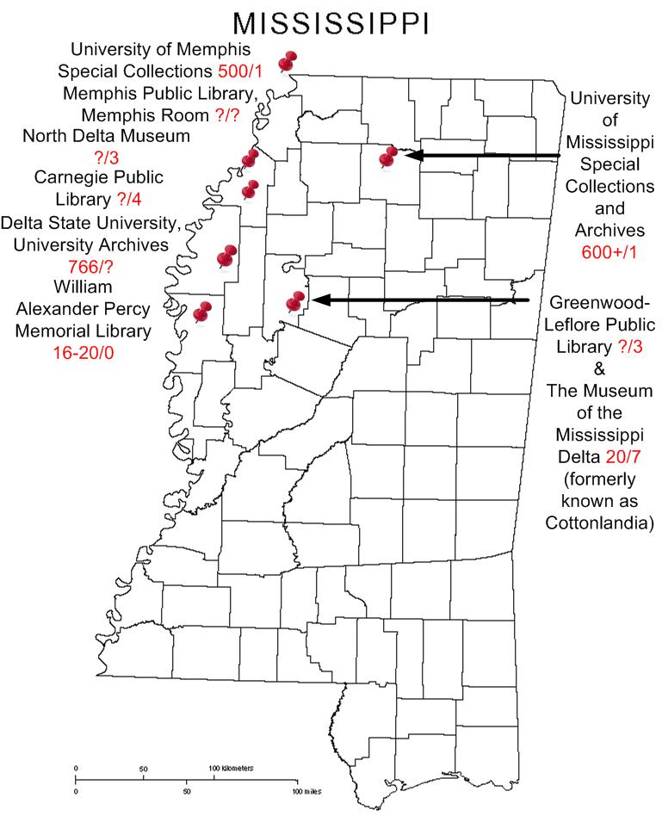

Slide 17
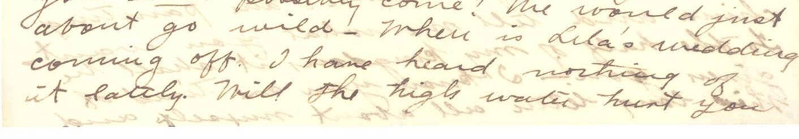
Findings: Seasons
“When is Lila’s wedding coming off. I have heard nothing of it lately. Will the high waters hurt you…”
Delta State University
Carr Collections (M227)

Slide 18
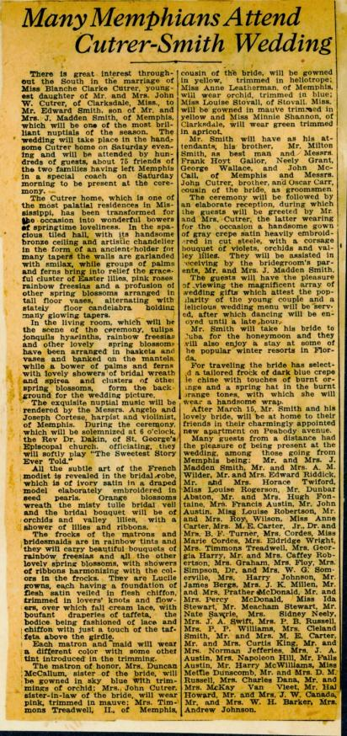
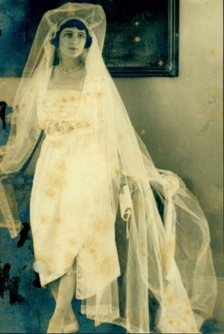
Findings: Class and Society
In one rare instance, we found that the Cutrer-Smith wedding crossed not only county lines but state lines. While the Cutrers were from Clarksdale, their wedding announcements were found in the larger Memphis newspaper. To be announced in such a large and well-distributed newspaper was indicative of an influential family. Further research revealed that Mr. Cutrer was involved in the Cotton Carnival and that his daughter had once been the Queen of Cotton Carnival.
From Memphis…
…to Clarksdale

Slide 19
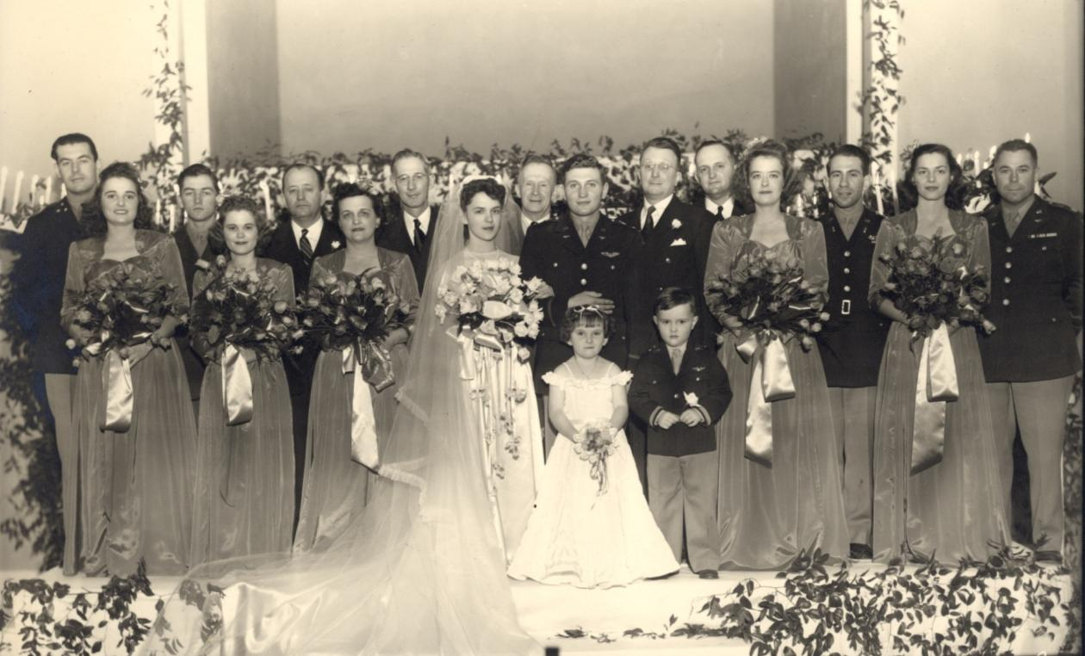
Findings: Matriarchy
LePoint & Warwick’s
Wedding Party, 1944
Notes:
LePoint / Smitty Wedding 1944

Slide 20
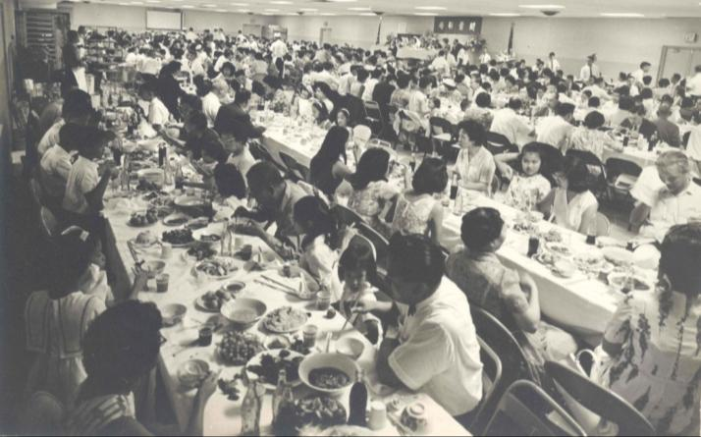
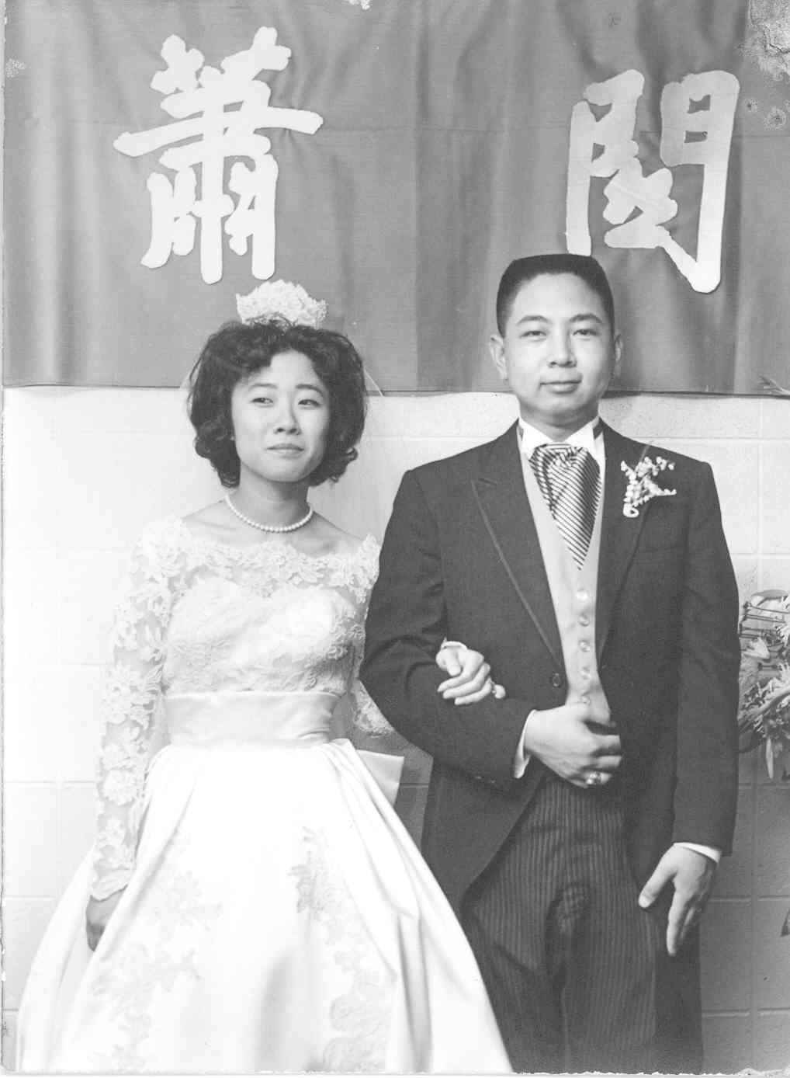
Findings: “Being From Off…”
Pairing Oral History
With photographs.
When Frieda Seu accepted John Quon’s marriage proposal, she knew this would not be any wedding she had ever attended before…

Slide 21
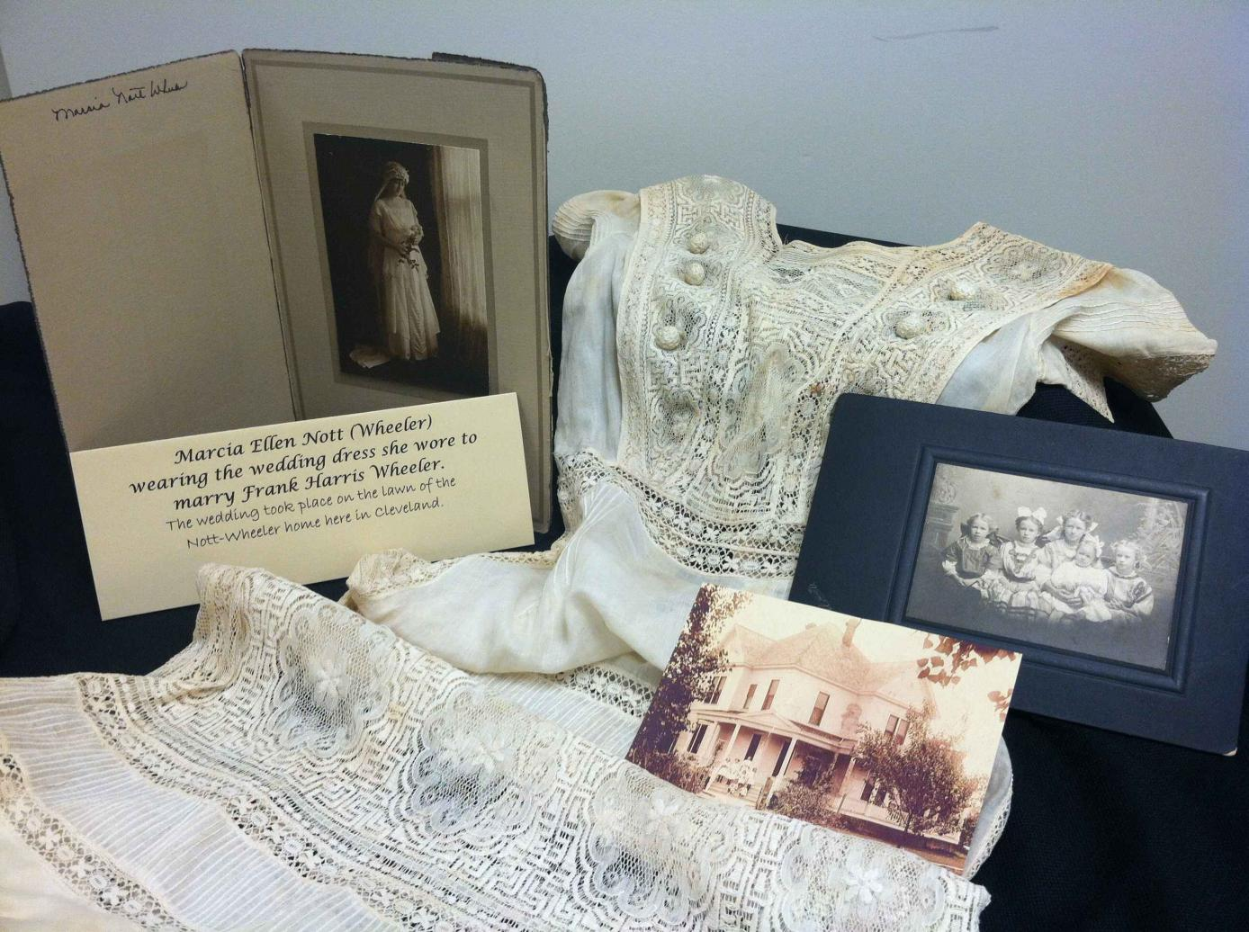
Nott-Wheeler wedding, Cleveland, 1915
Nott-Wheeler photographs

Slide 22
Findings: Traditions of Weddings
LePoint Cassibry-Smith
Cleveland
First Presbyterian Church
1944

Slide 23
Findings: Tradition of Weddings
Warwick & LePoint Smith celebrate the marriage of their daughter, Ivy. The wedding was held in the Smith’s back yard in 1968.

Slide 24
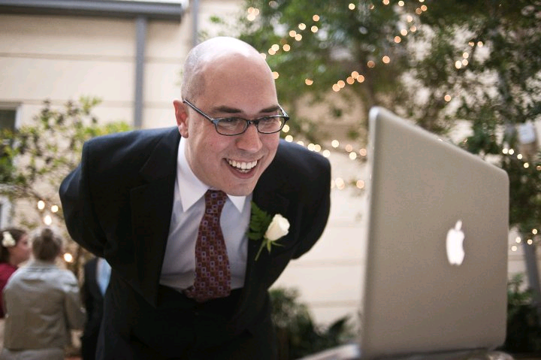
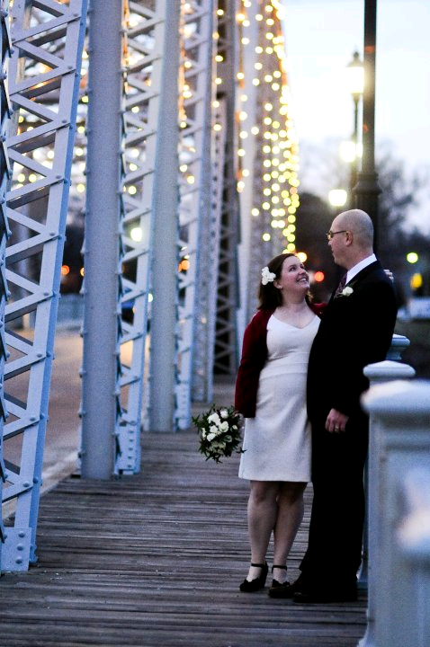
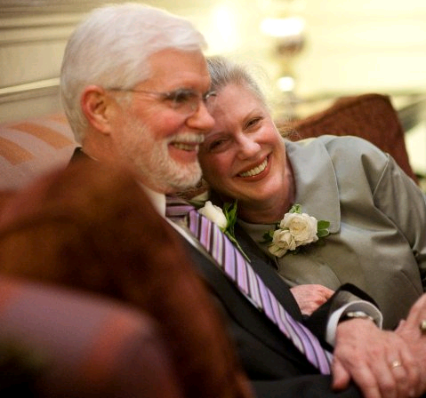
LePoint Smith’s granddaughter, Isabel, marries Brian, her ‘from off’ fiance in a sweet family wedding held in Greenwood. Brian’s family attended via Skype.

Slide 25
While budgets, geography, schedules, seasons, politics and religion have shaped the weddings we have researched, other factors determined how and where we were able to acquire our information.

Slide 26
Limitations
Time
Financial-paid for research travel out of pocket
Repositories- a mixture of types visited (either as groups or singularly) throughout the Delta.
Only nine repositories were visited. Limitations included: public access, archival staff, format of finding/ searching aids, and size and/or physical condition of collections, and lack of uniformity of research
Notes:
Time issues: Worked during “borrowed” time (during workdays) and only allowed limited professional days for research.
Nine Repositories are: Carnegie Public Library/Clarksdale; Museum of the MS Delta or Cottonlandia Museum/Greenwood; Memphis Public Library/Popular Ave. Branch; William Alexander Percy Memorial Library/Greenville; Capps Archives and Museum/DSU; University of MS, Archives and Special Collections, Oxford; University of Memphis, Special Collections/Memphis; North Delta Museum/Friars Point.
Limitations: Limited mobility-travel issues for us, not enough money or professional days to see everything. Too many counties and archives for us to view in such a short period of time. Public access-we agreed to only include public records and information. This excluded church records and family records that may have been great pieces of information, but not for this study. Archival staff-Staff at archives/libraries have varying degrees of knowledge concerning their collections. Some are also more helpful than others with the searching process. Format of finding/searching aids-Some archives and libraries have created online finding or searching aids and these aids range in helpfulness from extremely useful to almost useless. Due to hyperlinked text and scanned documents, some finding aids were utilized even before we arrived at certain facilities. Others were only photocopied or online “flat” documents with only collection names and box numbers and not descriptions at all. Lack of time and money-We simply did not have enough time to travel and visit every archive/public library/ museum in the 18 county Delta area nor did we have the financial resources. Size of the collection or physical condition of collections/individual pieces-Some collections that we attempted to view were quite large in size and, therefore, unmanageable for our time allowances. We could only view small selections from these collections according to what we could glean from the online finding aids or from the assistance of the librarian or archivist on duty. Additional collections had wonderful artifacts, but due to the age of the artifact, inadequate preservation, or both, the artifact was damaged almost beyond our use. Lack of uniformity of research-each researcher had her own way of collecting and assimilating research data.

Slide 27
Conclusions
Areas for Further Research
Digital media archiving
Marriage certificates
Churches
Newspapers
Notes:
Fertile ground for further scholarship

Slide 28
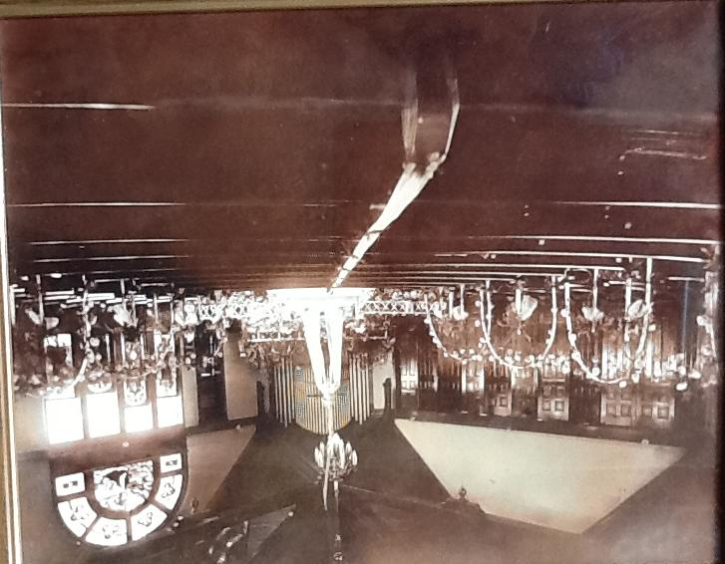
If not there…then where?
Notes:
Churches, homes, Facebook and other digital archiving, possibly thrown away, passed down through the generations etc.
No relevance to our generation so a lot is lost or thrown away
Scope of repositories’ collections

Slide 29
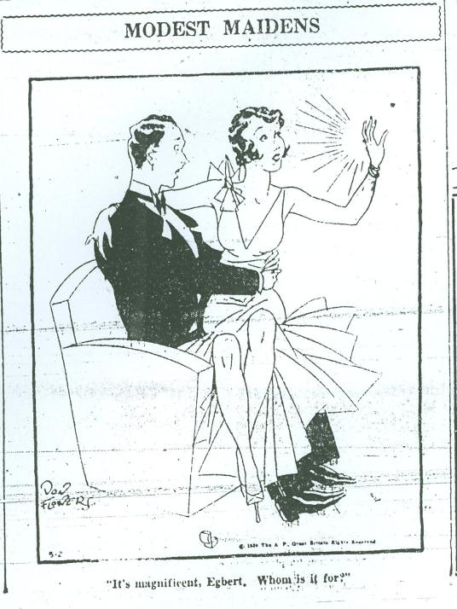
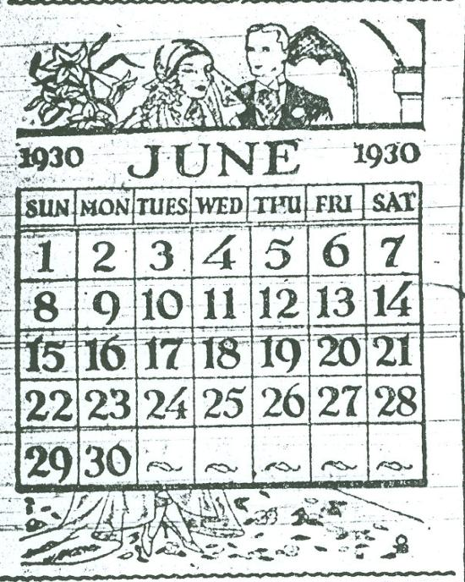
Daily Democrat Times Ads, 1930
Wedding Calendar for June 1930
“It’s magnificent, Egbert. Whom is it for?”

Slide 30
Contact
Cynthia M. Beardsley
  Reference/Instructional Services Librarian
  cbeardsely@deltastate.edu
Emily E. Jones
  University Archivist
  ejones@deltastate.edu
Margaret A. Swanson
  Instructional Resources Center Librarian
  mswanson@deltastate.edu
*A list of references for this presentation is available upon request.

