Slide 1
“Issues and Challenges of Maintaining The Papers of Ulysses Grant Collection: From Editors to Archivists”
Ryan P. Semmes
Assistant Archivist
Congressional and Political Research Center
Mississippi State University Libraries

Slide 2
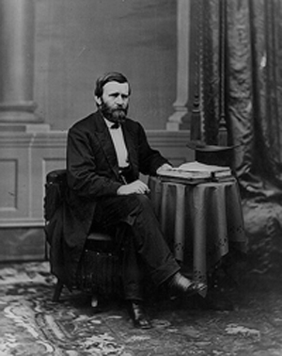
Papers of Ulysses S. Grant
The Papers of Ulysses S. Grant project arrived at MSU in December 2008.
MSU made the commitment to make the material available to researchers.
Previously, only editors had access to the collection.

Slide 3
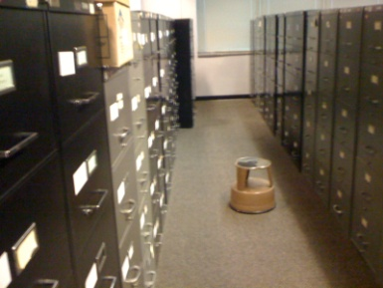
Papers of Ulysses S. Grant
Editorial Procedures
The Editors arranged their materials into 4 Major Divisions:
Source Cards
Subject Files
Rejects
Published Files

Slide 4
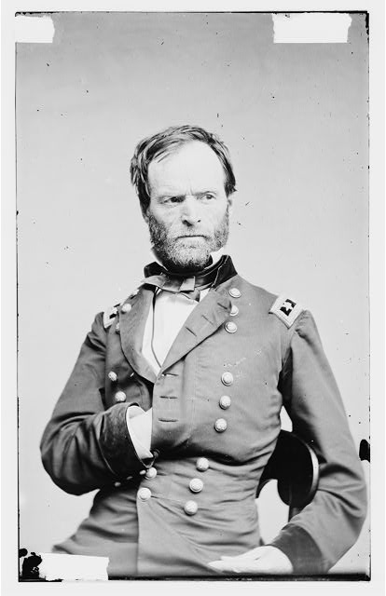
Papers of Ulysses S. Grant
At issue was the editorial descriptors:
Use of initials instead of full names
For example
  OEB for Orville E. Babcock
  WTS for William T. Sherman

Slide 5
Papers of Ulysses S. Grant
Another issue was the filing method:
Every published Grant letter had footnotes that included other pieces of correspondence. These were filed in individual folders which were then placed physically inside the original folder, making location of the original folder in the drawer difficult.

Slide 6
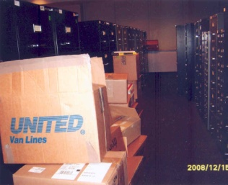
Papers of Ulysses S. Grant
Physical Arrangement
Approx. 15,000 Linear feet
95 file cabinets
Hundreds of boxes
Out of order:
  Cabinets placed around reading room
  Unusual numbering system
  Reject files B1-B9, then F16 down to F1

Slide 7
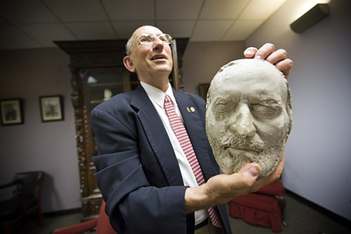
Papers of Ulysses S. Grant
Papers files vs. U.S. Grant Association Files
Separating the editorial function from the organization charged with maintaining the collection:
150 boxes of USGA Organization Records
20 boxes of memorabilia/scrapbooks

Slide 8
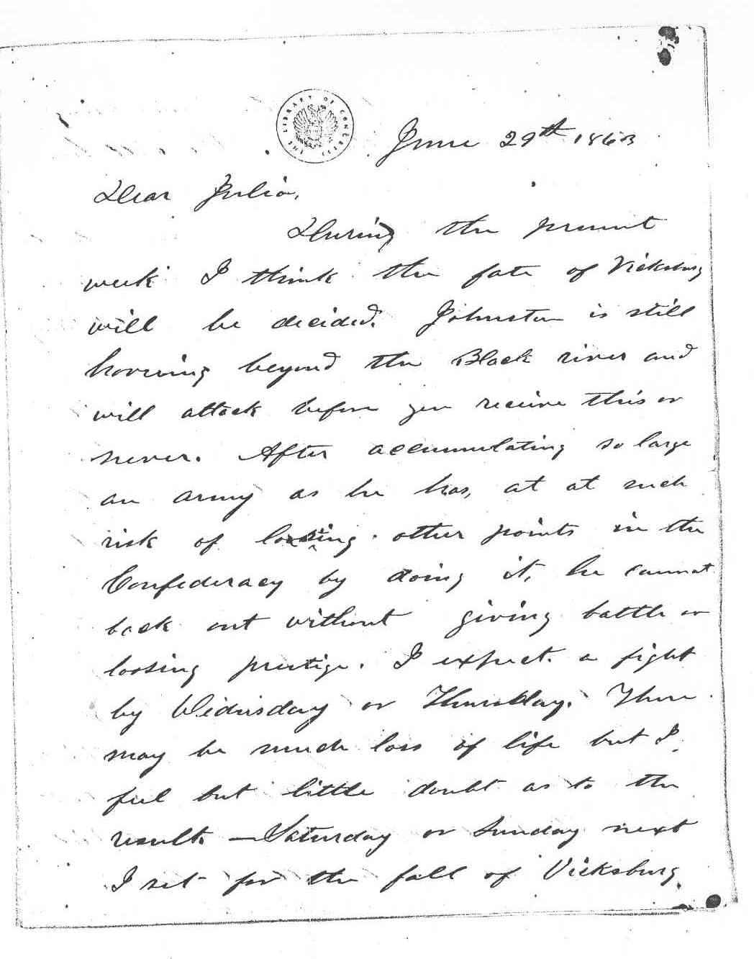
Papers of Ulysses S. Grant
Inventories-Unpublished
Comprehensive inventory of the Reject files
(renamed Unpublished files)
105 drawers of correspondence: over 60,000 items
Folder level-inventory: Creator, recipient, date
Multiple folders/letter:
Endorsements
Letter book copies

Slide 9
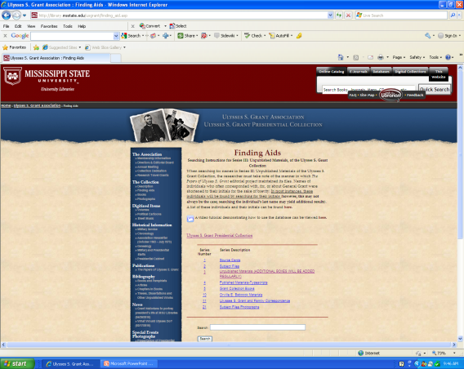
Papers of Ulysses S. Grant
Database
In-house built for CPRC collections
Folder-level, linear text searching
No metadata
Correspondent “Initial Key” provided

Slide 10
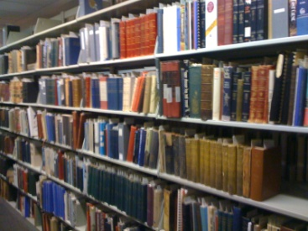
Papers of Ulysses S. Grant
Cataloging
100 boxes
4,000 volumes of books
1,100 individual titles
Approx. 3 months to catalog
Shelved and made available immediately (non-circulating)

Slide 11
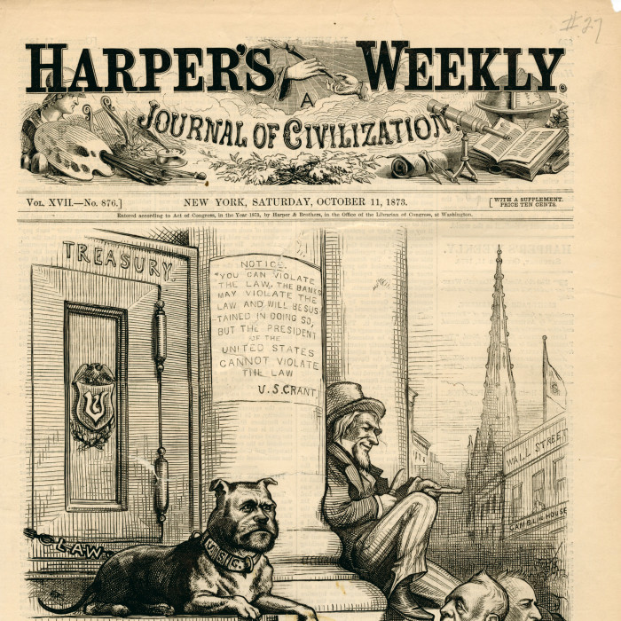
Papers of Ulysses S. Grant
Digital Collections
31 volumes of The Papers
11 Political Cartoons
14 Pieces of Sheet Music
100 Photographs
CONTENTdm

Slide 12
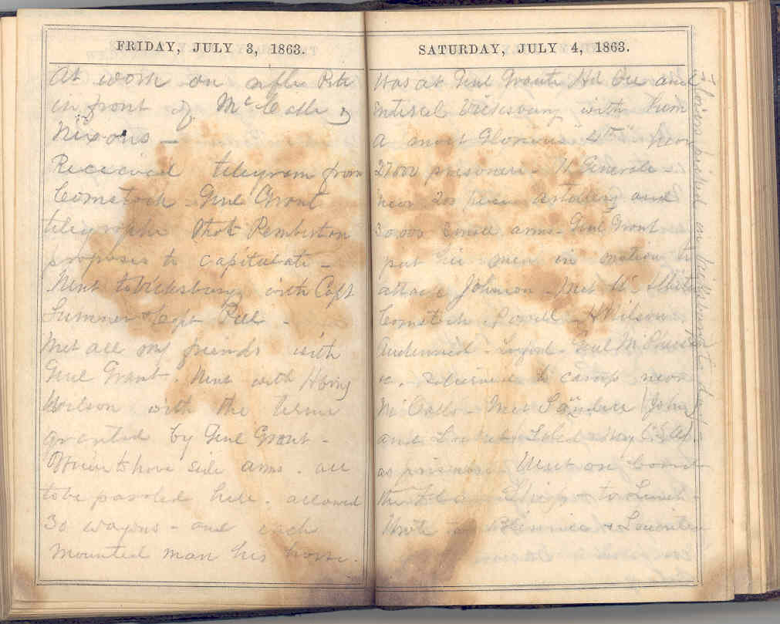
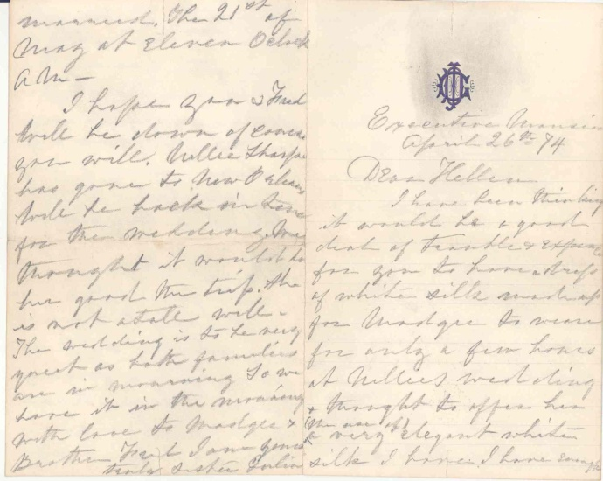
Papers of Ulysses S. Grant
Upcoming Digital Projects:
Original Correspondence
Babcock Diaries

Slide 13
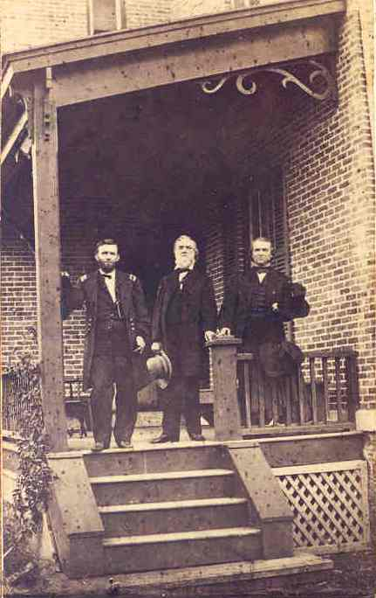
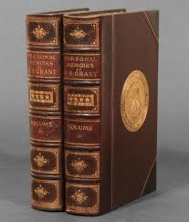
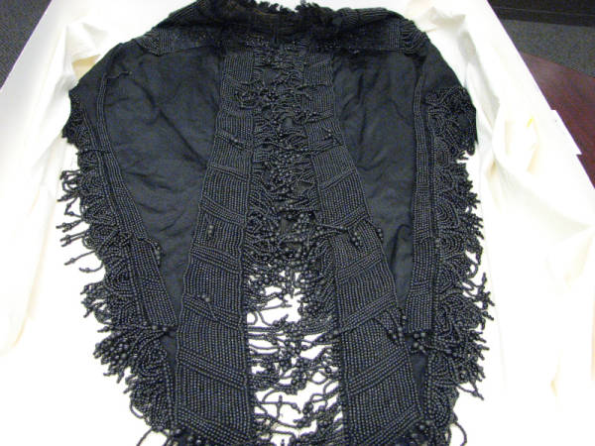
Papers of Ulysses S. Grant
Challenges remain as we adapt to this new type of collection.

