Slide 1
“Getting the Word out to Get the Participants in”
Archival Training Collaborative
Mona K. Vance

Slide 2
Background/Needs
Past train-the-trainer workshops focused on learning how to teach the workshop
Witnessed a need for trainers to promote and advertise their workshops for ATC
Wanted trainers to be market through various media avenues as well as across state lines

Slide 3
Training
Occurred in Jackson, Mississippi on November 3-5, 2011 at the Mississippi Department of Archives and History
14 people from across Alabama, Louisiana, and Mississippi attended
A chance to exchange ideas

Slide 4
Covered
The distinctions between marketing and public relations
  Marketing has at its core a desire to reach consumers and make them think, believe or do what you want. Public relations is more focused on influencing reputation, whether corporate or personal.
  Marketing is paid-for exposure under a company’s direct control, while public relations is free exposure
Highlighted the various ways in which you can promote an ATC workshop
  More than the traditional flyer or pamphlet
  Radio, television, newspaper, blogs, websites, etc.

Slide 5
Books
Many Happy Returns: Advocacy and the Development of Archives Edited by Larry J. Hackman
365 Ideas for Recruiting, Retaining, Motivating, and Rewarding Your Volunteers: A Complete Guide for Nonprofit Organizations by Sunny Fader
Public Relations for Dummies (2nd Edition) by Eric Yaverbaum
Marketing Workbook for Nonprofit Organizations Volume I: Develop the Plan by Gary J. Stern
The Nonprofit Marketing Guide: High Impact, Low-Cost Ways to Build Support for Your Good Cause by Kivi Leroux Miller
The New Breed: Understanding and Equipping the 21st Century Volunteer by Jonathan McKee and Thomas W. McKee
Forces for Good: The Six Practices of High-Impact Nonprofits by Leslie R. Crutchfield and Heather McLeod Grant

Slide 6
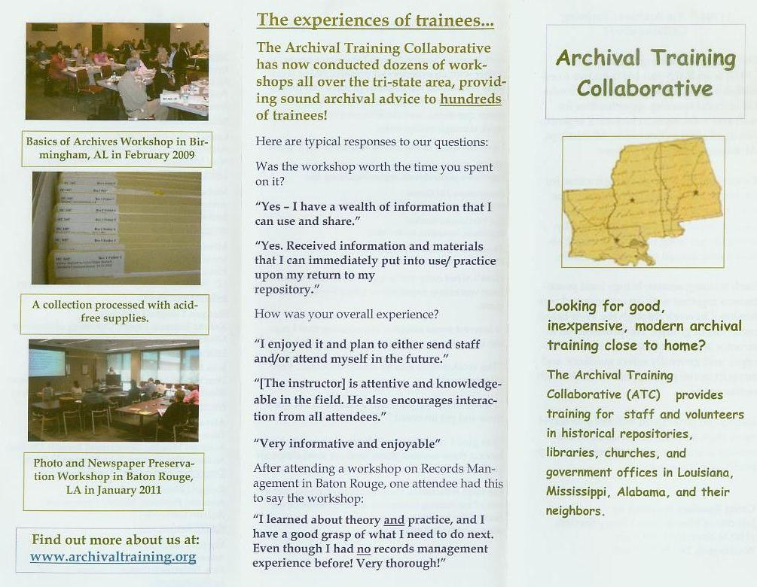
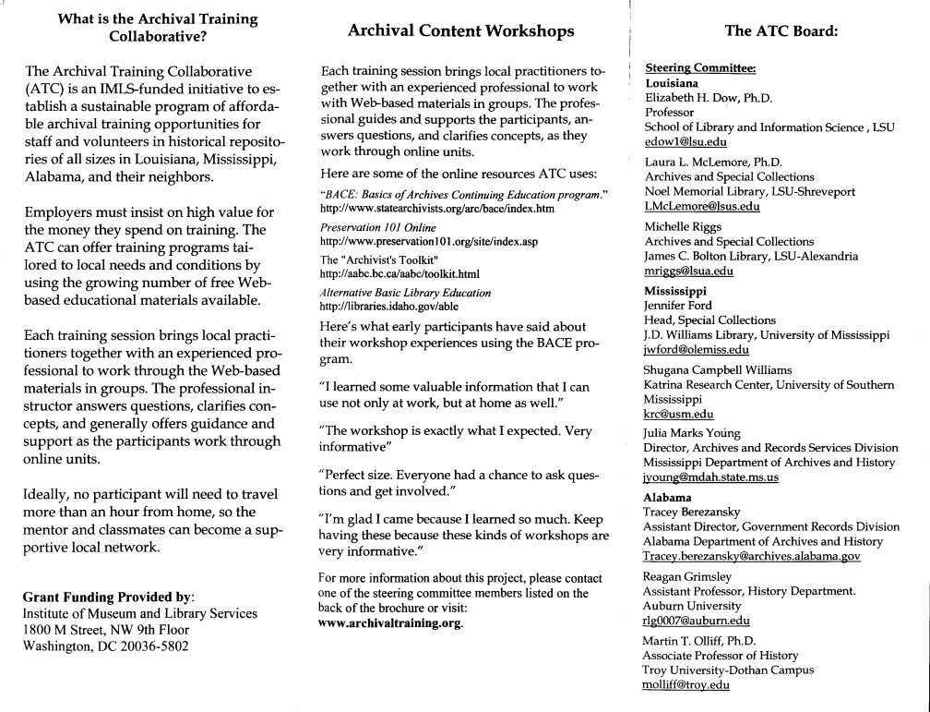
Already Had
ATC Brochure
Outside
Inside

Slide 7
Examples
Television
  Local community spots
  “Mid-Morning with Aundrea” at WCBI in Columbus, MS
Radio Stations
  Public Service Announcements
  WLNA in Sunflower County, MS
Blogs/Social Media
  “Local History Announcements” Columbus-Lowndes Public Library
  ATC Facebook page https://www.facebook.com/#!/groups/125017918118/

Slide 8
Website and Video
Website
  http://archivaltraining.org
Video
  Used to promote ATC workshops to a mass audience
  http://www.youtube.com/watch?v=jOwk3Kgeh1c&hd=1
  Produced by Travis Williams, an SLIS student at LSU
  Over 920 views

Slide 9
Outcome
Trainers now have to tools to promote and market their workshops
ATC anticipates greater success with the workshops over the course of the next year and into the future.

Slide 10
Consider…
How do you currently promote and publicize your events and programs?
Do you know of any ideas that we did not mention?
Have you operated a public relations campaign to promote something at your institution? If so, how did it go? Successes? Failures?

