Slide 1
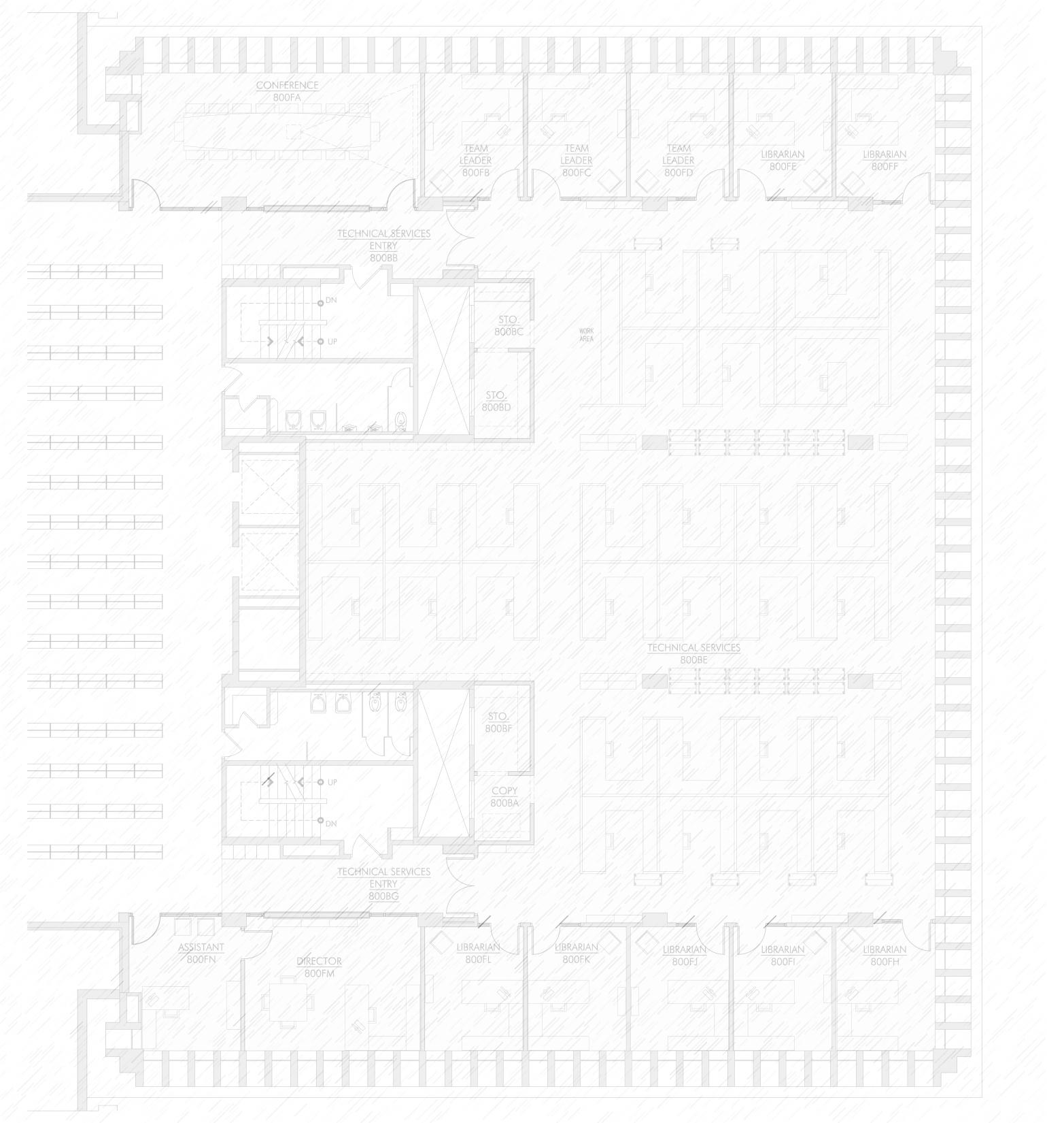
Vanderbilt Libraries:
Building
an Exhibition Program
Notes:
Vanderbilt’s Libraries were given the opportunity to renovate the 1941 Central Library in 2010. Today I’ll give just a brief overview on the project, then launch in on designing casework, which is an area with a number of decisions to make, and then add information about getting help from your colleagues, selection and placement, publicity and programming and lessons learned.
The project grew to include new classrooms, a community space, group study areas, a cafe and exhibit spaces.
We had already been curating exhibits in many of the campus libraries, mostly in traditional, free-standing cases. Central, Divinity, Education, Music, Science & Engineering, and Special Collections each selected and promoted its own exhibits, which frequently highlighted materials about the library’s associated school or discipline, often drawn from the stacks with a primary goal of drawing attention to circulating resources. Rare and unique materials were exhibited, of course, in Special Collections, but also by the Library’s WT Bandy Center for Modern French Studies and by the Divinity Library. Special Collections and the Divinity Library had a web presence for its exhibits. And so we had an exhibits program, but it was part of the ETOB model (each tub on its own bottom) and each had its own focus. The new exhibit spaces would be housed in Central but would be used to display materials in all disciplines, and so would be the first step in a larger, centralized exhibit program that reflects the university’s own model of “one university.”
In many ways the timing for a renovation was good for the library.

Slide 2
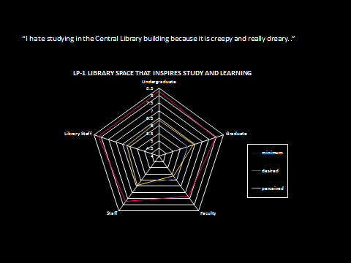
Identifying Needs
Notes:
This is a LibQUAL radar chart, which I am sure many of you have seen, here looking at opinions of the library’s space.
We had just completed a LibQUAL survey that had drawn record responses and so had qualitative and quantitative data suggesting that the Central Library was in need of renovation. Some suggestions for improvement were also noted among those LibQUAL comments. Our new dean Connie Dowell had already begun to follow up on those comments by holding focus groups with the different library audiences and particularly the undergraduate students. The focus groups, though time consuming, were exceptionally useful, generating ideas and also buy-in from the student government association, a critical factor in the success of the project. Top requests from students were: electrical outlets; group study rooms, food, natural light and artwork.
We also had a good administrative team in place with strong, collegial bonds. A team was formed of Associate Dean Bill Hook, who oversaw the construction project for the libraries—Bill had only a couple of years prior supervised the renovation of the Divinity Library, so he was well acquainted with Vanderbilt’s model for construction. Associate Dean Jody Combs supervised and directed technology for the exhibits and loaded interactive content. I worked on the physical cases and content.
We had a strong communications system within the library and within the campus, something we had built over the previous 5 years as part of our last strategic plan. We would expand on this during the renovation by setting up a team dedicated to construction updates, to keep staff and patrons aware of changes and build enthusiasm for the completion.
Most importantly for the exhibit project, our dean had been building support for system-wide activities from the time that she arrived on campus. By building in strong recognition within the library and the university for staff who stepped up to support system-wide programs, Dean Dowell laid the way for the help we would need to renovate the library on a very short schedule. Recognition might be as simple as an article from the dean in our staffnews blog or a handwritten note from the dean. The important point is that staff were primed to participate in projects outside of their daily work.
On the other hand, there were some concerns with the project.

Slide 3
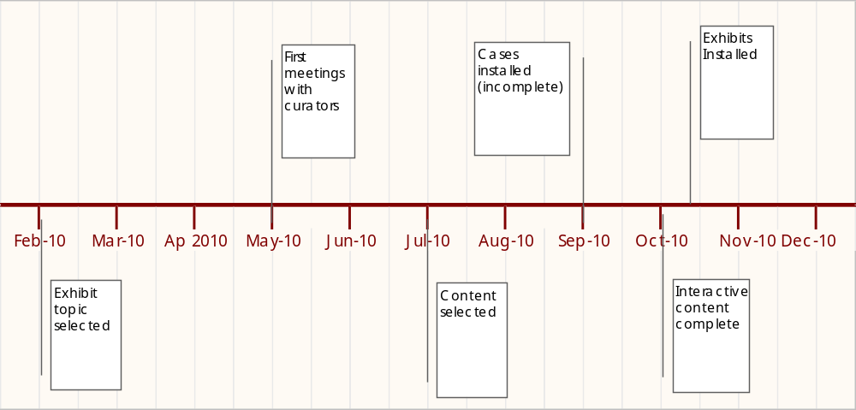
Timeline
Notes:
We had to accomplish the majority of the construction within the bounds of the summer months, closing the doors right after graduation and creating a temporary entrance for users and being ready to open again in late August when students returned for fall classes. Here is a timeline of the exhibit portion of the project—showing that our broad topic—the 60s at 50—was finalized in February of 2010. We would have 8 months to select and interpret objects and do all the other tasks associated with building a first exhibit from scratch.
We would need support from across the libraries to accomplish this task. We were also moving into the busiest time of the school year with papers and exams approaching. If we were going to involve subject specialists, we would have to wait until the end of the school year in early May.

Slide 4
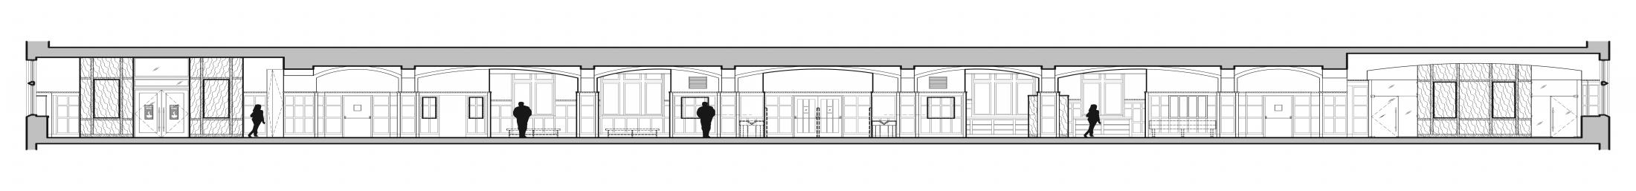
Exhibition Needs
1. Create mission
2. Build cases and touch screens
3. Identify content
4. Solicit support staff
5. Generate publicity
6. Oversee programs
Notes:
Multitasking was characteristic of this project for all of us—we would be designing and placing casework and selecting lighting at the same time that we were choosing exhibit topics and selecting items for display. Some of the big groups of tasks that would need to be accomplished included:
1. Formalizing the mission—for us, this was understood in broad terms but not placed on paper
2. Building cases and touch screens----more on this later
3. Identifying and scanning content, while writing interpretive text
4. Soliciting support staff
5. Generating publicity
6. Planning programs (whew)

Slide 5
Mission
“The purpose of the library’s exhibition program is to raise awareness of unique and rare materials in the library’s collections through popular and educational exhibits that draw the campus community and make the library a destination for the middle Tennessee community.”
Notes:
Let’s start with the mission, that rudder that moves us through the water in the right direction. For those of you with exhibits programs in place, I’d like to ask you all if you can tell me who your audience or audiences are for your exhibits? Here is our mission:
“The purpose of the library’s exhibition program is to raise awareness of unique and rare materials in the library’s collections through popular and educational exhibits that draw the campus community and made the library a destination for the middle Tennessee community.”
I don’t need to tell you that a clear mission is important for not only the selection of materials but for the inevitable requests for exhibits that follow the building of a new exhibit program. It helps us remain focused on the program goals and not be distracted by interesting opportunities that do not further those aims.
As you can see, our mission has a strong emphasis on external appeal, outside of the immediate campus community. Audience will differ from library to library and the literature on library exhibits suggests that there is no consensus here, as one would expect. Audience is such a critical factor, affecting all parts of the program, from selection to installation and even evaluation.
Our goal is to raise the visibility of the library on campus as a contributor to the educational mission and source of pride within the reputation of the university and draw visitors from outside of the campus community. So for me, an important question is “Would this exhibit draw someone with no connection to Vanderbilt?”
Our next big task was casework, one of the more time-intensive steps in the project. We needed to think about where the cases would be placed, how they would be built and lighted and that required us to think about all of the different types of exhibits we might show in the coming years so as to build flexibility into the finished product.

Slide 6
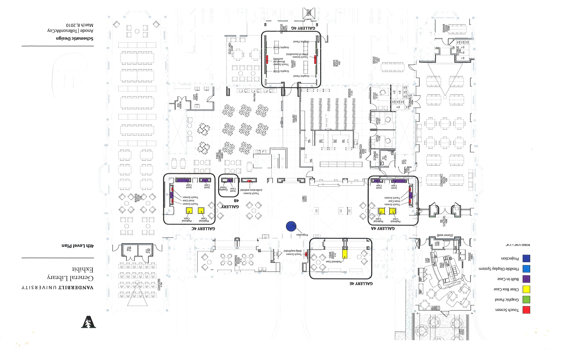
Notes:
Central Library is a building with 2 primary entrances—this is the 4th floor which faces out to Library Lawn and so is considered the campus entrance to the building. We removed the card catalogues and rows of quick access workstations and made the lobby a social area, designed for meeting a friend, holding a reception, or seeing an exhibit, along with its regular uses.
Laying out an exhibit space in an existing library reminds me of placing exhibits in a historic home—it is difficult to direct visitors from one point through a set narrative to an end point. The cases here are designed for random grazing—they work together to build a concept but each case may be appreciated on its own content.
We chose a combination of built-in cases and free-standing pedestals. Inset cases run across the length of the 4th floor lobby and pedestals are scattered around the lobby space. (Note colors and what they mean) Inset cases are 5’ tall and (L-R) 3’ wide, 5’ 4’” wide and 4’ wide. Depth is 22” with a shelf depth of 18”. Interactive touch screens are housed at the north and south ends of the walls and in the center. The five examples in the lobby are comprised of 4 gallery interactives which show still images in 3 sizes and text, and 1 video interactive. Visitors can see the still images as thumbnails, full sized and at an enlarged size and they find interpretive text there.

Slide 7
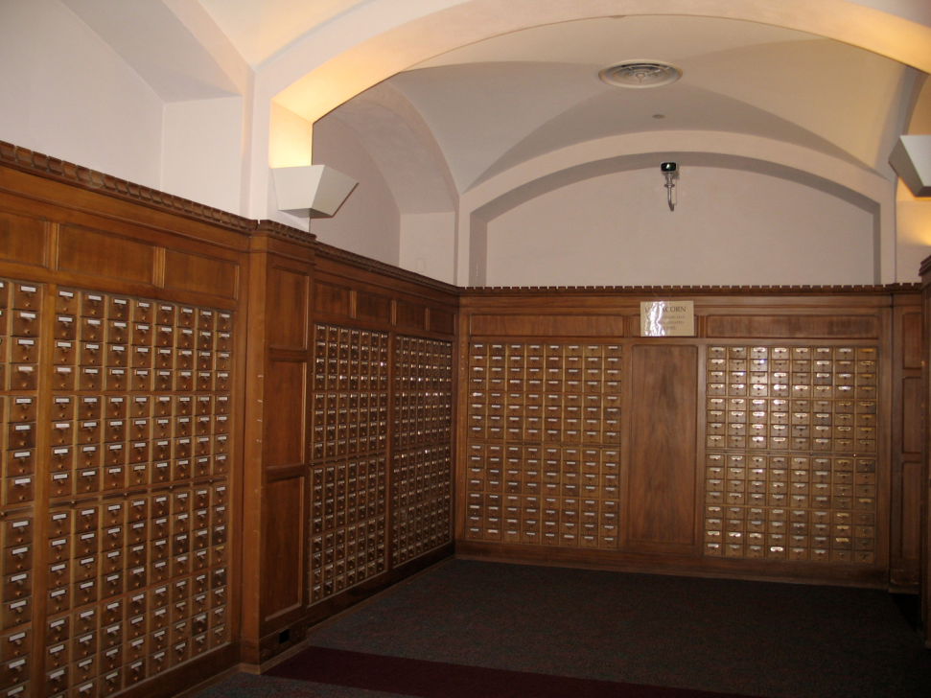
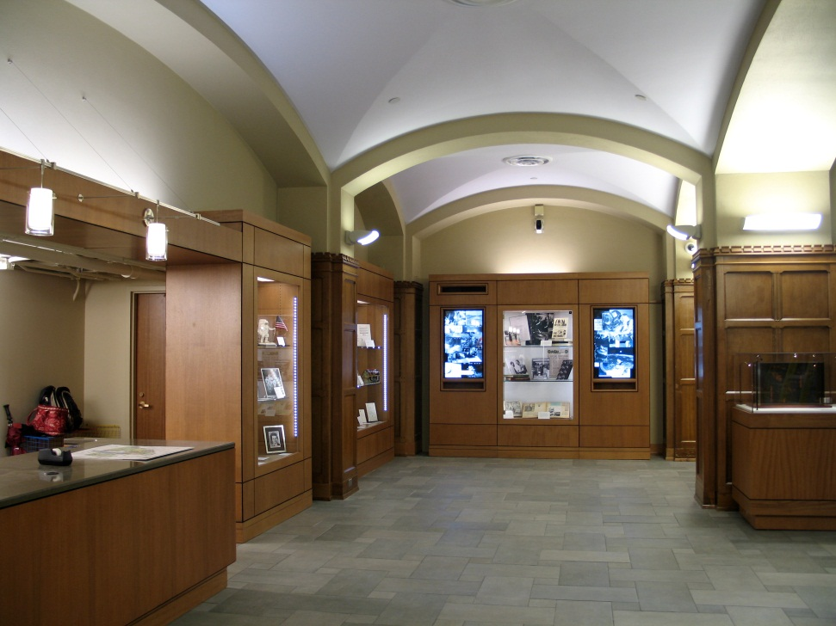
Lobby: Before and After
Notes:
This shows that placement more clearly, here in the south end of the cases. The card catalogs were removed and some were reused in the new café. We wanted to start with a big bang—one exhibit that covered two floors of space and we found that the 60s at 50 gave us a broad topic to connect important stories.
Cases on this end contained content about the Space Race, the development of television in the 1960s and how that changed the way we get information, and a case on the film industry in the 60s. We also displayed a multiple edition artwork by John Cage, the university mace (designed and first carried in the 1960s). On the north side were cases reflecting the Civil Rights Movement, Vietnam War, Music, and Automobile design in the 1960s, all playing off the collection strengths and key loans.

Slide 8
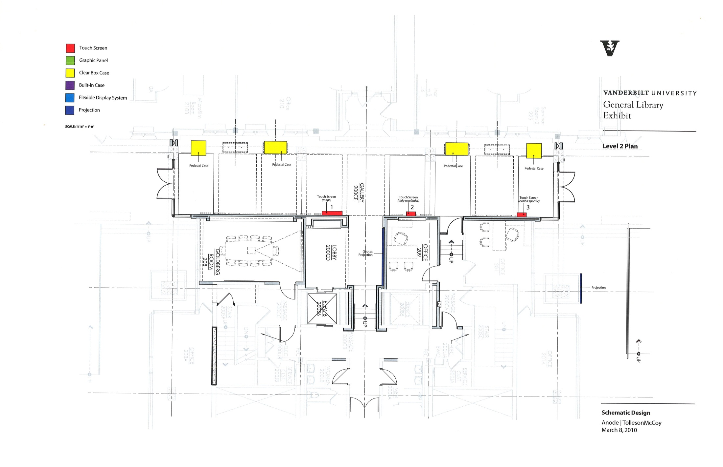
Notes:
The Second floor entrance comes off of 21st Avenue, the main corridor on this end of the campus. It also is near one of the largest public parking spaces off campus and so it is seen as the public entrance. The gallery was created out of an underutilized breezeway between the 1969 Special Collections addition and the old 1941 facility.

Slide 9
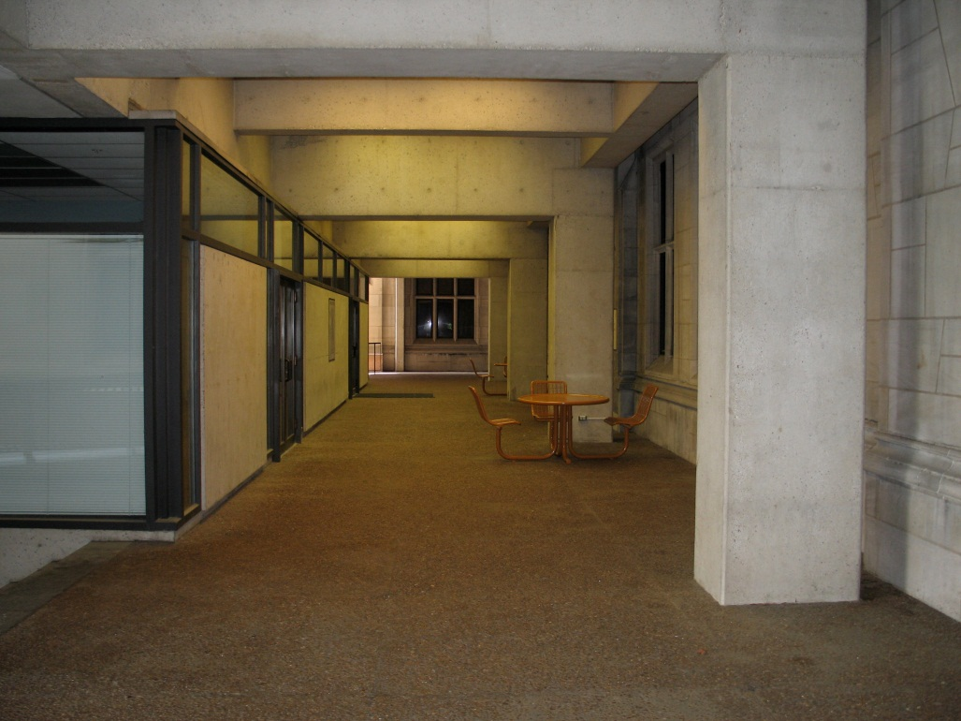
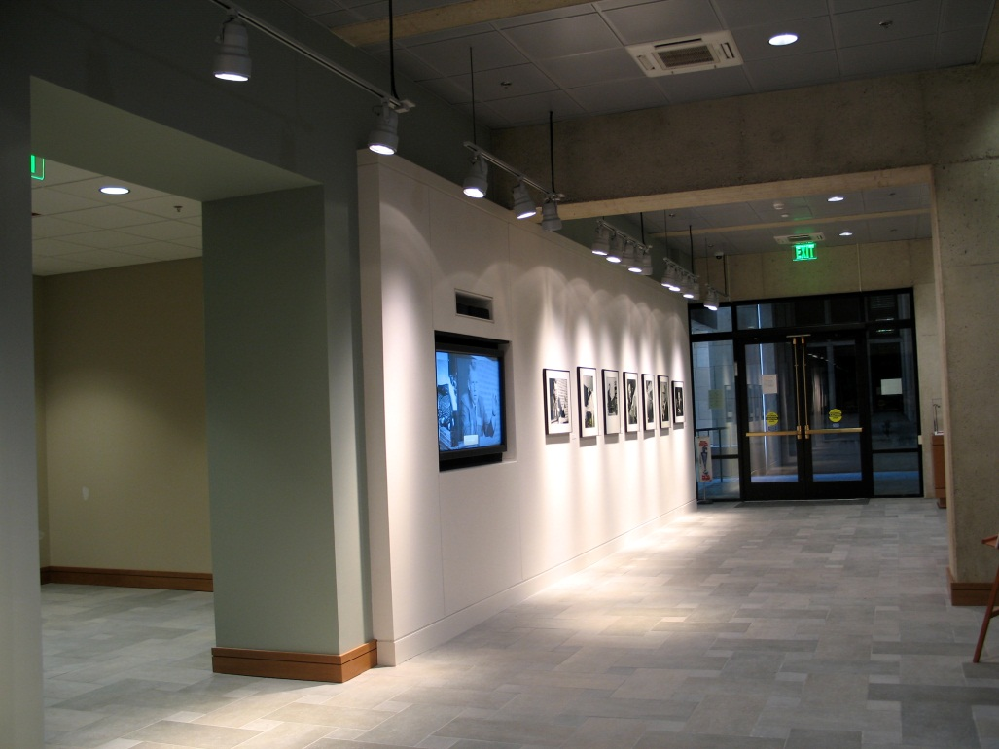
Gallery: Before and After
Notes:
Here you see the south end of the Gallery with an interactive touch screen showing video clips of speakers who came to Vanderbilt in the 1960s, along with wall mounted images of some of the speakers. There are also 2 pedestal cases holding sports memorabilia from the 1960s and political buttons. On the north end are pedestal cases with one of the archives’ time capsules, painted a psychedelic design, and a case on Robert Penn Warren’s Who Speaks for the Negro? , which was published in 1965. The Library had recently collaborated with the university’s Robert Penn Warren Center to digitize and make available the interview that Warren made in the creation of that book.
A gallery interactive is situated at the other end of the gallery that gives visitors an overview of all of the exhibits in the Library. We also have some wall space here to hang materials and place introductory text and graphics. An 8’ tall light box on the wall outside of the entrance contains the exhibit graphic, drawing viewers into this point. I think having a combination of wall space and casework has added to the flexibility of this program.

Slide 10
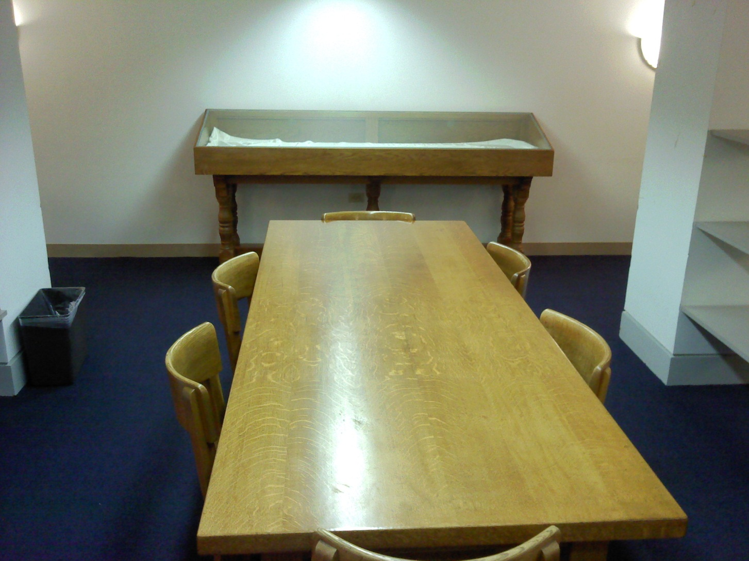
Cases
Notes:
Here is an example of casework we had in the lobby before the renovation. Subject specialists would create temporary exhibits for these cases, which you had to use by opening the back and sliding your object inside. The new cases would need to address the needs of a museum within the setting of a working library on a limited budget. This required a lot of discussion among the architects, consultants and library staff to find a balance for building materials and light levels.

Slide 11
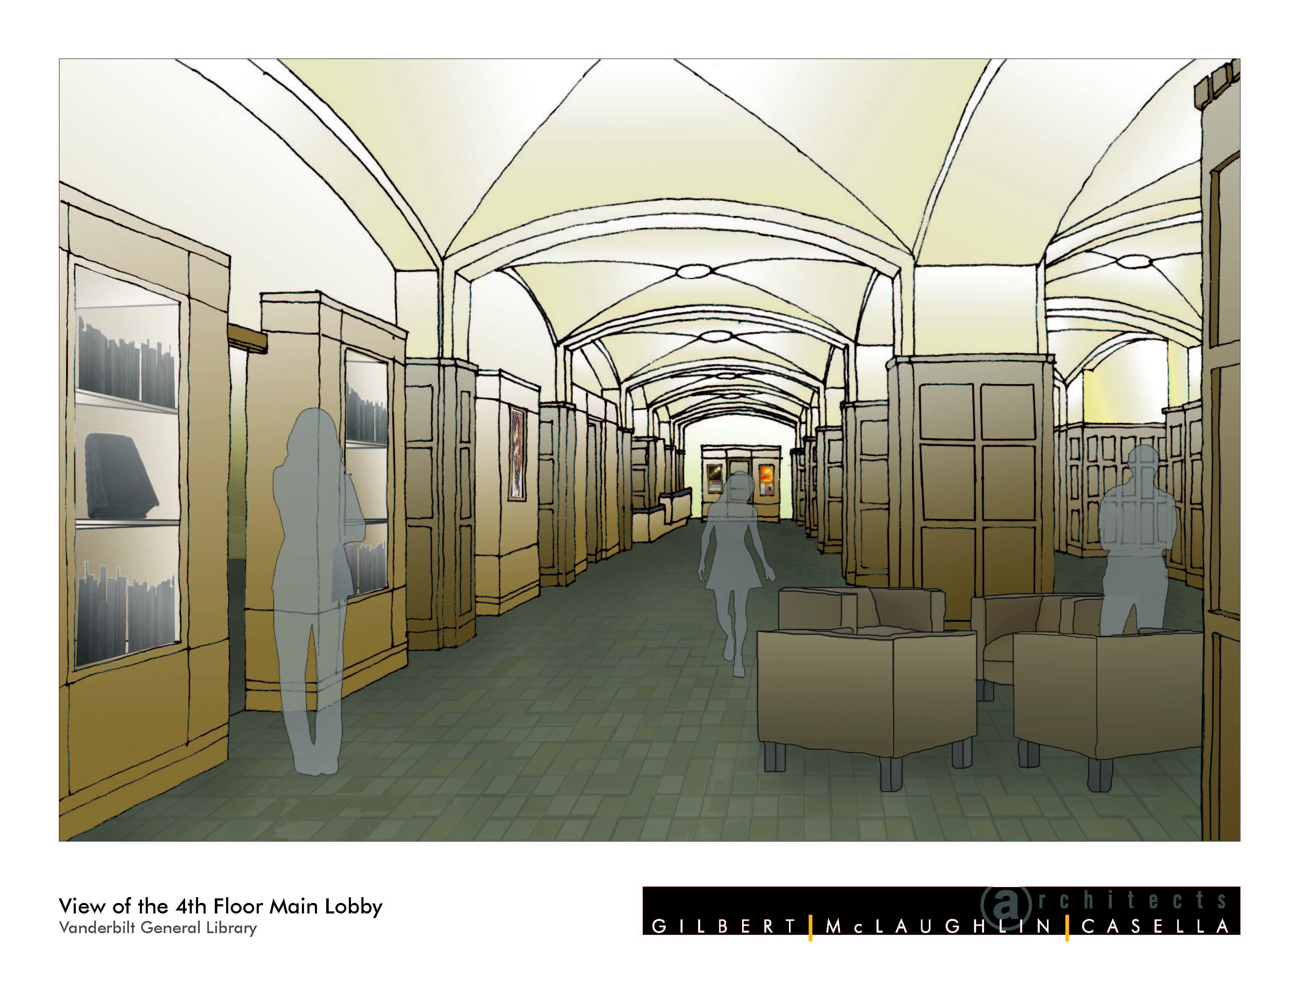
Notes:
Our goal was to create cases that would be safe and secure, while providing the flexibility to showcase a range of collections, all within our budget.
My first step was to call on my colleagues whose collections we might like to borrow: archives, museums, and libraries. What standards did other university libraries have for their exhibition programs and what would they expect when considering loaning an object to us? (Yale, Harvard, Emory, NYPL, and UCLA libraries). Their concerns centered on heat, humidity, light, dust and security. The highest standards I found were: a constant 68 degrees plus or minus 2 degrees; 45%RH plus or minus 5%; and 5 to 10 foot candles on all objects as well as limits to one air exchange/day to maintain a balanced microclimate.
I also spoke with local museum curators, checked websites of larger lending museums like the Smithsonian Institution, and consulted with art conservators and conservation websites. A bibliography of some of the best sources I found for case standards is attached to the end of this presentation.
We found that the best solution for us was to build the cases locally with MDF (medium density fiberboard) with low VOC glues. [Volatile Organic Compounds] We also chose to build some cases to higher specs than others to allow for, again, flexibility within the program and still stay within our budget. All cases would be safe for the objects, but the pedestal cases would be designed to address all of the issues outlined by the academic libraries, so that we could use them for loans and very fragile objects.
Exterior surfaces were veneered. Inset cases, depicted here, open at the front or back depending on the width of the case (larger cases open in the back). We rejected the initial recommendation for cases with glass fronts that had to be removed with suction cups—far too dangerous and limits access for quick fixes, like a label that might fall over. This was a challenge for the architects and required a number of re-works before we got the cases to an acceptable design. I have to note here that our architects—Gilbert McGlaughlin—were invaluable resources for the exhibit program and the design they developed is attractive, safe and functional. The only disadvantage of the back door cases is that they require 2 people to place objects but that is far better than the alternative.
All cases were lined with Class A fabric that is archival and flame retardant, to meet both standards with padding behind the backs to allow us to pin objects to the backing. The inset cases contain moveable 3/8 inch tempered glass shelves. The architects looked at the stress levels of the tempered glass and built a special two-prong support peg to hold the heaviest objects on the shelving. All cases were filtered from ultraviolet light with film on the inset cases. Inset cases were designed with tamper-resistant screws and locks with wireless asset tags to alert Central circulation staff to motion. Security cameras were installed in the exhibit areas.
We worked with lighting consultant Lori Roper who helped us reach a good balance between the lighting needs of the library and those for the exhibits, balancing Illuminating Engineering Society standards with those recommended by conservators. For the inset cases, we used a fluorescent fixture mounted above the display case along with two adjustable, dimmable LED fixtures mounted to either side of the case face to avoid a central dark space. This allowed us to adjust lighting for different objects and different events. Because light damage is a result of light levels over time, we have the option of keeping the lights low most of the time but pumping them up for opening events.

Slide 12
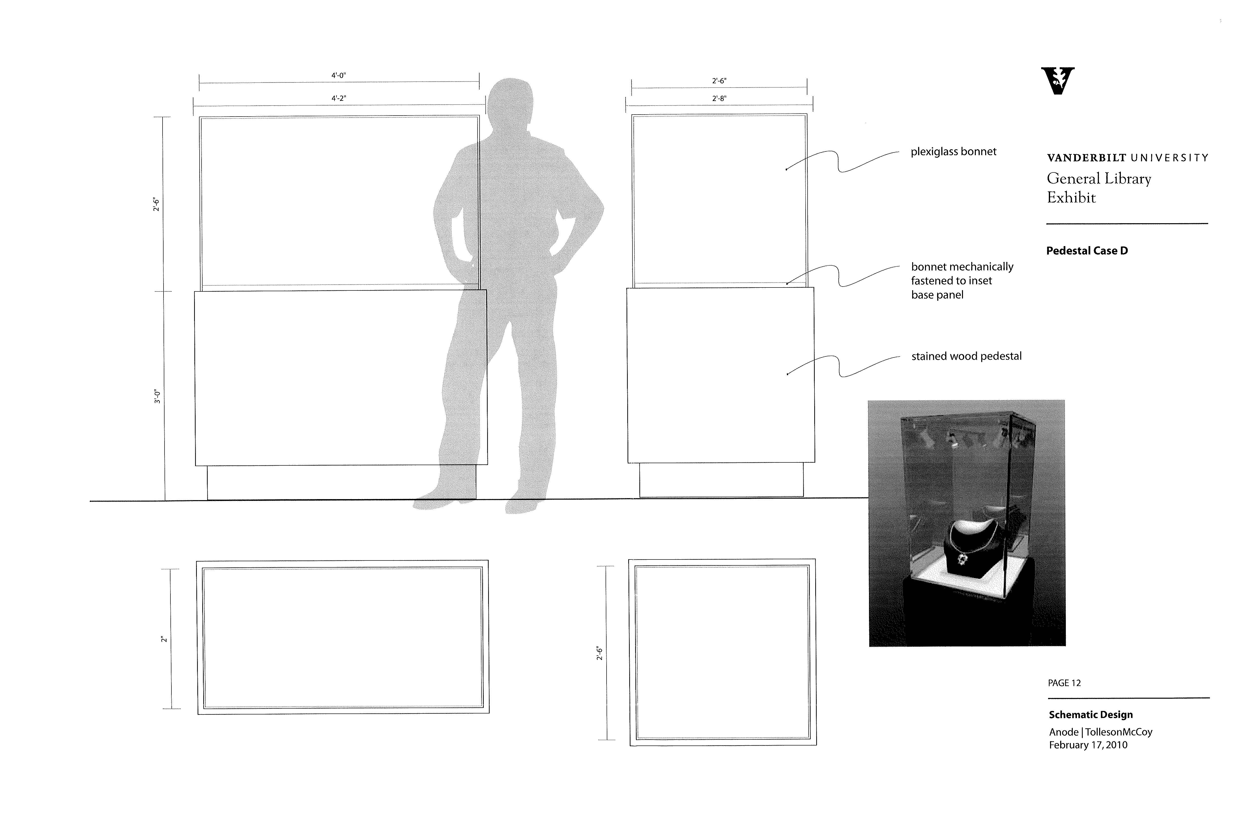
Notes:
Pedestal cases were made in two sizes: 30” square and 24” x 48” to give us flexibility in the types of materials displayed. We wanted to allow for the unobstructed display of some very long items like an accordion fold out book, but we thought that the 30” squares would accommodate most topics in jewel-box like presentations. Pared with the inset cases, the pedestals allow us to offer a “sidebar” for a larger exhibit topic.

Slide 13
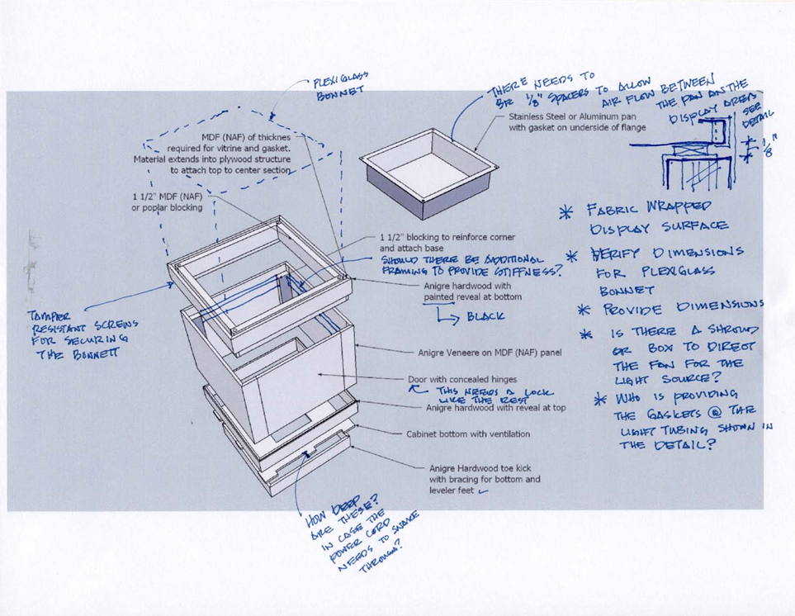

Cases
Standards
Security
Flexibility
Notes:
Because we could not control the air exchange in the built-in cases, we selected higher archival standards for free-standing pedestal cases to allow for the most stringent loan requirements, including air exchange limitations, controlled with a neoprene gasket seal. Pedestal cases contain top drawers for Art –Sorb desiccants.
For the pedestals, we used a fiber optic light tub with adjustable wands made by Visual Coral. A kick-toe was built into the bottom with hidden reveal to provide ventilation for the fans which cool the light motors.

Slide 14
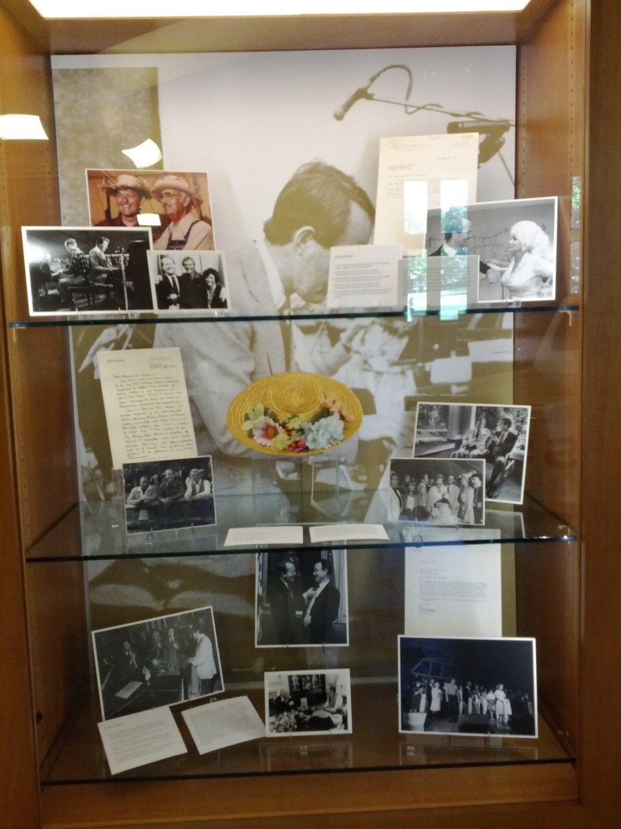
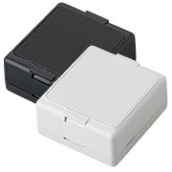
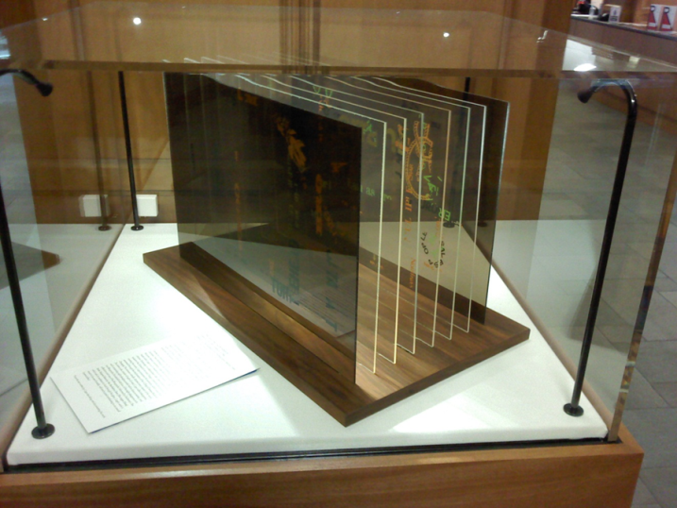
Cases
Honeywell wireless asset tags
Notes:
Bonnets were made with 3/8 inch OP3 UV filtered Plexiglas by Precision Plastics out of Maryland. We chose to bump up the specs from ¼” plexi to 3/8” to give the bonnets more stability and more of a professional look. The extra thickness did not increase the weight appreciably. Four additional 20” high bonnets would be available to swap out with standard 32” high bonnets, along with (2) 50” high bonnets. This would give us flexibility to display anything from a hanging scroll to a Faberge egg. Two people can lift the tops, though we have used three or four for the oversized bonnets on the larger cases. Bonnets are attached with tamper-resistant screws and contain wireless asset protection tags.

Slide 15
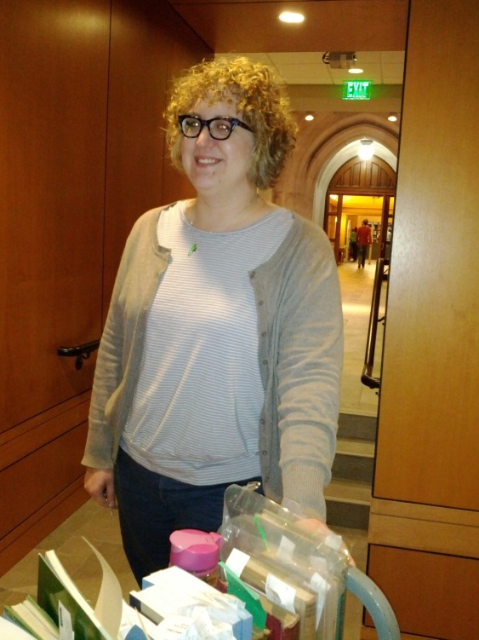
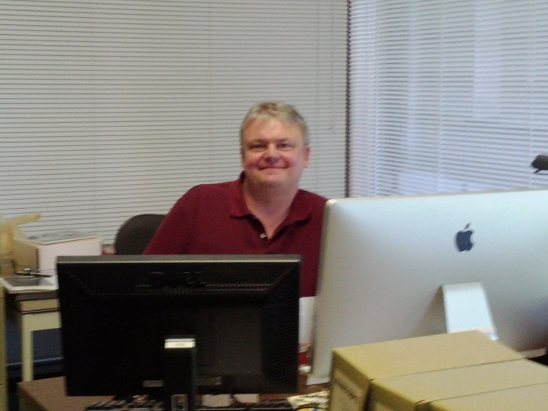
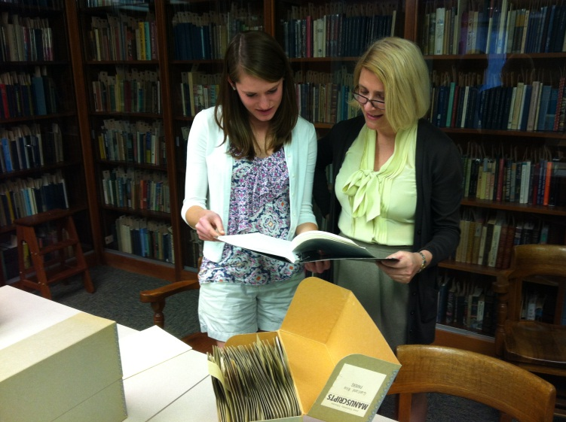
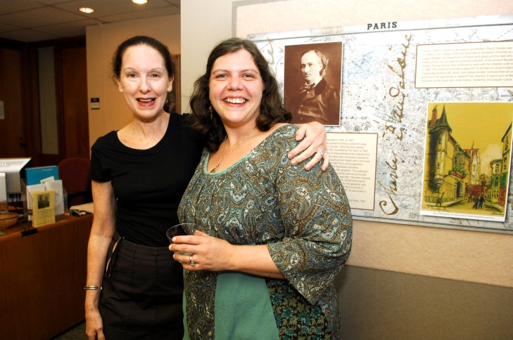
Exhibits Team
Digital Exhibits Manager = new position
Preparator =
Collection Assistant
Graphics =Digital Imaging Specialist
Registrar = Cataloguer
Curators =
Subject Specialists
Faculty
Students
Notes:
Museums have expert installers, record keepers, communications staff and content providers to build exhibits—we did not. And so I tapped a number of staff who I knew to have the skills I would need for the project. I found a ready staff who were interested in supporting this new system-wide effort and possibly learning a few new skills. Charlotte Lew, the Divinity Library Collection Assistant, I knew to have worked in the preservation department building box supports for fragile books. She definitely knew her way around a mat cutter and, more importantly, had a sincere appreciation for fragile objects. She became our preparator. Charlotte advised on object supports, cut labels and ordered supplies. She also worked with me on the actual installation. My graphics position was filled by Henry Shipman, the Digital Imaging Specialist in Special Collections, who provided visuals for all of the interactives, sized the files for our needs, and built some of our displays in PhotoShop. I knew that Henry had a visual arts background and PhotoShop experience. A number of other staff would be tapped for installation help.
For curatorial staff, I drew from the subject specialists brain trust here at the library, inviting them to take one of the case topics that related to their area of expertise to select and interpret text in about 2 months time. This allowed me to cover 5 of the 7 inset cases with “consulting curators” and it gave the bibliographers the chance to do some original research in their areas of specialization in the archives. It became a win-win situation, and some of those subject specialists are using primary sources found in their research in their instruction. My thanks go to all of them.
Many of these librarians had created exhibits in the past using stacks materials; using special collections material was new to some as their emphasis had been to expose students to circulating materials. We also had to work on research procedures in Special Collections—for some who had not worked in that area they had to learn how to handle fragile documents and how to record where they found things so that they could find them again and properly cite them for label copy.
We had some debates about label copy. The focus of the exhibits was intended to be popular and educational but the staff were trained to write for an academic audience. Here again is the importance of knowing our audience. I think we struck a good balance, with text that appeals to a broad audience and still provides academic information for students and faculty.

Slide 16
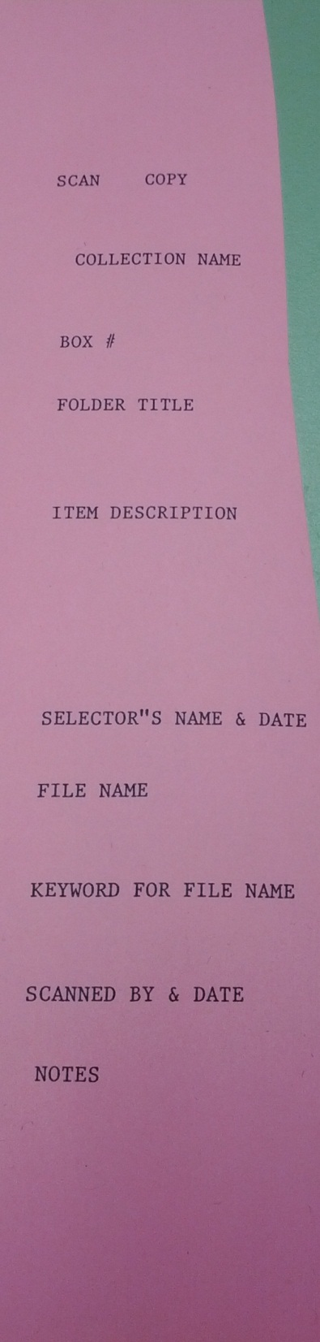
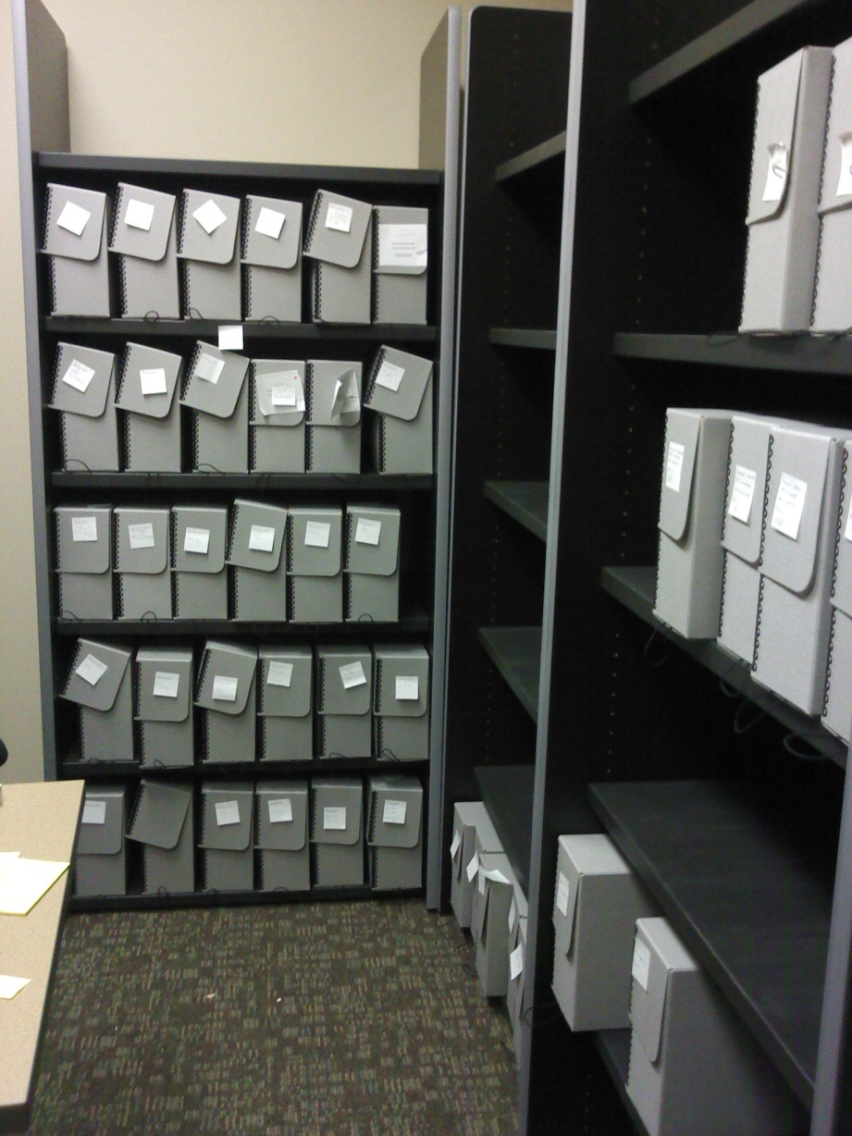
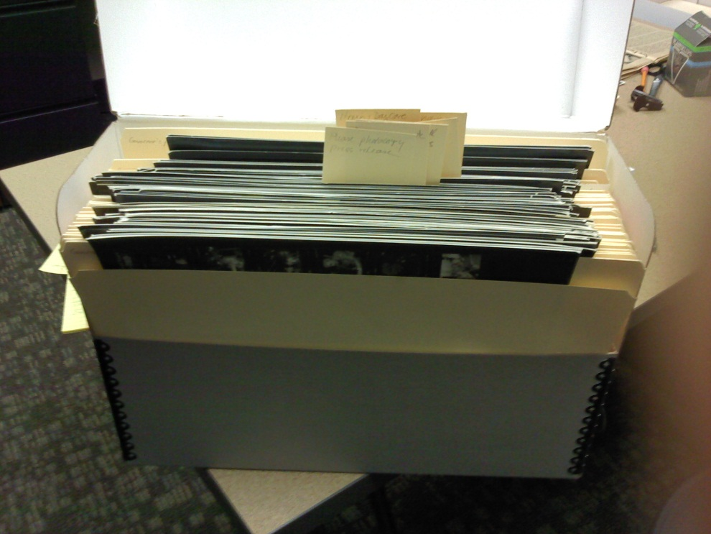
Selection
Notes:
This is a view of the processing room that we added with the construction. It’s proved to be very helpful for viewing materials without disturbing other patrons. Here you see some of the boxes that contain materials that have been scanned for the fall 2011 exhibit.
We developed a working system for capturing potential materials for the exhibits. To identify the broad theme for the exhibit, Kathy and I went through the collections and took snapshots with my phone camera, then downloaded those to my computer to have a working set of images to finalize the overall topic, identify themes and case topics. Once these were selected, we began to search through the materials for strong candidates for inclusion. Those were flagged in boxes and sent to Henry, our scanner. He created folders for each of the exhibits and scanned Tiffs, converting those images to JPEGS for me to use while building the exhibit.

Slide 17
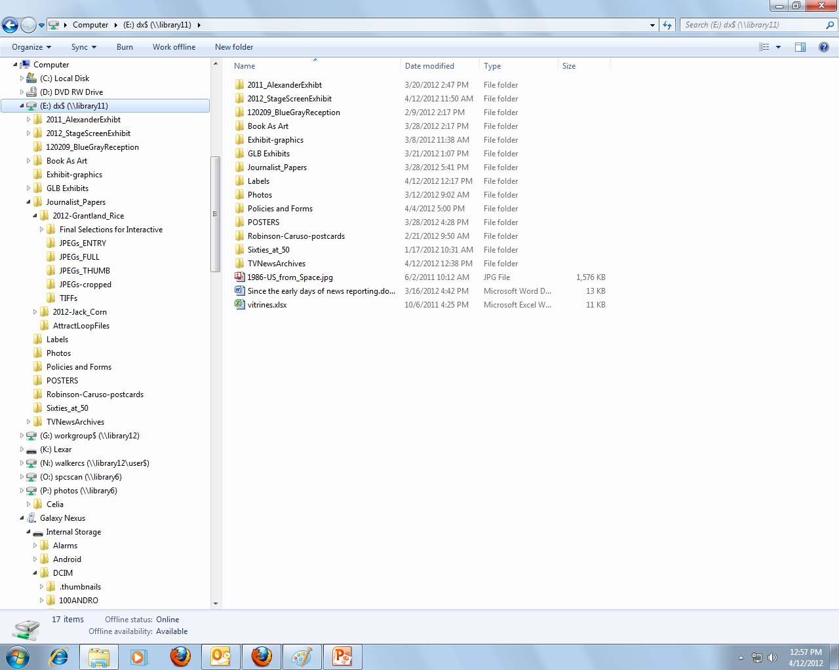
Notes:
In 2012, we hired a digital projects manager and she had the idea to dedicate a server to the exhibits so that we could share assets easily. With a shared server, a curator can select a film clip and send the request to our film editor by email and he can pull the file off the server and make the selection without having to send materials via interoffice mail or courier.

Slide 18
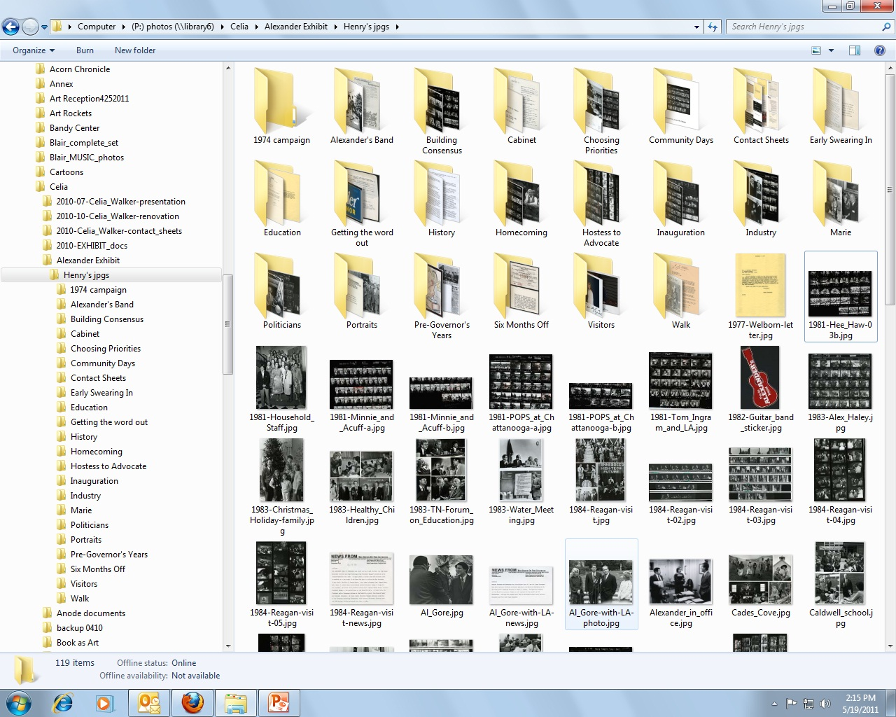

Notes:
We ended up with a selection of images that I drag and drop into their case folders and then pull out to virtually place them within the cases. Some of the extra images that don’t fit into the cases will be added to the interactive to fill out the story beyond the physical limits of the cases. Items were selected based on a number of criteria, including relation to topic, significance, visual appeal, rarity and, of course, condition. Selected objects too sensitive to display were reproduced.

Slide 19
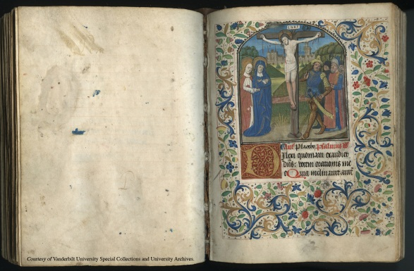
Excel Entry Sheet
Exhibit | Object Author | Object Title | Object Medium | Object Date | Collection | Folder | Call# | Scan? | File Name | Caption (max 60 words)
Early Printing | printed by Anton Koberger | A leaf of the Liber chronicarum : a folio of the Nuremberg chronicle | manuscript | 1483 | Nettie Hale Rand Collection of Fine Bindings and Printing |  | CE53 .S336 1932
Early Printing | Catholic Church | Book of Hours [Horae beatae Virginis Mariae ad usum Romanum] | Manuscript on vellum. Roman script. Headings in red and gold; initials in gold on blue; twelve miniatures. | 1480 | Nettie Hale Rand Collection of Fine Bindings and Printing |  | BX2080 .C37 1480
Bookmaking | Loyd Haberly | The crowning year and other poems | Bound in orange leather, back with raised bands and letters: POEMS tooled in gold; front cover has on outer edge a single fillet, within which is a Maltese cross, at each corner, two square panels at upper end, and two oblong ones at lower, formed with fillets intersected near center by a crown ornamented with crosses, dots, squares, fleurs-de-lis, and pointillé. | 1937 | Nettie Hale Rand Collection of Fine Bindings and Printing |  | PS3515 .A125 C7 |  |  | Colophon: "One hundred & fifty copies of this book have been printed in the Paradiso type designed by the printer and Graily Hewitt from that used by Numeister, Gutenberg's errant apprentice, for the first printing of Dante's poem." Printed in red ink, with a tail piece in black.
Bookmaking | Robert Bridges: with wood-cuts from designs by Edward Burne-Jones. | Eros & Psyche; a poem in XII measures, | Bound in white grained leather, back in gilt tooled panels, front side with gilt tooled round ornament, consisting of central flower surrounded by four butterflies, gilt top, uncut edges, pull-off case of boards covered with white linen. | [Newtown, Mont., Wales] Gregynog, 1935 | Nettie Hale Rand Collection of Fine Bindings and Printing |  | PR4161 .B6 E7 1935
Notes:
We found that we had trouble tracking the images with the descriptions the curators jotted down in their notes and so we devised a simple Excel entry sheet. I use a similar system for other digital projects and have found it useful for the search capabilities of Excel.
What systems have you all found to be useful for selection?

Slide 20
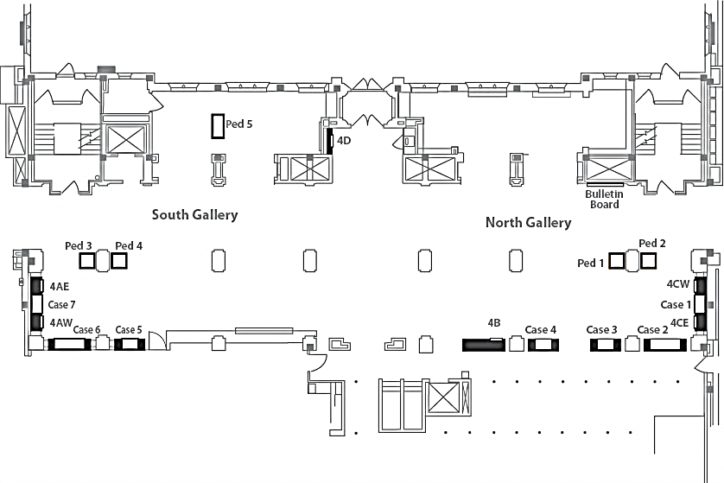
RADIO
Interactive
THEATER
(Ryman Programs, Grand Tour Programs, Theatre, A. Woollcott)
Patsy Cline
Lula Naff
Geraldine
Fararr
Marian
Anderson
Music Boxes
& Schnaufer
Interactive
OPERA
THEATER
Early TV
Interactive:
- Country Music
- Radio
(Sign in book WSM, Naff Letters, Music Boxes)
Opry & Country Music
MUSIC
Performance
Caruso,
Gramophone
Opera, Met Tours
Interactive
MUSIC
WSM Radio
Interactive-AV:
- Country Music
- Radio
- Opera
(Jack Hurst, Judge Interviews, E. R. Murrow, C. Gramophone, Schnaufer)
4th FLOOR GALLERY
Notes:
We also use PowerPoint to layout objects on the floor level and on the case level.

Slide 21
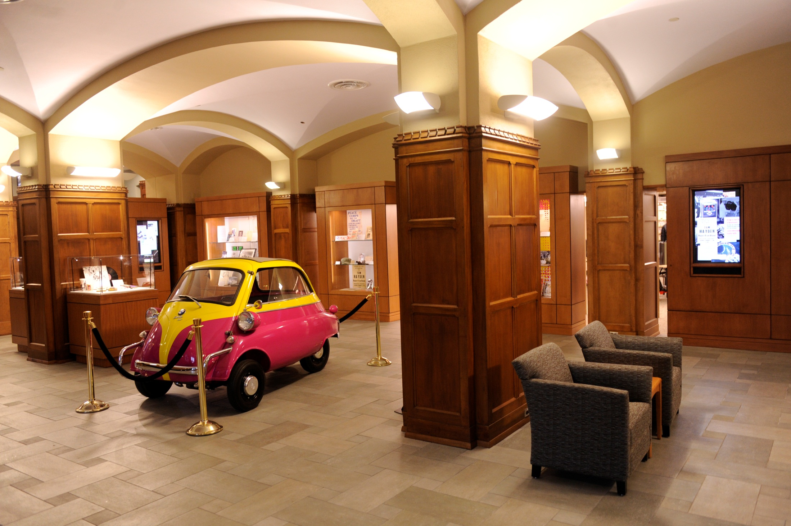
Notes:
Of course, we wanted a show with visual appeal and a row of documents is not always very interesting. We found that it was helpful to borrow some 3D artifacts from collectors and public collections. Of course, this required forms and paperwork, something to have on hand for any exhibit program. The dean had a wonderful idea of displaying large scale three dimensional items in the lobby, which has proven to be very popular. For the 60s at 50, we borrowed 2 mini cars and a motorcycle from a local automobile museum. We are already lining up large scale items for the next exhibit.

Slide 22
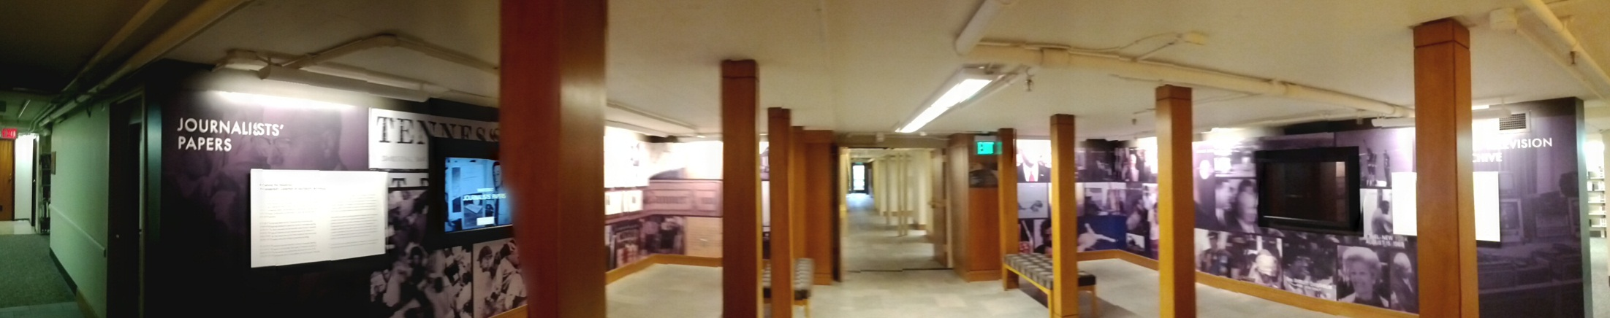
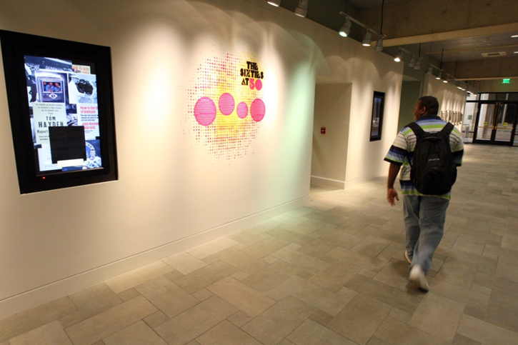
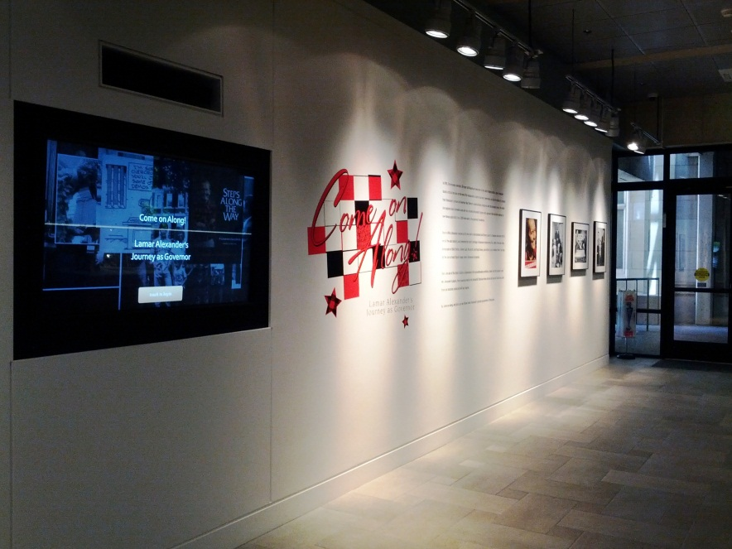
Touchscreens
Notes:
We have seven exhibit interactives on the 4th floor and 2 more in the 2nd floor gallery. These were designed and built by Anode, a Nashville-based firm, in conjunction with our team. Two semi-permanent interactives highlight our Television News Archive database and our journalists’ papers. The other interactives change with the exhibits.
Interactives allow the viewer to see each image as a thumbnail, which they click on, then the see the image at a “full” size and finally they have the option to blow it up to a third size, which essentially fills the screens, so is about 3’ by 2 ½’. This works very well for newspaper print and letters and for items with small details that are hard to see in the case.

Slide 23
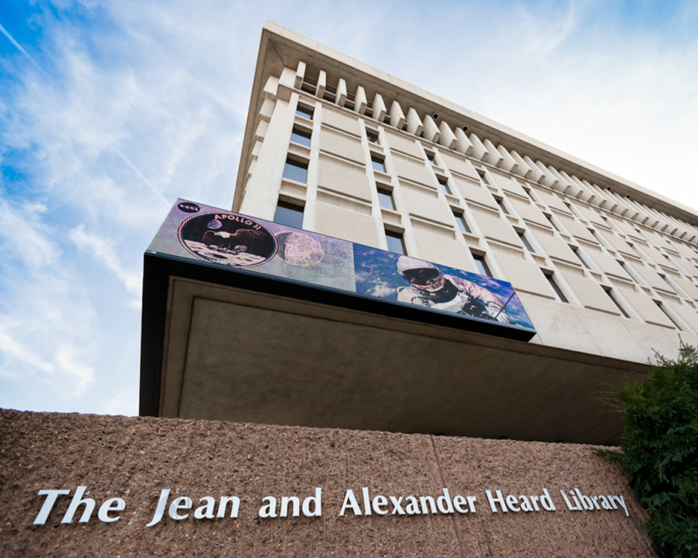
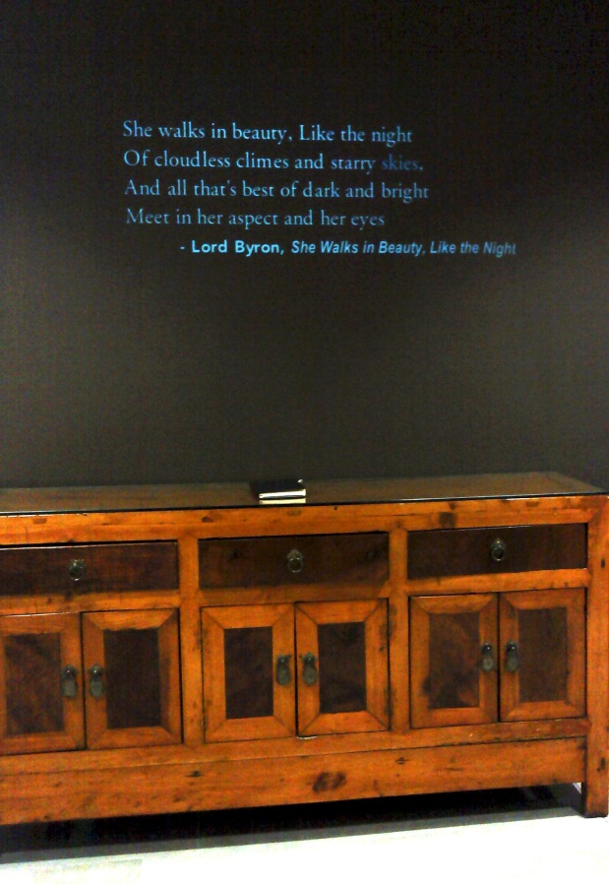
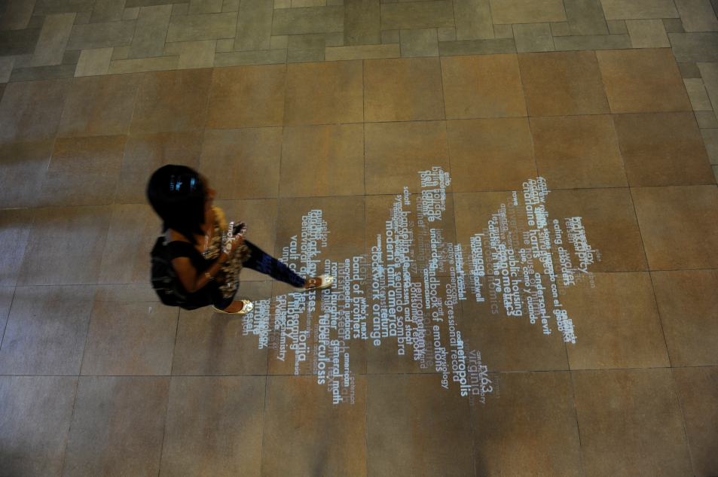
Other Firesign Applications
Notes:
Other Firesign applications include the word cloud in the 4th floor lobby which pulls search terms from the searches generated in our online catalog to form patterns on the floor. A sensor in the ceiling allows the shape to interact with movement like this woman walking through the design. We also have a projection off the 2nd floor gallery that currently contains famous literary quotations. The author and title are intentionally delayed to give viewers a chance to guess who wrote the quote. I think there is a lot of potential for use with this fairly simple technology. In the fall, I’m thinking of pulling quotes from our exhibit subjects to use here. We left out a comment book for viewers to tell us their favorite quotations and we have recently gathered those suggestions for review.
Last but not least is the 5’ x 40’ LED exterior exhibit on the building façade. It rotates images from the exhibits and occasionally contains temporary exhibits of Special Collections items that relate to holidays or events.

Slide 24
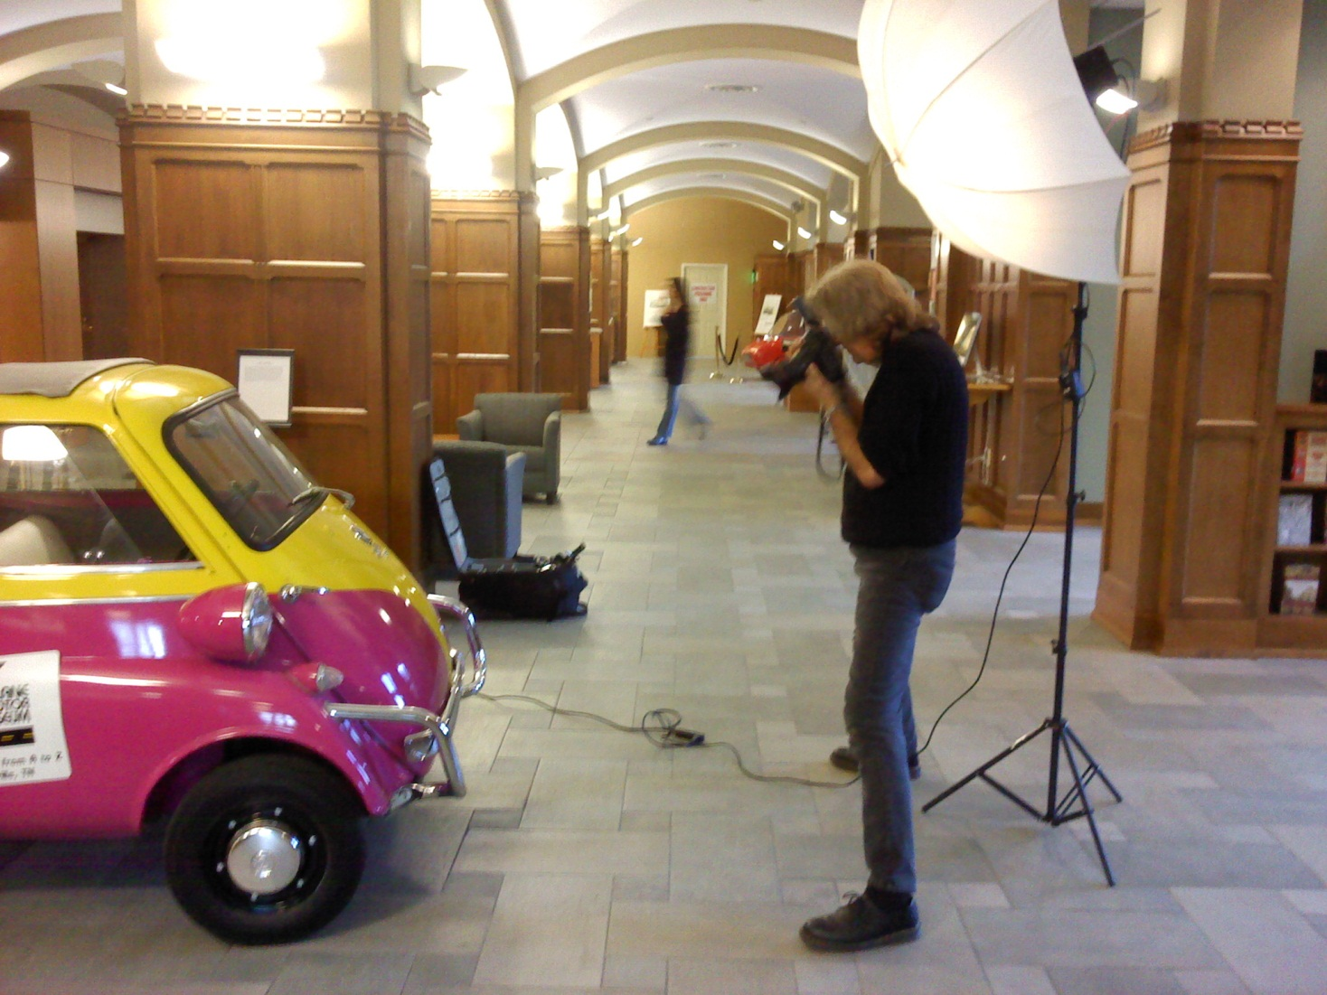
Publicity
Notes:
Here you see Steve Green, Vanderbilt Creative Services, photographing a car for an article. We work with campus public affairs and creative services staff to generate press releases and articles for the exhibits. This would have been much more difficult without the excellent staff at the university. Publicity is one way that we evaluate the exhibit program. We also have comment books at two locations in the library and track tours.

Slide 25
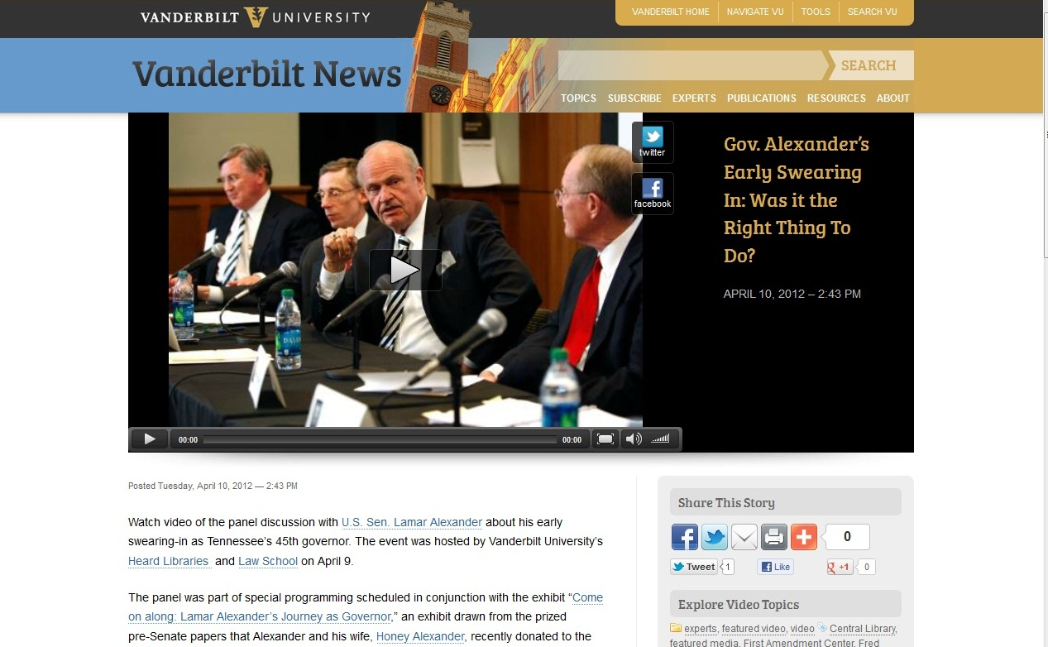
Programs
Notes:
Here you see a recent panel discussion we held in conjunction with the current exhibit. Planning programs to take advantage of the exhibits is ti e-consuming and we have recently hired a person to do all of our events.

Slide 26
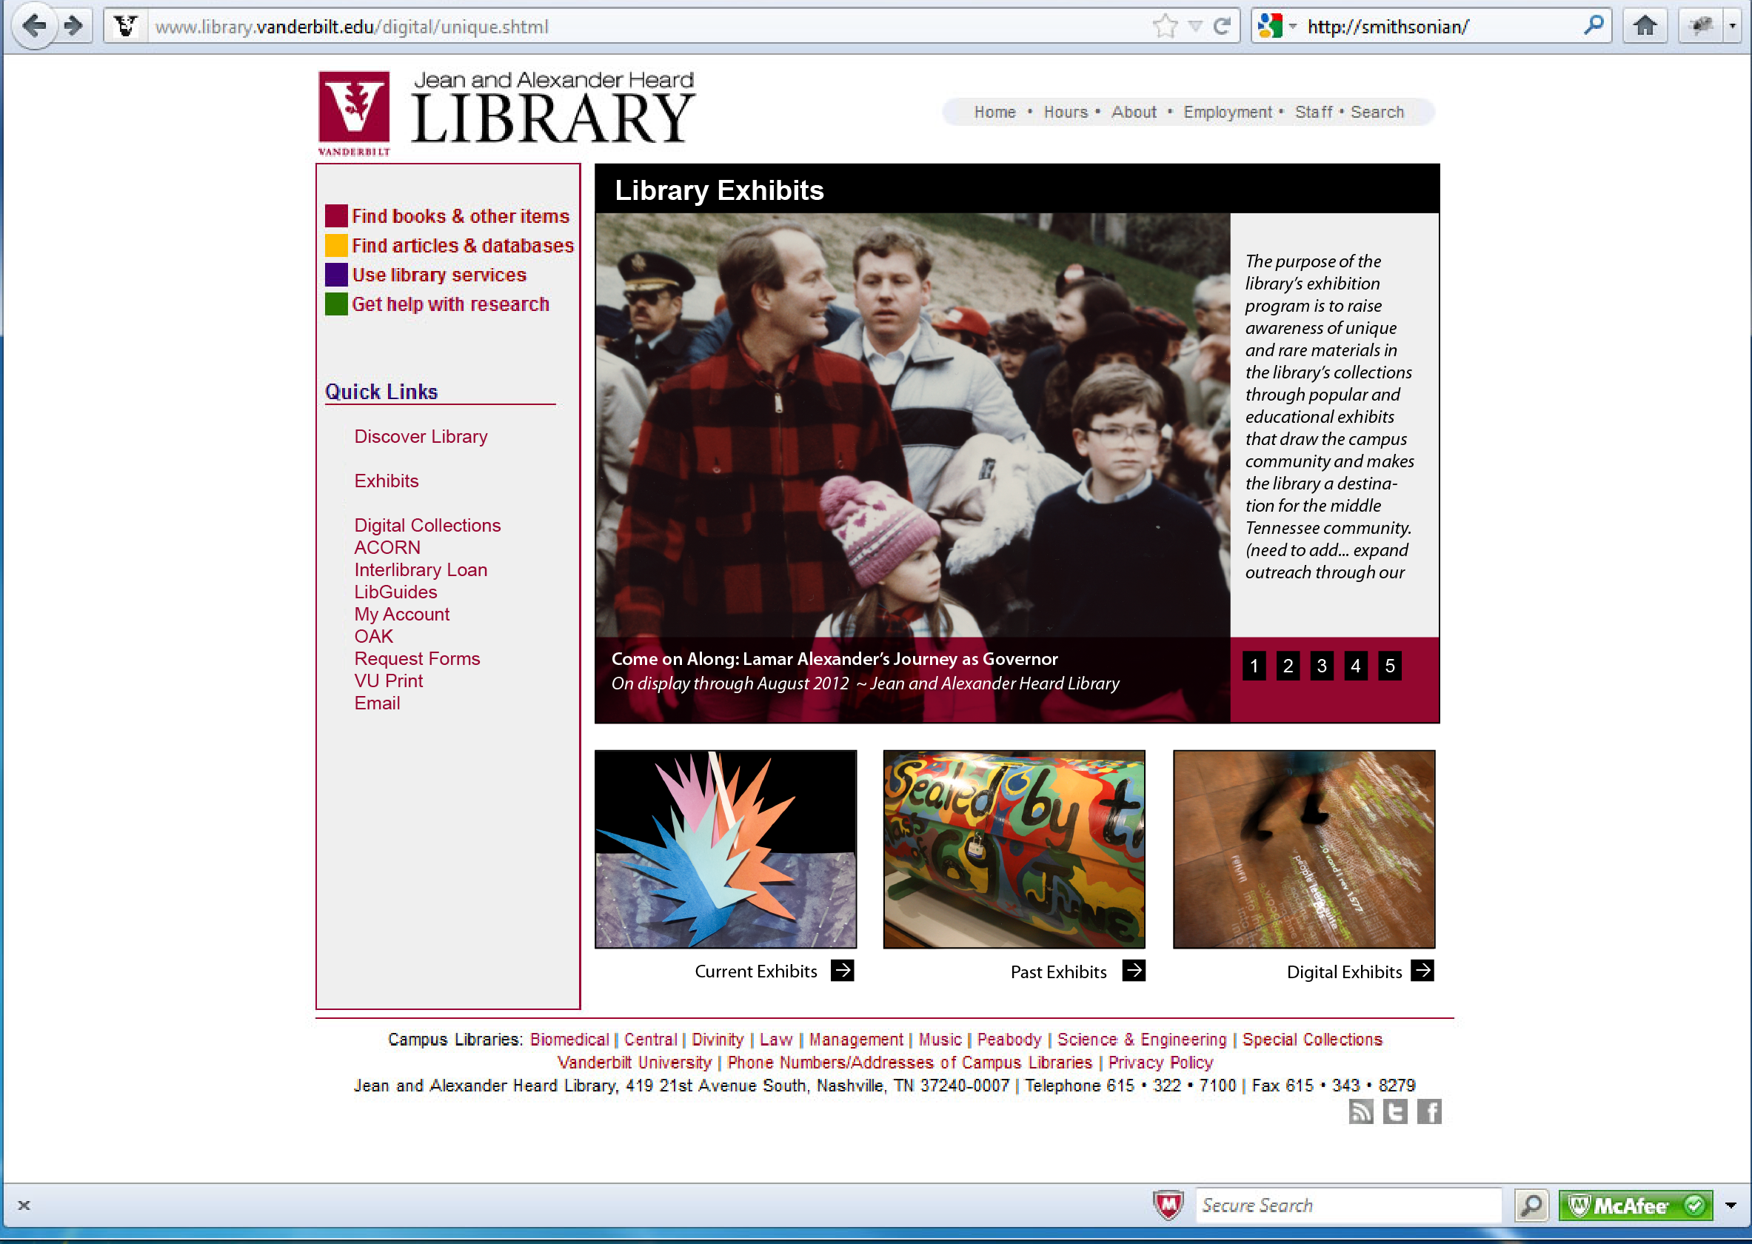
Notes:
We delayed creating a web presence for the exhibits due to time constraints but are now in the final stages of designing the web version. The library is in the midst of a website revamp, so we are waiting for that to finish the layout.

Slide 27
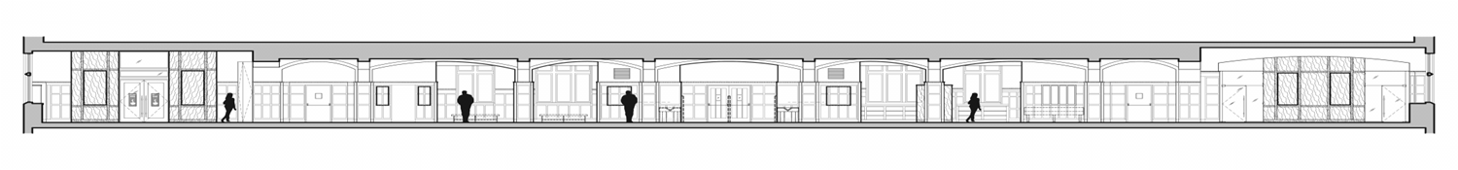
What We Learned
①Success brings requests for collaboration
  Clear mission is critical for exhibit proposals
  Create multi-year plan for exhibits
  Faculty and students can support the program
  Visibility can lead to more in-kind gifts
②Staff are interested in participating and the work supports their instruction
③Evaluation methods: tour counts, comment books, publicity, gate at Special Collections
Notes:
Success brings requests for collaboration
Clear mission is critical for exhibit proposals
Create multi-year plan for exhibits
Faculty and students can support the program
Visibility can lead to more in-kind gifts
Staff are interested in participating and the work supports their instruction
Evaluation methods: needs more work

Slide 28
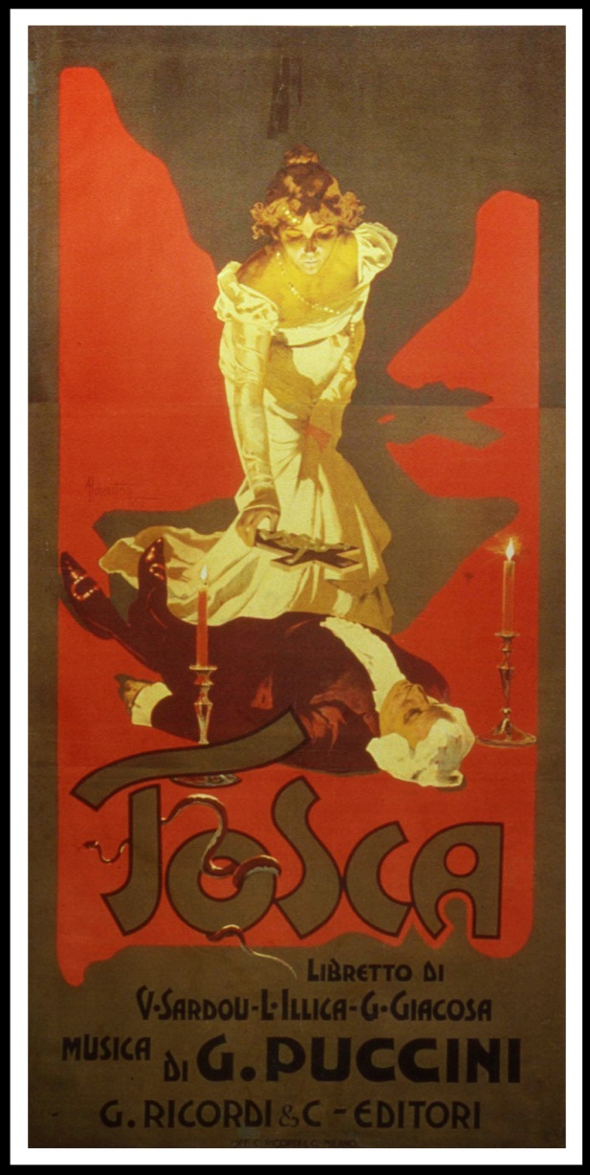
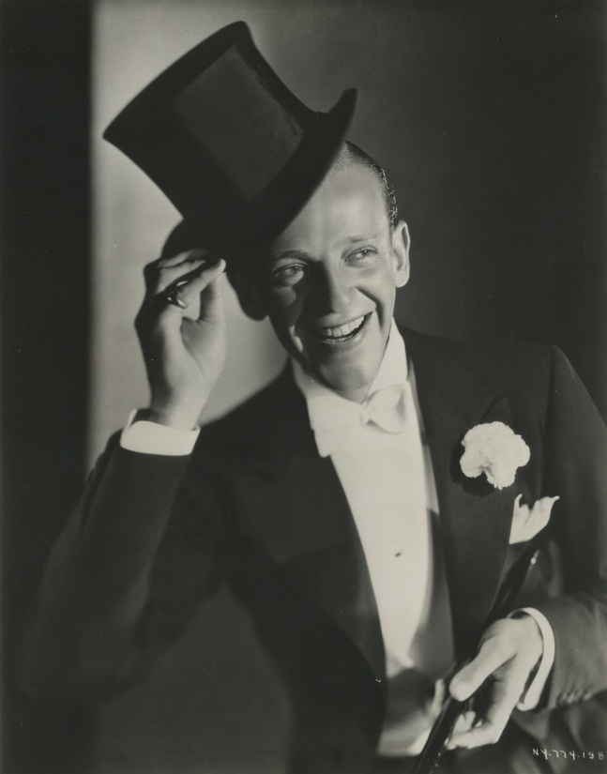
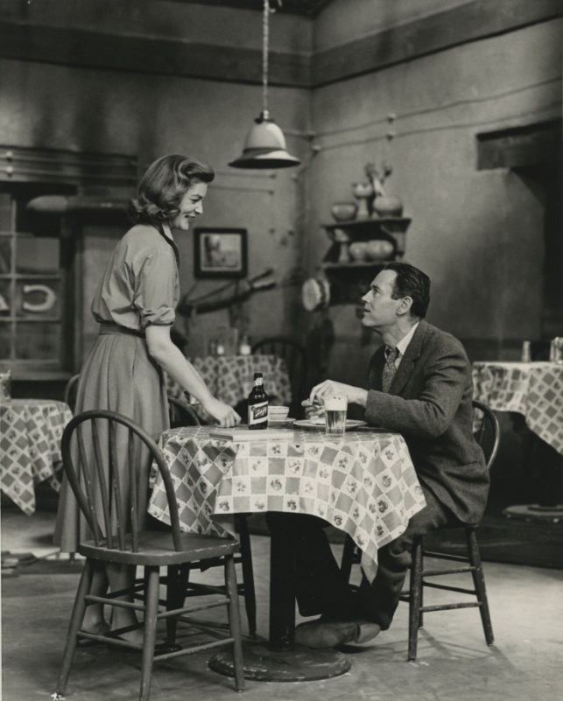
Coming Soon: Stage and Screen

Slide 29
Resources
ANSI/NISO Z39.79-2001, Environmental Conditions for Exhibiting Library and Archival Materials, National Information Standards Organization, 2001 http://www.kb.dk/export/sites/kb_dk/da/kb/nb/bev/Z39-79-2001_Udstillingsstandard.pdf
“Exhibition Standards,” Smithsonian Institution, August 2002 http://www.si.edu/opanda/Reports/EXStandards.pdf
Guidance for Exhibiting Archive and Library Materials, National Preservation Office (2000) http://www.bl.uk/blpac/pdf/exhibition.pdf
“Standards, ”American Association of Museums http://www.aam-us.org/aboutmuseums/standards/stbp.cfm#bp
“Statement of Professional Standards and Ethics,” AASLH (2002) http://www.aaslh.org/ethics.htm
Toby J. Raphael, “Preventive Conservation and the Exhibition Process: Development of Exhibit Guidelines and Standards for Conservation,” Journal of the American Institute for Conservation, Vol. 44 No.3, Fall-Winter, 2005, Available on JSTOR http://www.jstor.org/stable/40025154

