Slide 1
Archival Training Collaborative
Impact Survey
By James Williamson, M.L.I.S
Graduate Assistant
Louisiana State University

Slide 2
Impact Survey Highlights!
Or How I Learned to Stop Worrying and Love Statistics.

Slide 3
ATC Impact Survey:
In which state did you participate in a workshop?
Answer | Response | %
Alabama | 28 | 28%
Mississippi | 27 | 27&
Louisiana | 46 | 46%
Total | 101 | 100%
Notes:
A good group from each state.

Slide 4
ATC Impact Survey:
Gender Demographics
Answer | Response | %
Male | 14 | 13%
Female | 90 | 87%
Total | 104 | 100%
Notes:
As expected

Slide 5
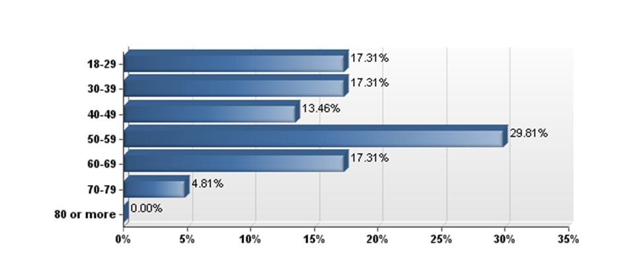
ATC Impact Survey:
What is your age range?
*Note: 104 total respondents answered this question
Notes:
Let’s add a graph for this…

Slide 6
ATC Impact Survey:
What is your status in your institution?
Answer | Response | %
Staff | 66 | 63%
Volunteer | 7 | 7%
Both | 3 | 3%
Student | 14 | 13%
None of the above; I just took the workshop out of interest | 14 | 13%
Total | 104 | 100%
Notes:
Expected more volunteers!

Slide 7
ATC Impact Survey:
Status in a institution compared to the age of the respondents
 | Staff | Volunteer | Both | Student | None of the above; | Total
18-29 | 11 | 0 | 0 | 5 | 2 | 18
30-39 | 11 | 0 | 1 | 6 | 2 | 18
40-49 | 13 | 0 | 0 | 1 | 0 | 14
50-59 | 25 | 2 | 1 | 2 | 1 | 31
60-69 | 5 | 3 | 1 | 0 | 9 | 18
70-79 | 1 | 0 | 0 | 0 | 2 | 5
80 or more | 0 | 0 | 0 | 0 | 0 | 0
Total | 66 | 7 | 3 | 14 | 14 | 104
What is your age range?
Notes:
Note major groups
-staff 50-59
Still had a wide range for the survey

Slide 8
ATC Impact Survey:
Which of the following best categorizes your institution?
Answer | Response | %
Church | 2 | 2%
College or University | 31 | 30%
Genealogical Society | 5 | 5%
Historical Society | 3 | 3%
Local Government | 2 | 2%
Museum | 11 | 11%
Public Library | 17 | 16%
State Government | 3 | 3%
Other | 18 | 17%
N/A-Student | 12 | 12%
Total | 104 | 100%
Notes:
Just to give an idea of who we are deali

Slide 9
ATC Impact Survey:
How long did you travel to attend the workshop?
Answer | Response | %
None | 4 | 4%
Less than 15 minutes | 24 | 24%
16-30 minutes | 20 | 20%
31-45 minutes | 7 | 7%
46 minutes-1 hour | 10 | 10%
More than an hour | 16 | 16%
More than two hours | 21 | 21%
Total | 102 | 100%
Notes:
People are welling to drive for our product
-Louisiana drove less (between 16-30 minutes)
-Alabama drove further (most over 2 hours)
-held at universities( most happen to be two to three hours apart)

Slide 10
ATC Impact Survey:
How much financial support for training did you receive from your institution?
Answer | Response | %
None; I paid my own way | 45 | 44%
Less than half | 2 | 2%
About half | 1 | 1%
More than half but not all | 4 | 4%
All | 42 | 41%
Not employed; I paid my own way | 8 | 8%
Total | 102 | 100%
Notes:
Talk about survey monkey comparison
Manager said they supported over 100 dollars
-For the most part kept their word
45 respondents that paid their own way 19 were students or personal interest people
25% of staff were not paid any amount
Some volunteers received funding but not many
-th

Slide 11

Repository Survey:
How did people receive their training?
Results from the Historical repository Survey
- 38.8% of managers said training came from on-the-job training
-only 10.2% of managers use continuing education workshops
- 35.49% of staff and volunteers said that they were learning from on-the-job training
-only 10.8% said it came from continuing education such as works shops
ATC Impact Survey had respondents said something different….

Slide 12
ATC Impact Survey:
How have you acquired most of your archival training?
Answer | Response | %
Workshops | 41 | 40%
On-the-job training | 22 | 22%
Self education | 17 | 17%
Graduate school | 18 | 18%
Other | 4 | 4%
Total | 102 | 100%
ATC has been a big part of providing a continuing education market for the region.
Notes:
This is different from other survey which said that most received training on the job.
Since the three years of the survey of historical repositories, the market of continuing education workshops has grown in the tri-state area and it seems that more and more people are relying on these workshops for training. The ATC has been a big part in creating products for the market of workshops. The ATC workshops have also shown to be reaching students and personal interest people who may not have access to on-the-job training.

Slide 13
What Type of Workshops were Wanted by Managers
When asked for the topics of workshops managers wanted to attend….
Top 5 Topics from Repository Survey for Managers
  -Arrangement of historical materials 69.4%
  -Digitization 67.3%
  -Description of historical materials 67.3%
  -Exhibits 61.2%
  -Preservation 61.2%

Slide 14
What Type of Workshops were Wanted by Staff and Volunteers
When asked for the topics of workshops staff and volunteers wanted to attend….
Top 5 Topics from Repository Survey for Staff and Volunteers
  -Preservation- 63.2%
  -Conservation- 61.8%
  -Arrangement of Historical Materials 57.4%
  -Digitization- 54.4%
  -Copyright-50%
Notes:
for the most part, the two groups agreed on similar things
Workshops on preservation and arrangement were highly attended but workshops on digitalization were poorly attended. Why?

Slide 15
How the ATC responded
ATC offered several workshops on preservation and conservation( 15 total).
-they were the third highest represented topic in the ATC Impact Survey at 20% each.
Arrangement and processing workshops were the 2nd highest represented workshop topics.
Digitization workshops were offered and suffered low attendance and only represented 14% of workshop respondents .
The ATC did not offer workshops on copyright, though they were requested.
Notes:
ATC trainers played to their strengths. Certain topics were untackled because of a lack of confidence on these subjects.
Topics fell more in line with what managers wanted.

Slide 16
To what extent has your confidence in using the knowledge and/or skills presented in the workshop in the workshop increased as a result of the ATC workshop?
Answer | Response | %
To a very great extent | 10 | 10%
To a great extent | 39 | 39%
To a moderate extent | 31 | 31%
To a small extent | 18 | 18%
Not at all/never/rarely applicable | 2 | 2%
Total | 100 | 100%
Notes:
ATC is building confidence

Slide 17
To what extent have you passed the knowledge and/or skills to others after completing the ATC workshop?
Answer | Response | %
To a very great extent | 4 | 4%
To a great extent | 12 | 12%
To a moderate extent | 31 | 32%
To a small extent | 30 | 31%
Not at all/never/rarely applicable | 20 | 21%
Total | 97% | 100%
Notes:
Knowledge is being passed. Not to a great degree but it is there

Slide 18
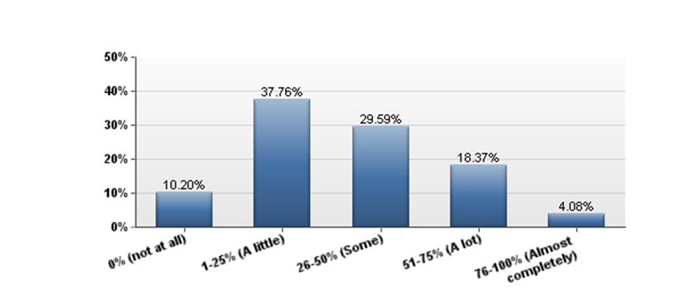
As a result of this workshop, how much has your overall performance changed?
Notes:
Respondent mostly fall between range of 1-50%
Performance change is coming because of ATC workshops

Slide 19
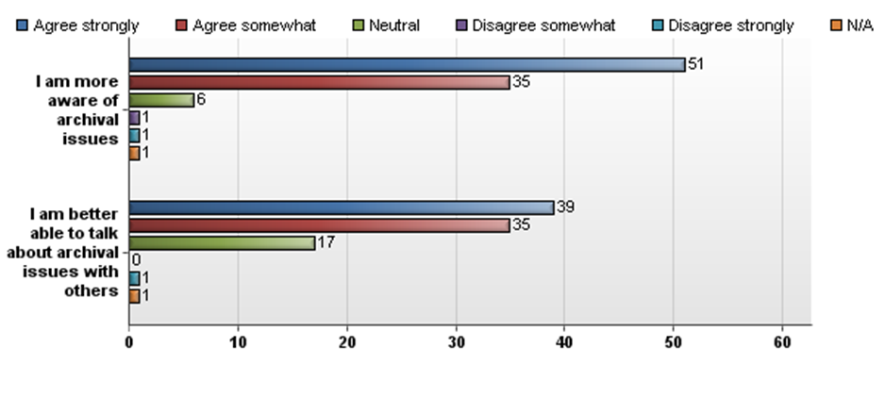
Because of the ATC workshop:
*Note: Bars go down in the left-to-right order of the statements
Notes:
Very few are say negative things about there awareness and ability to communicate about archival issues

Slide 20
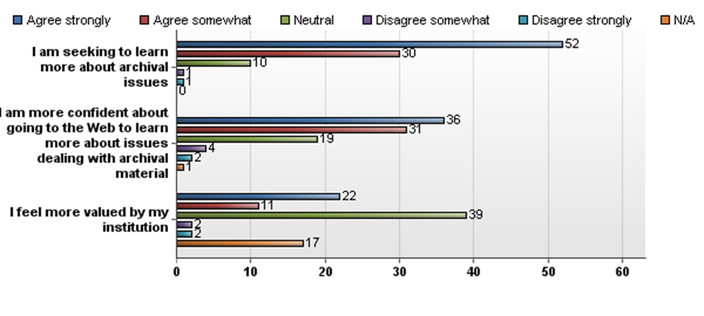
Because of the ATC workshop:
*Note: Bars go down in the left-to-right order of the statements
Notes:
Tell audience
-people are seeking to learn more because of the ATC
-people are confident looking for material on the web
-Some are felling more valued

Slide 21
Comparing ATC Respondents before and after ATC Workshops
9 out of 20 respondents who reported no archival knowledge on the ATC workshop topic say that have a small extent of knowledge afterwards.
  -8 out of 20 expressed that they have not had the opportunity yet to express their new knowledge
19 out of 32 respondents who expressed a small extent of knowledge now say they have a moderate extent of knowledge
10 out of 32 who reported a small extent of knowledge on the ATC workshop topic say that have a great or very great extent of knowledge because of the ATC workshop.
Because of ATC workshop, we are helping many people but not all advance to new levels of knowledge!
Notes:
Respondents are up in archival knowledge
-maybe not to the amount we want but there are progressing

Slide 22
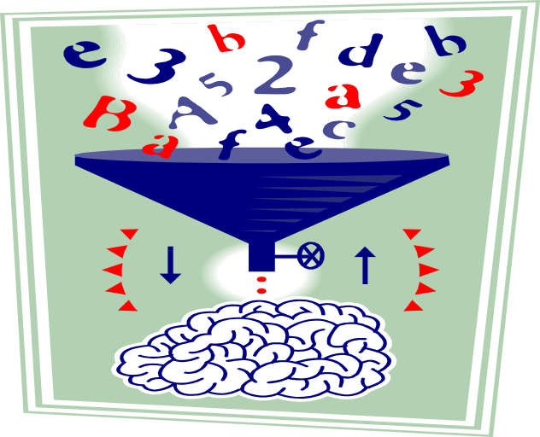
ATC Workshops are having an impact on their participants.
A majority noted some kind of improvement because of the workshops
Confidence has increased among most participants
They are passing the knowledge that they have gained to others to a small or moderate extent
Participants are more aware of archival issues and the ATC has created a desire for more learning
Notes:
We’ll find some typical comments to read to them…

Slide 23
Respondent Comments:
Focused
  “more focused and do-able. Certainly the encouragement and enthusiasm of the presenters made my work/project more approachable...less daunting.”
Awareness
  “made me more aware of problem areas in our environment. Some situations have been resolved completely, others are much better today than before the training.”
Notes:
Indicate question

Slide 24
Respondents Comments: Additional Comments
More work
  “Harder because I now know what needs to be done...no more ignorance is bliss.”
Refresher
  “No. Because I had already been given the information by my supervisor.”
  “Refresher course - re-enforced knowledge and procedure.”
Instructors
  “ I found the instructors to be very knowledgeable and friendly, if somewhat disorganized.“

Slide 25
ATC Workshops Evaluation
The ATC provided over 40 different workshops in the last three years.
Workshop success depended on reaching new and interested people in their area, but people traveled distances as long as the workshop met a need.
Workshops that were more hands on and dealt with physical material such as arranging and preserving paper documents and photographs were appreciated.
ATC workshops focused on topics that trainers felt they had expertise to provide, while missing a variety of topics because of a lack of confidence.
Notes:
Things to say
-reached people beyond our desired audience
-helped people with physical and intellectual task associated with archives
-need to build different strengths

Slide 26
“Before I refuse to take your questions, I have an opening statement. “
-Ronald Reagan

