Slide 1
The 1/8 Rule in Mississippi: Using Difficult Civil Rights Topics in Class Instruction
Jennifer Brannock
Curator of Rare Books & Mississippiana
The University of Southern Mississippi

Slide 2
Civil rights collections

Slide 6
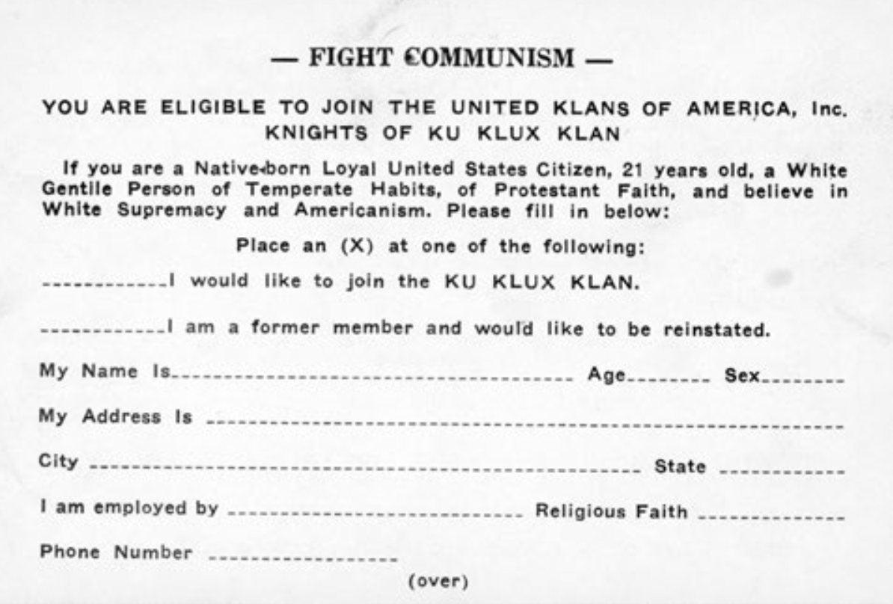

Slide 7
Active learning
Teaching Undergraduates with Archives Conference, University of Michigan (2018)
Librarians Active Learning Institute, Dartmouth College (2019)

Slide 8
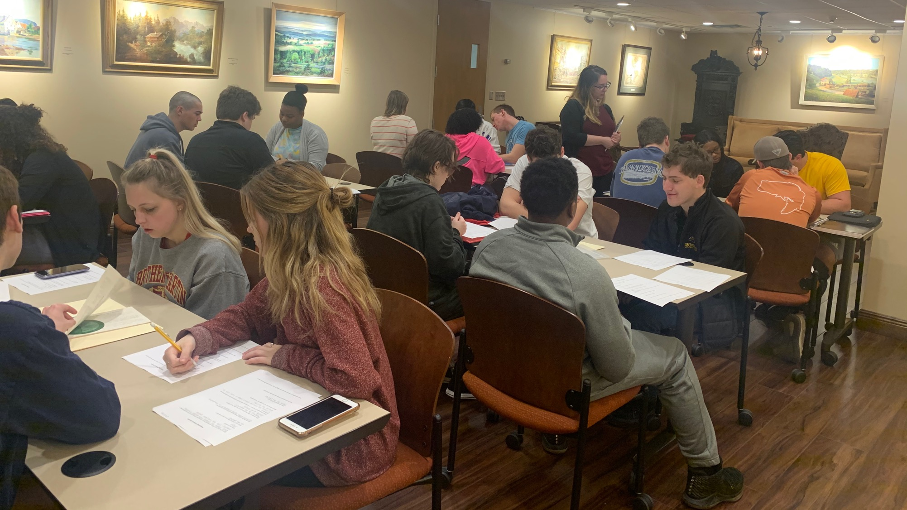

Slide 10
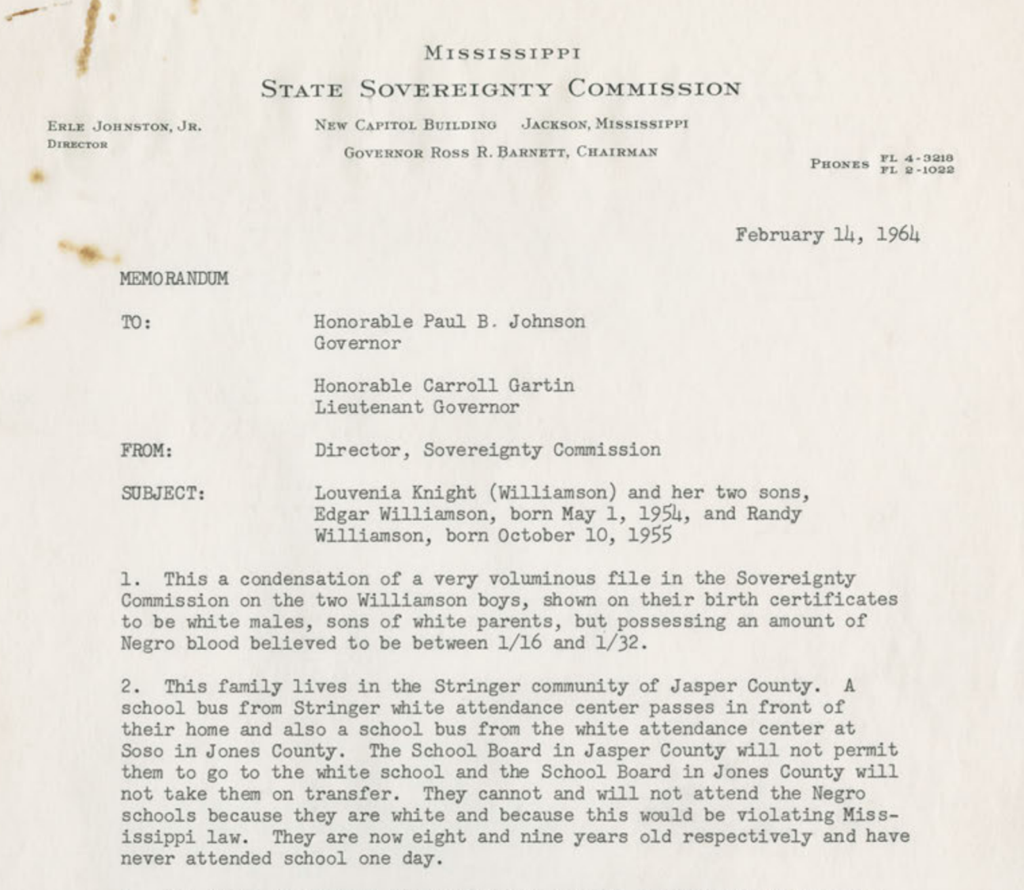
Notes:
Define 1/8 rule

Slide 11
Speed dating
4-6 stations
1 item at each table
Questions to analyze the item
Rotate from table to table

Slide 12
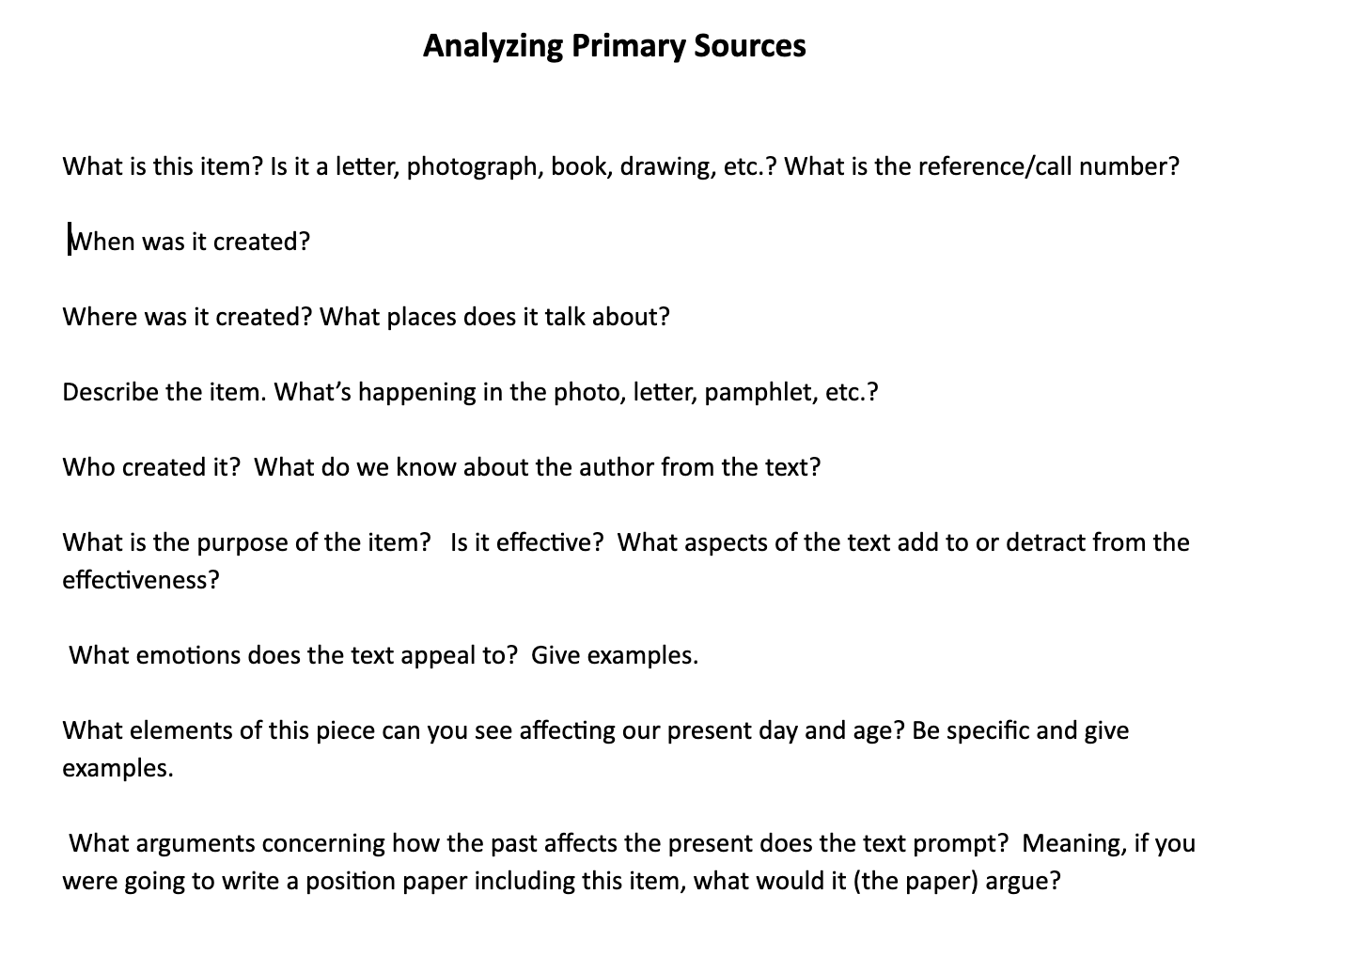

Slide 13
Narrative building
4-6 stations
1 or more documents at each table that represent one part of the story
Students report out at the end.

Slide 14
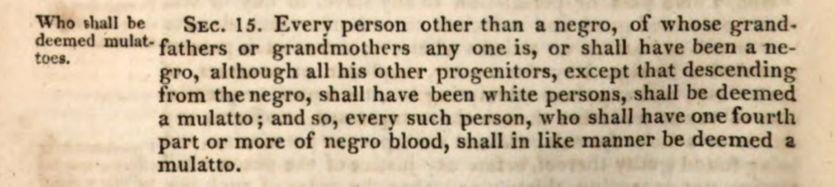
Table 1
The Revised Code of the Laws of Mississippi (1824)

Slide 15
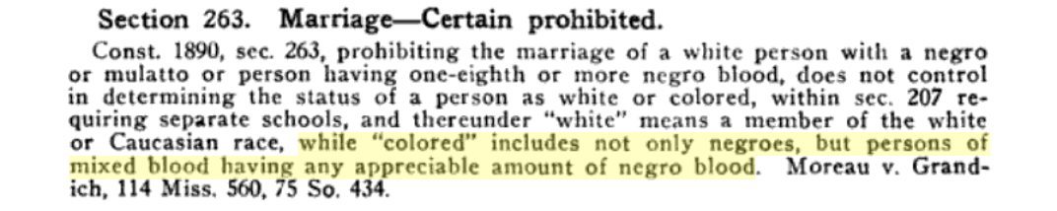
The Annotated Mississippi Code, Supplement of 1921

Slide 16
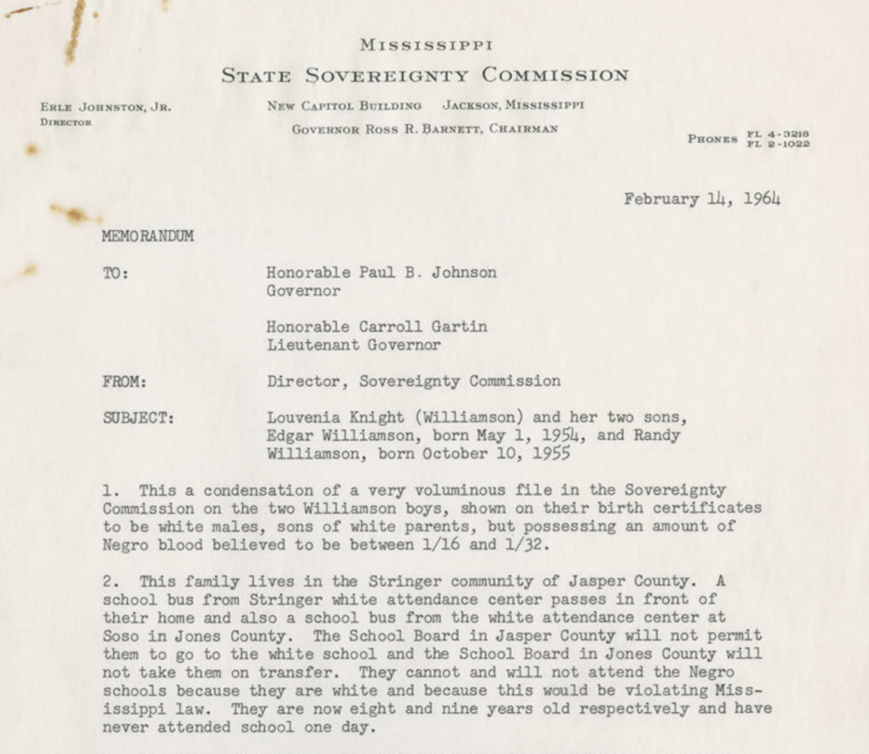
Table 2

Slide 17
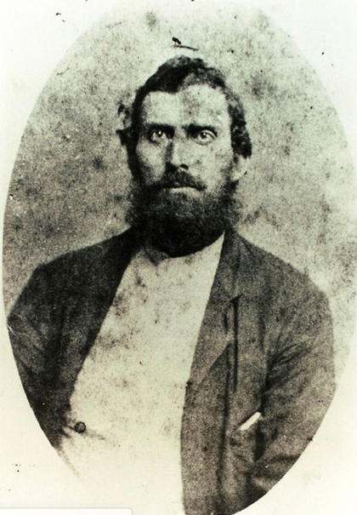
Table 3
Newt Knight Family Tree

Slide 18
Table 4
Memo from the Mississippi State Sovereignty Commission to Governor Paul B. Johnson Jr.

Slide 19
Response from students
“I liked the document activity”
“Loved the activity.”

Slide 20
Questions?

