Slide 1
A CAPitol Idea: Teaching WITH CONGRESSIONAL COLLECTIONS
Kate Gregory, Political Papers Archivist
Mississippi State University Libraries
Notes:
Are your classroom colors different than what you see in this template? That’s OK! Click on Design -> Variants (the down arrow) -> Pick the color scheme that works for you!
Feel free to change any “You will…” and “I will…” statements to ensure they align with your classroom procedures and rules!

Slide 2
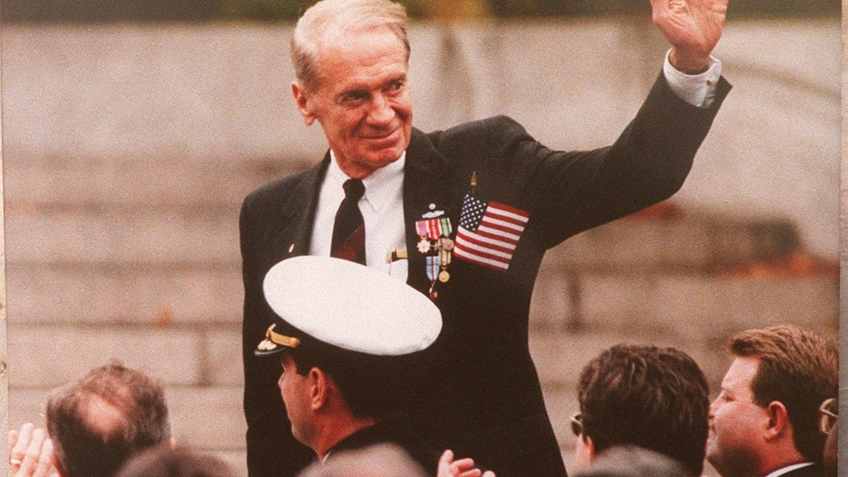
Congressional and Political Research Center
Who we are | Our collections
Division of Special Collections at MSU Libraries, est. November 1999 Mission: Provide research material on individual U. S. Senators and Representatives, the U. S. Congress, and politics at all levels of government and to promote research and interest in government. Coordinator: Ryan Semmes | Local, state, federal, including judiciary Staffers, organizers, constituents Predominantly Mississippi-related
Congressman G.V. “Sonny” Montgomery, GVM Papers, MSU Libraries

Slide 3
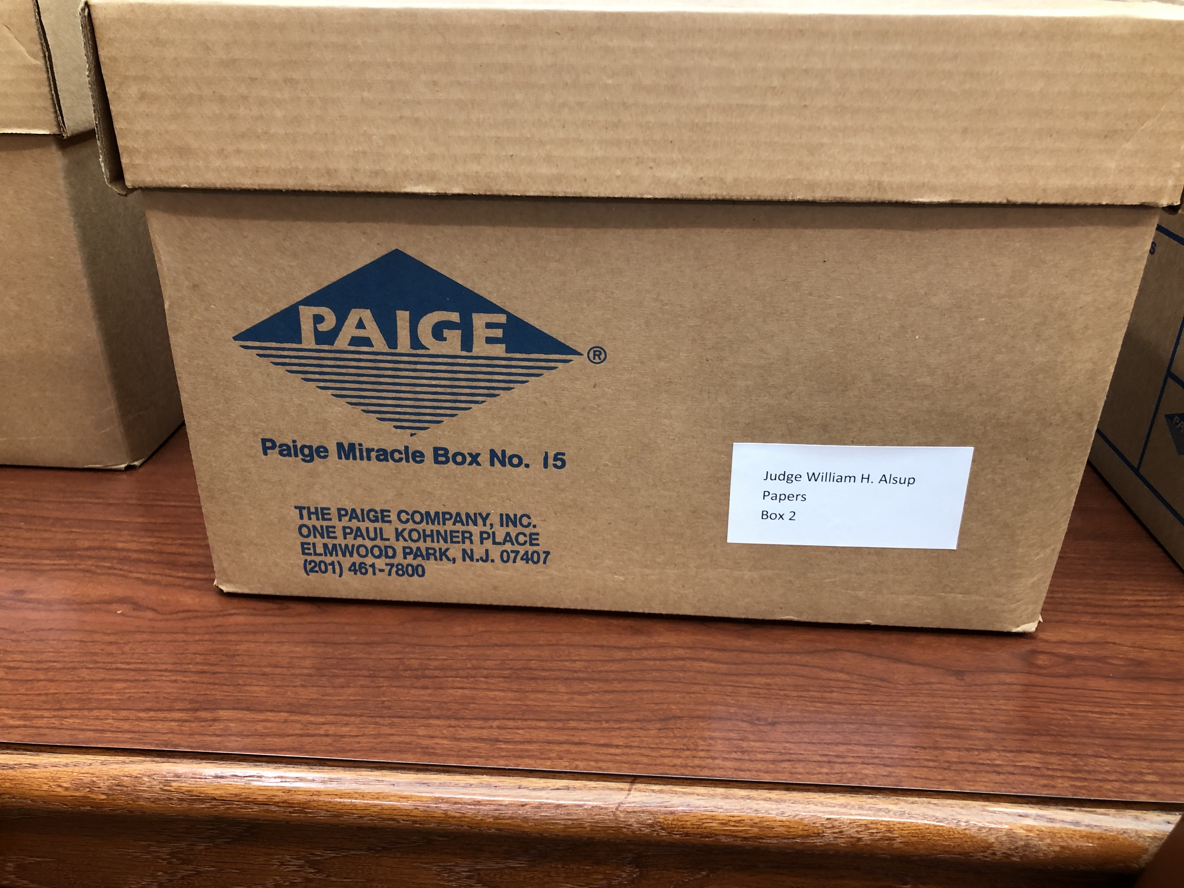
Who do we serve?
Our patrons include
MSU community – faculty, undergraduate and graduate students Academic researchers from other institutions “Oppo” research – campaign consultants Advertisers, journalists, genealogy/general interest Can facilitate up to 30 patrons

Slide 4
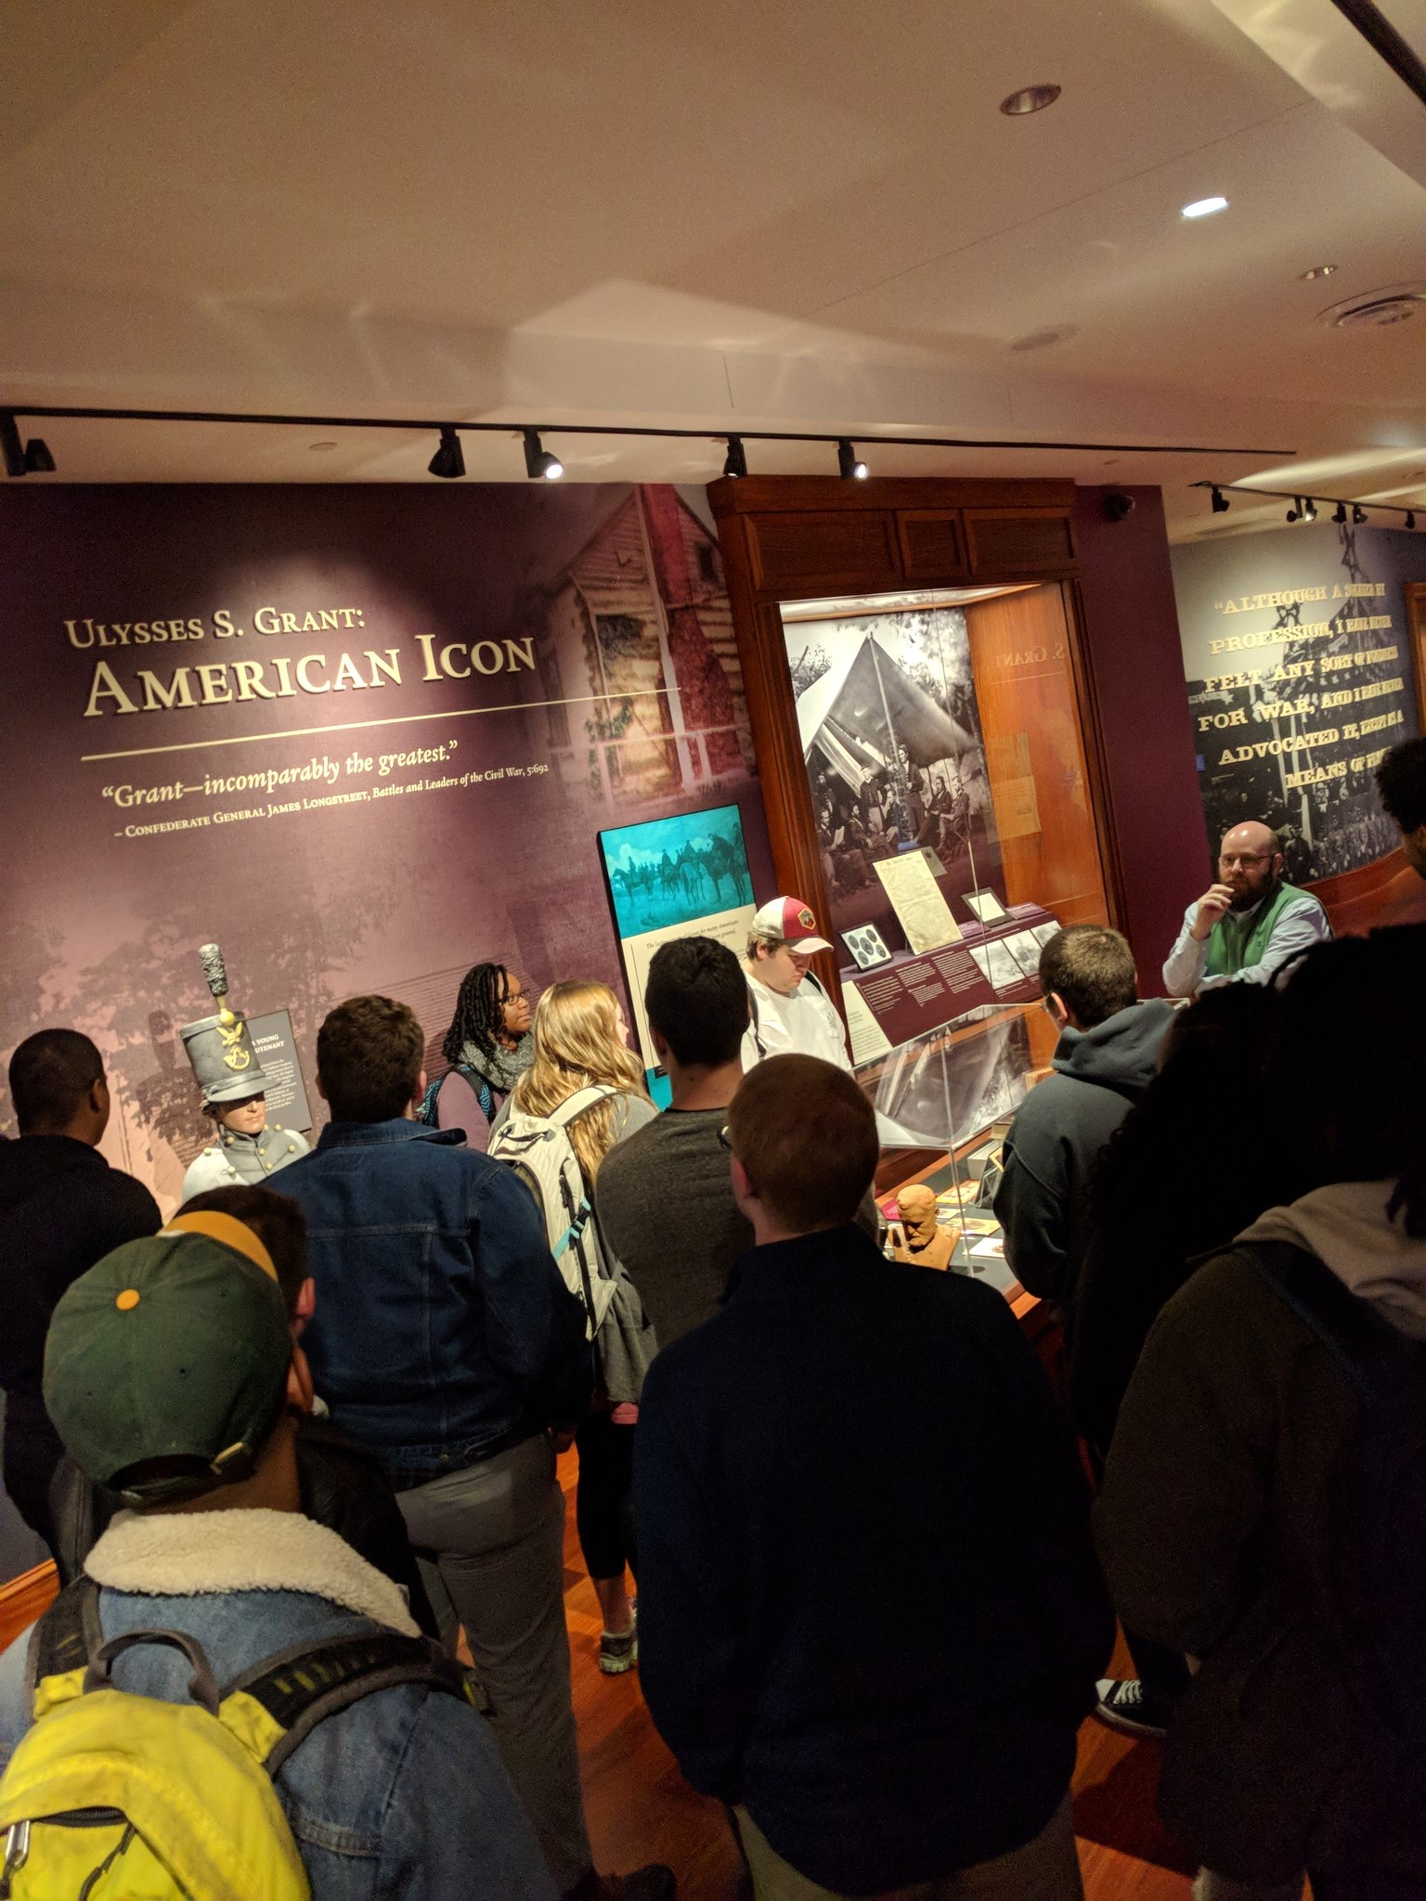
Outreach and engagement
Broadening our scope
Primary academic discipline we serve is history Recent success engaging education courses and political science courses, among others Established relationship with Department of Political Science Relationship with Stennis Center and Stennis Institute New facility on the 4th floor - also home of the Ulysses S. Grant Presidential Library

Slide 5
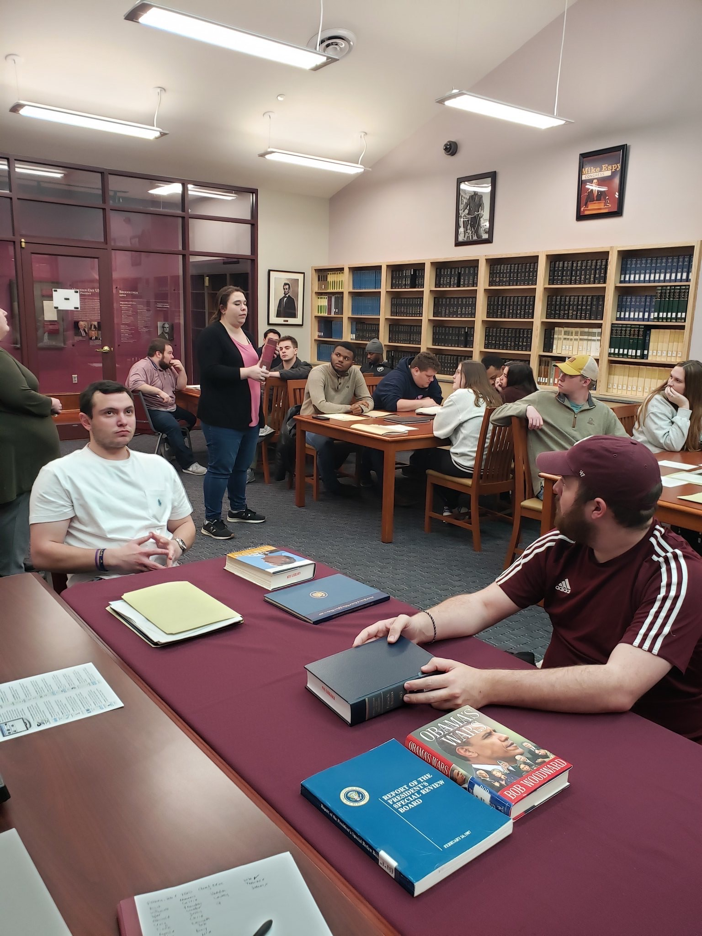
Split-level Political Science courses
Since 2018
Dr. Thessalia Merivaki, MSU Dept. of Political Science Topics have included: Election Reform, Voting Rights Act, Chief Executive, Legislative Process We provide instruction in our reading room, individualized reference sessions, sometimes a tour of the Grant/Williams collection galleries, and our auditorium at semester’s end for final presentations.

Slide 6
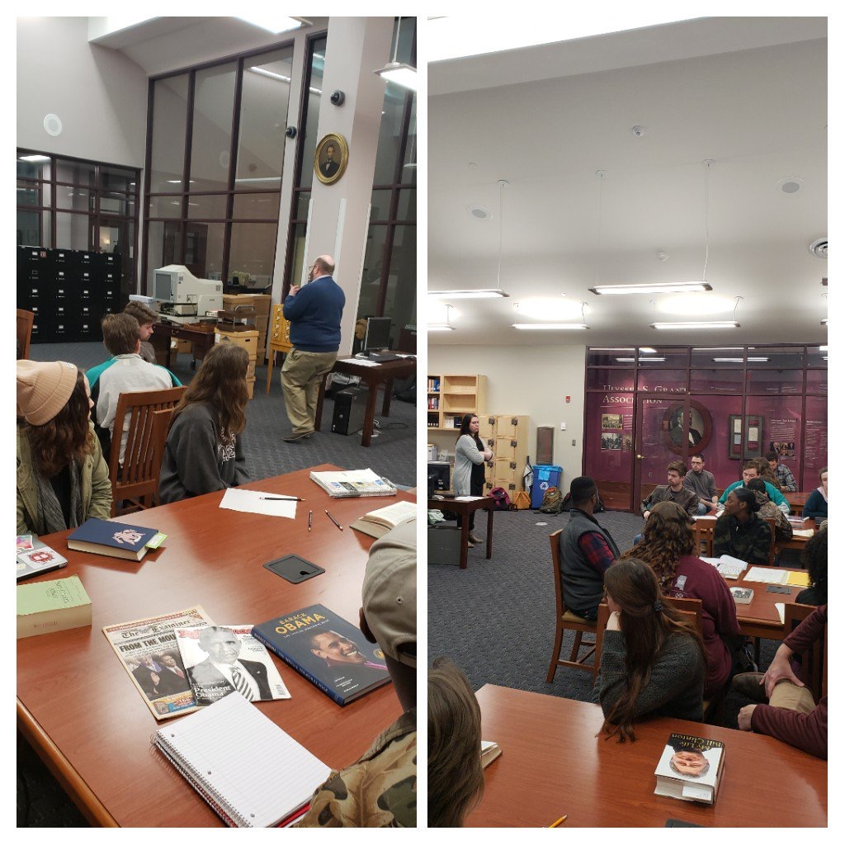
About the courses
Legislative Process | Chief Executive
Course objective: Students were assigned various roles on two House of Representatives committees Final project is a mock draft, debate, passage of bill How lawmakers work together to pass legislation | Course objective: Students learn about the role of the executive branch (the president) Focus on modern presidency – Carter to Obama (1977-2017) The course is divided into groups of 4-5, each of which is assigned one of the presidents and is tasked with presenting a “dossier” about their president.

Slide 7
Designing the sessions
Legislative Process | Chief Executive
Priorities: One item per 2-3 students – to foster teamwork and discussion Diversity of materials – representing as many of our relevant collections, mixture of arcane and fun Challenges: Instructor’s request wasn’t clear - referred back to syllabus ”Breaking the code” – learn more about the subject of the collection/general terminology Keywords – “Markup,” “conference,” “omnibus” Learn the materials! | Priorities: Find materials that represent each president assigned in the course. One item per student Challenges: Limited primary source material from our collections on recent presidents (W, Obama) Discussing how congressional materials help us understand a presidency

Slide 8
Selecting materials
Legislative Process materials used | Chief Executive materials used
Mike Espy papers: Gramm-Rudman-Hollings Act (Finance Committee), House Select Committee on Hunger, Yazoo River Basin backwater pumps funding (Agriculture Committee) David Bowen papers: 1981 Farm Bill (Agriculture Committee), Endangered Species Act of 1973 (Merchant Marines & Fisheries Committee) Charles Griffin papers: HUD 1972 amendment (Banking & Currency Committee) Sonny Montgomery papers: Music licensing bill (Judiciary Committee), GI Bill (Veterans Affairs Committee), MilCon Authorization (Armed Services Committee) | Public Papers of the Presidents Letters to the Congressmen from presidents Mike Espy papers: Cabinet material Books from our collections – autobiographies and memoirs, memoirs by staffers LibGuide

Slide 9
Follow-up
Reference | Assessment & future plans
Individual reference appointments Built into the course schedule for Chief Executive – each group (Carter group, Reagan group…) is required to schedule a reference session with us Focus on digital materials: Presidential library websites, National Archives, Congress.gov, Library of Congress, Gallup poll records, navigating our catalog, ArchivesSpace finding aids | Activity sheets for Legislative Process Methods of overall assessment of session Chief Executive class “checks in” with Dr. Merivaki twice during semester

Slide 10
Resources
Helpful resources | Contact me:
https://www.senate.gov/reference/glossary.htm Danielle Emerling (2018) Civics in the Archives: Engaging Undergraduate and Graduate Students with Congressional Papers. The American Archivist: Fall/Winter 2018, Vol. 81, No. 2, pp. 310-322. The Dirksen Congressional Center’s Teaching About Congress DocsTeach: Congress The National Archives Lesson Plans Bahde, A., & Smedberg, H. (2012). Measuring the magic: Assessment in the special collections and archives classroom. RBM: A Journal of Rare Books, Manuscripts, and Cultural Heritage, 13(2), 152-174. | Kate Gregory kgregory@library.msstate.edu (662) 325-9773 http://library.msstate.edu/cprc

