Slide 1
Representations of Black History in Archives:
Completing a Collection Analysis of an Archival Collection
Carrie P. Mastley (She/Her)
cmastley@library.msstate.edu
Mississippi State University Libraries
17 April 2020

Slide 2
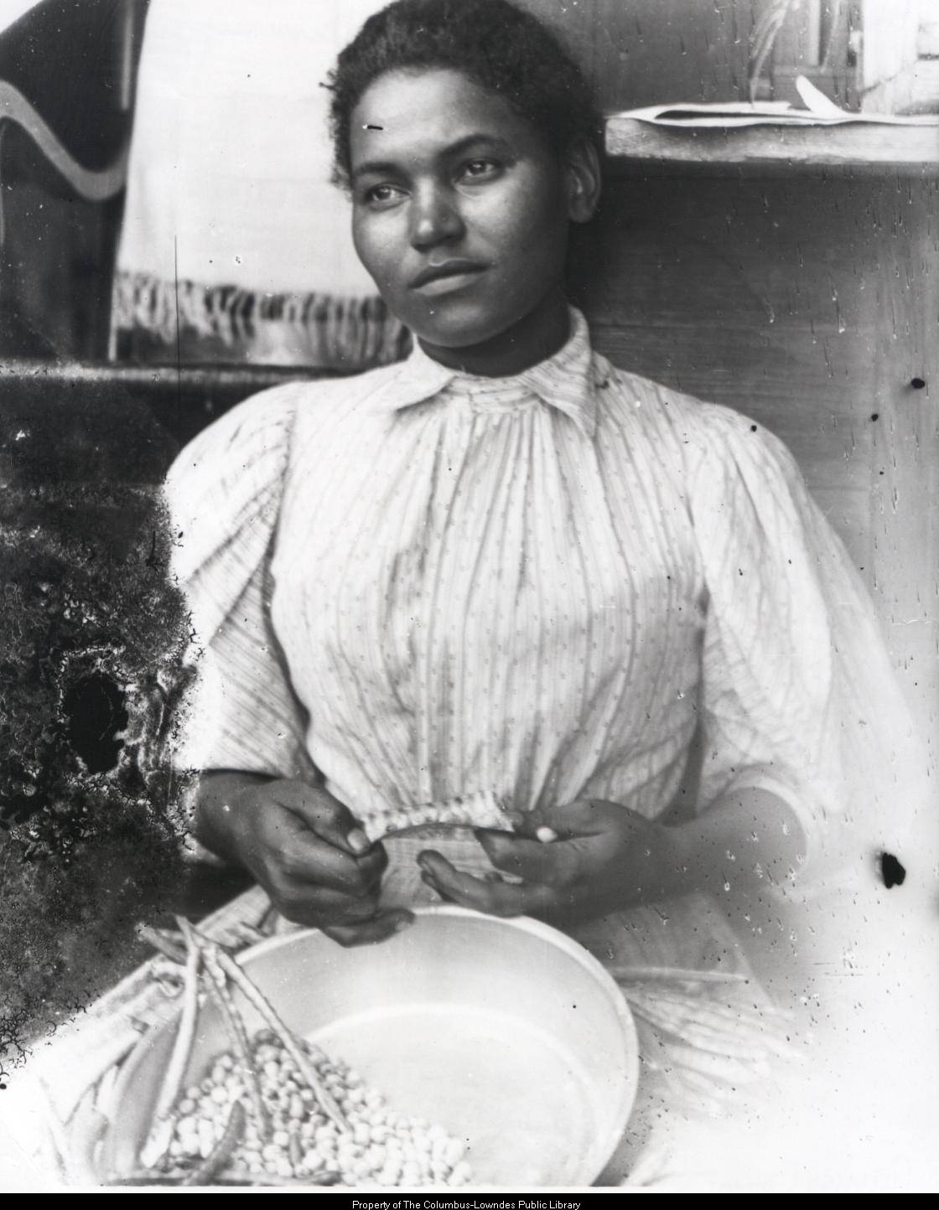
Overview
Background
  Billups-Garth Archive
  A Brief History of Black History
Why Collection Analysis?
Goals for Collection Analysis
Methodology
Results & Implications
Significance
Photograph of a Black woman shelling peas, circa 1890s. From the Marion Stark Gaines Photograph Collection, Billups-Garth Archive.

Slide 3
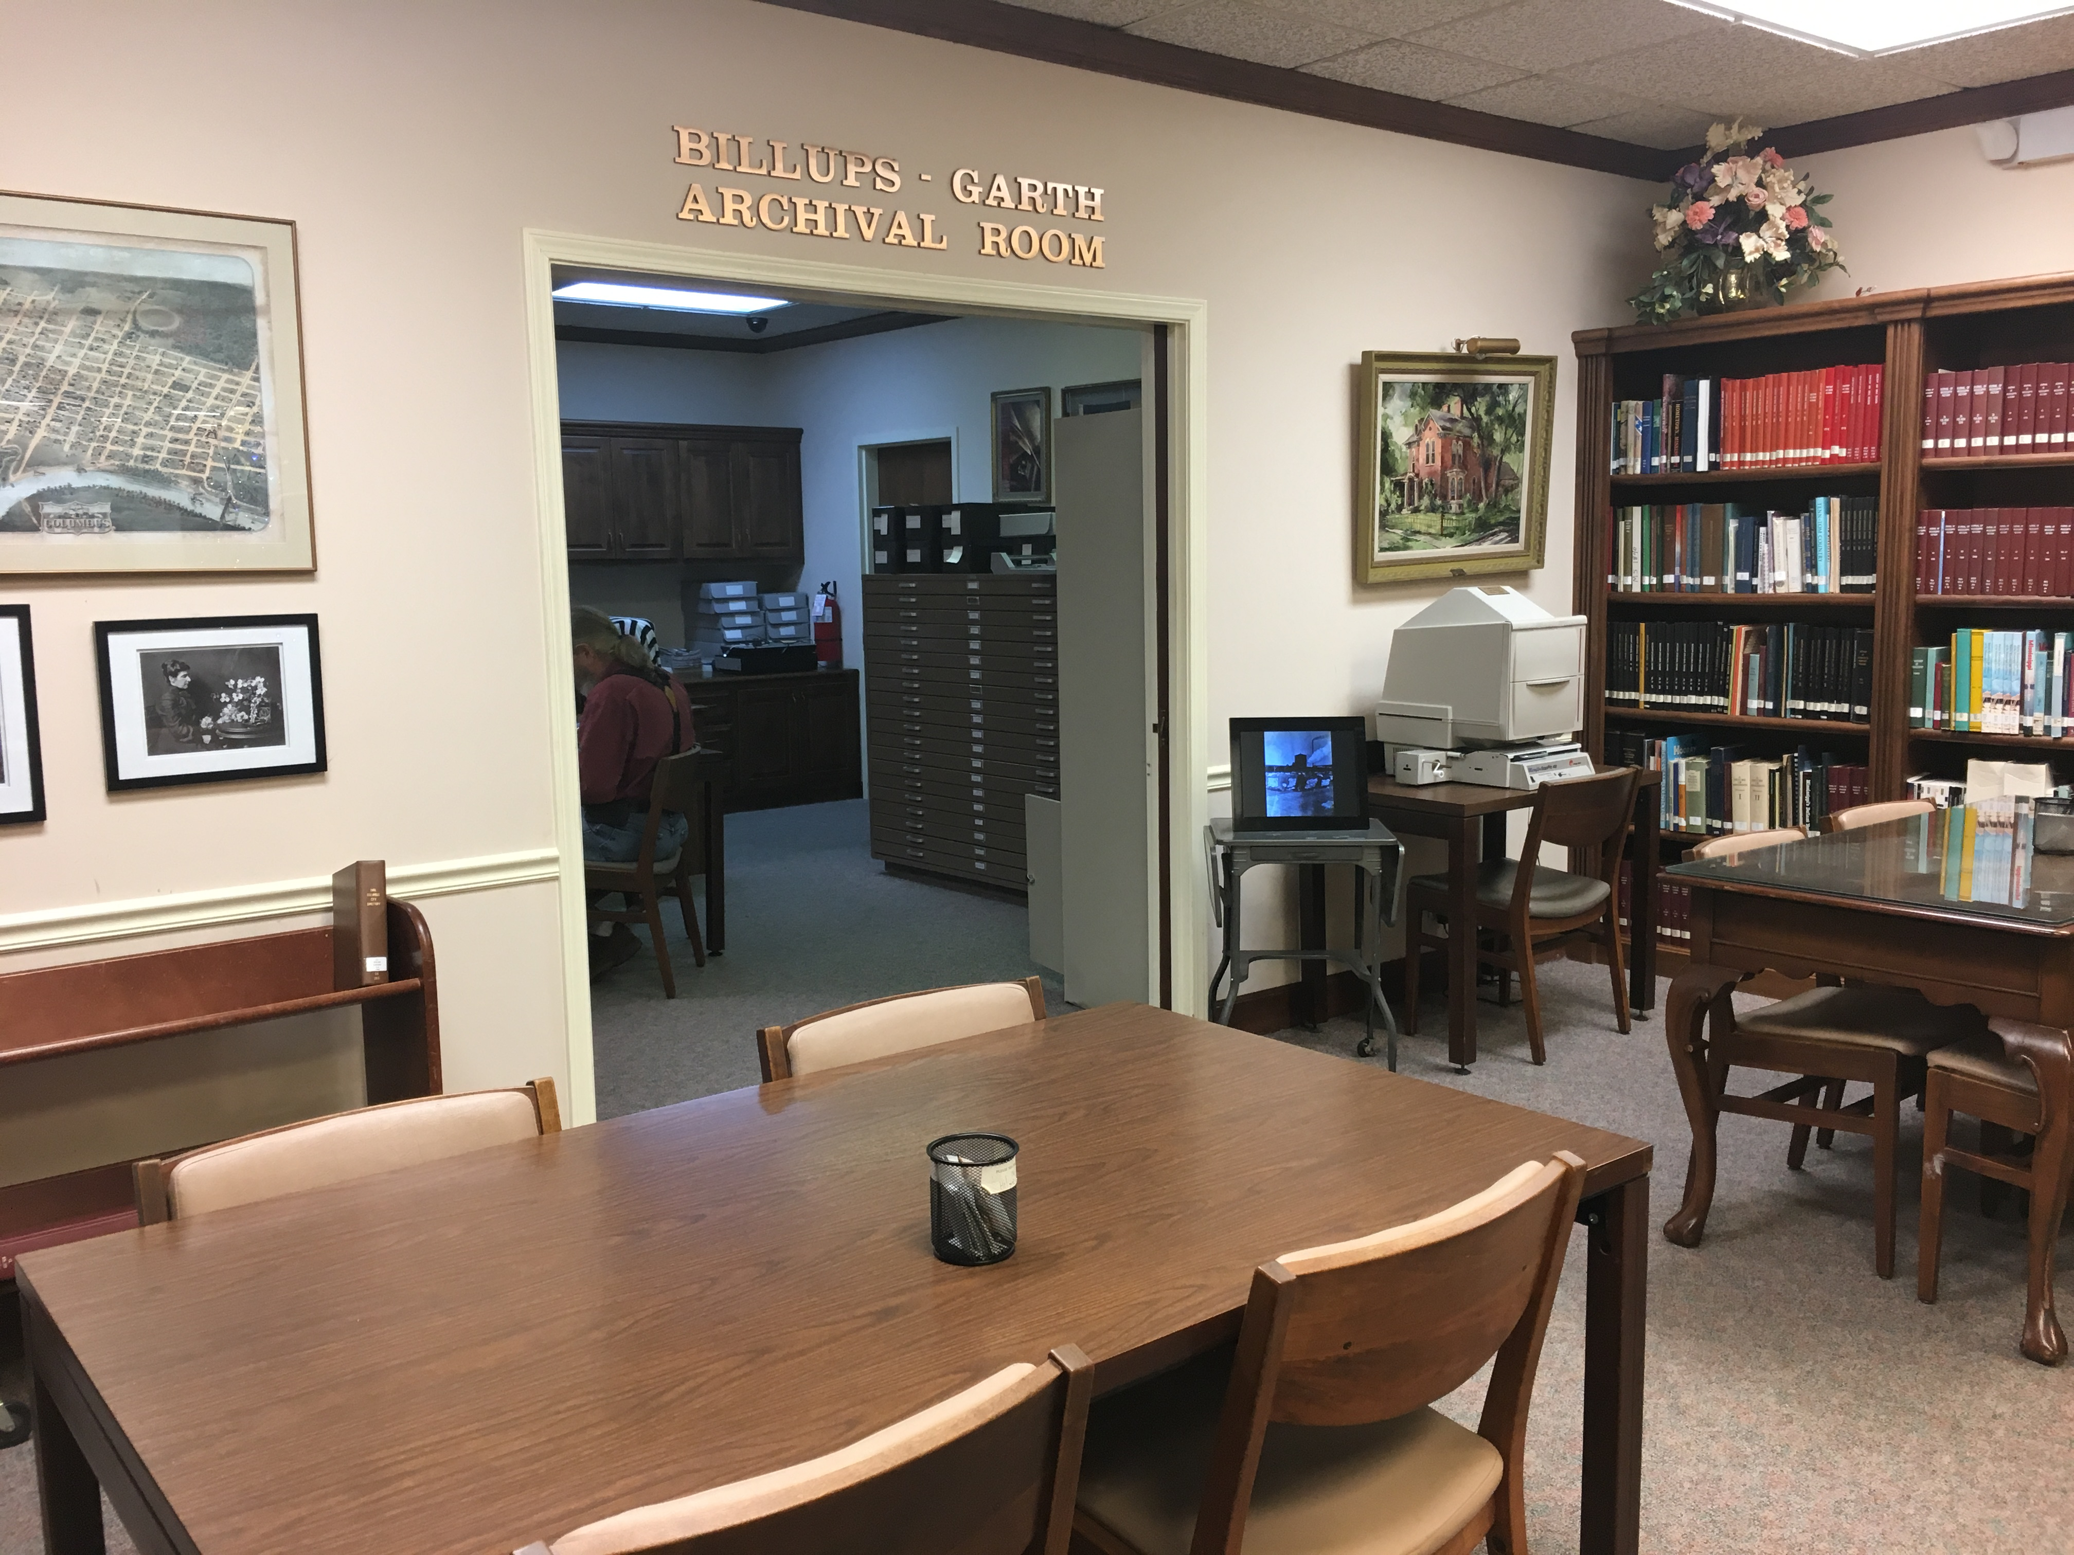
The Billups-Garth Archive
Located in Columbus, Lowndes County, Mississippi
Situated within the Local History Department at the Columbus-Lowndes Public Library
Founded in 1992
Contains over 1,000 cubic feet of archival materials:
  County records
  Court documents
  Manuscripts
  Maps
  Photographs
  School records
  Vertical files
  (Vance-Ali, 2013, Side tabs 1-3)
Photograph of the entryway of the Billups-Garth Archive, December 2017.

Slide 4
A Brief History of Black History in Archives
Documentation of Black history predates the Civil War
  Criticized their community’s omission from the historical record;
  Combatted “derogatory characterizations in the master narrative” (Gibbs, 2012, p. 197).
Carter G. Woodson, “Father of Black History”
  Along with J. Franklin Jameson, developed the Carter G. Woodson Collection of Negro Materials at the Library of Congress in the 1920s (Goggin, 1985).
Arthur Schomburg
  Instrumental in “recovering, archiving, and popularizing a dynamic history of the African Diaspora” in the 1910s and 1920s;
  Collection makes up the core of the New York Public Library’s Schomburg Center for Research in Black Culture (Holton, 2007, p. 219).

Slide 5
A Brief History of Black History in Archives
1960s and Black Studies
  Marginalized and “mainstream” repositories begin to intersect (Gibbs, 2012, p. 197).
  Prompted the examination of collections (Porter, 1976, p. 77).
1970s
  Howard Zinn and F. Gerald Ham reprimanded the archival community’s role in unequal collecting practices.
A lack of representation remains, even in the 21st century (Johnston, 2001, pp. 213-215; Flinn, 2007, p. 152; Prescod, 2017, p. 76).

Slide 6
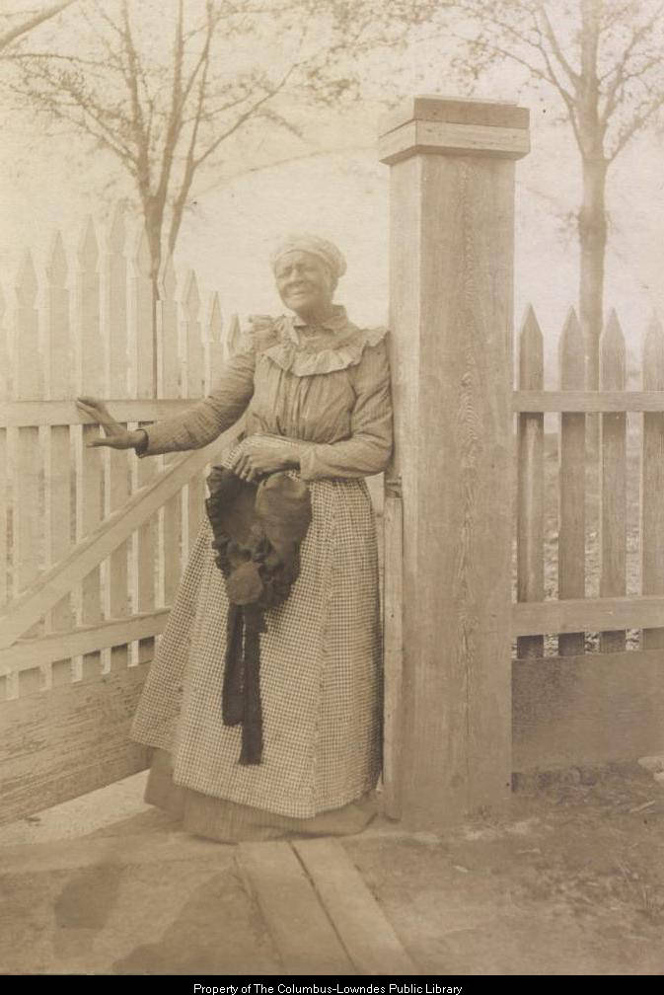
Possible Reasons for Lack of Representation
Lack of written records;
incorrectly or inefficiently coded record indexes;
skepticism toward mainstream repositories;
histories assumed insignificant (White, 1987, pp. 237-238; Johnson, 2017, p. 1).
“Professional passivity,” neutrality, apathy, and a general adherence to the status quo (Zinn, 2009, pp. 555-556; Gibbs, 2012, p. 196).
Photograph of a Black woman with bonnet by fence, circa 1890s. From the Marion Stark Gaines Photograph Collection, Billups-Garth Archive.

Slide 7
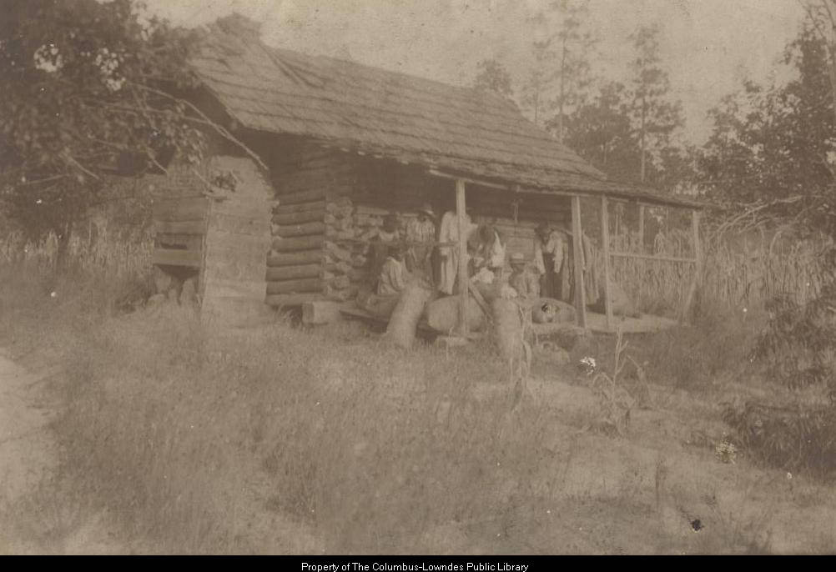
Noted Limitations of Extant Resources
Subjects of collections are often limited to:
  slavery;
  Civil Rights Movement;
  music;
  sports;
  entertainment (HistoryMakers, 2010; as cited in Gibbs, 2012, p. 199).
Lack of “Black agency in the making of the record” (Prescod, 2017, p. 76).
Photograph of Black individuals packing bales of cotton on the front porch of a log house, circa 1890s. From the Marion Stark Gaines Photograph Collection, Billups-Garth Archive.

Slide 8
Why Collection Analysis?
Analysis provides important information about a given collection:
  The number of pieces and titles in a particular subject;
  formats represented;
  age and condition of materials;
  breadth and depth of coverage;
  language in which the resources are available;
  patron use and nonuse of the collection (Johnson, 2014, p. 297).
Why is it important to archivists?
  Archivists should conduct collection analyses to create “collecting priorities,” which allow archivists to “realistically evaluate the materials they currently hold, identify any significant weaknesses and use this knowledge to develop acquisition priorities” (Johnston, 2001, p. 219).

Slide 9
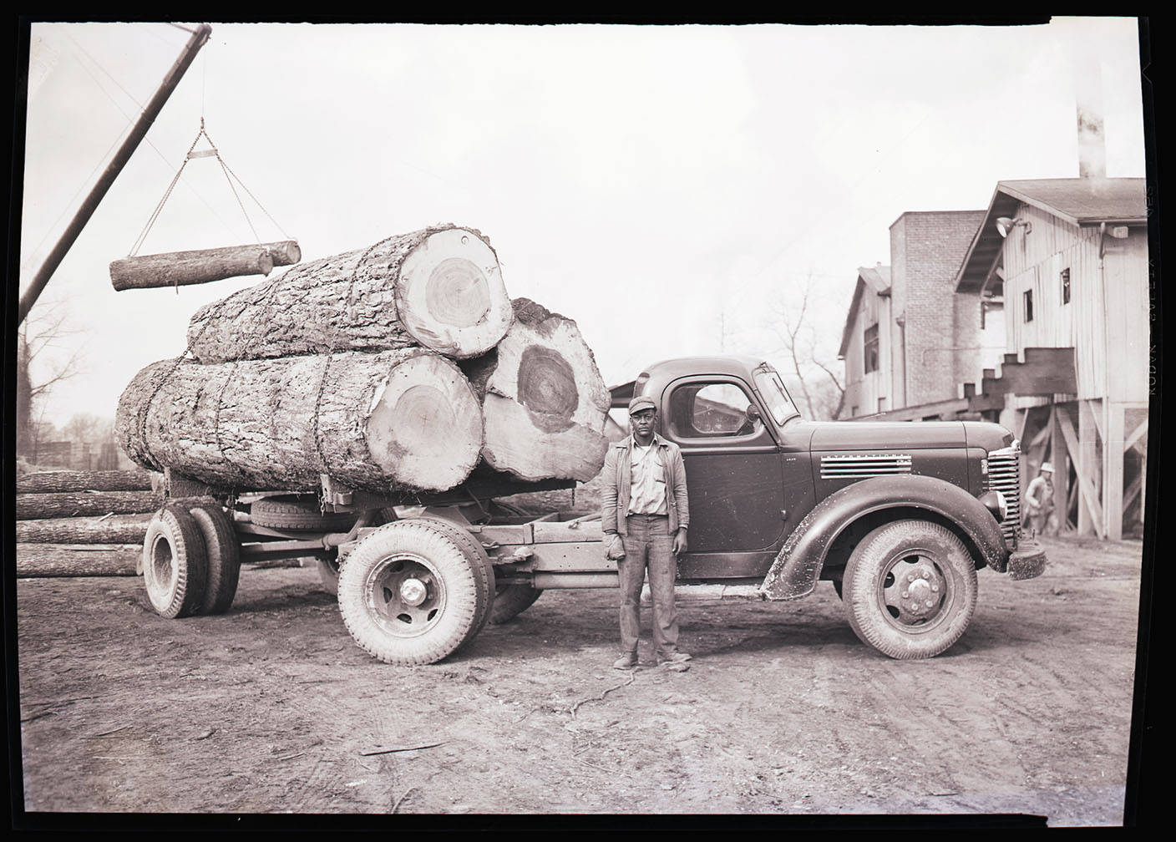
Goals for Collection Analysis
R1. What is the percentage of Black primary resources within the existing archival collection?
R2. What types of resources make up this percentage (e.g., textual documents, ephemera, sound recordings, etc.)?
R3. What are the subjects or themes associated with these resources?
R4. What percentage of these resources originated from within the Black community?
E. L. Bruce Co., 12 December 1920. From the Carl Brown Photographs Collection, Billups-Garth Archive.

Slide 10
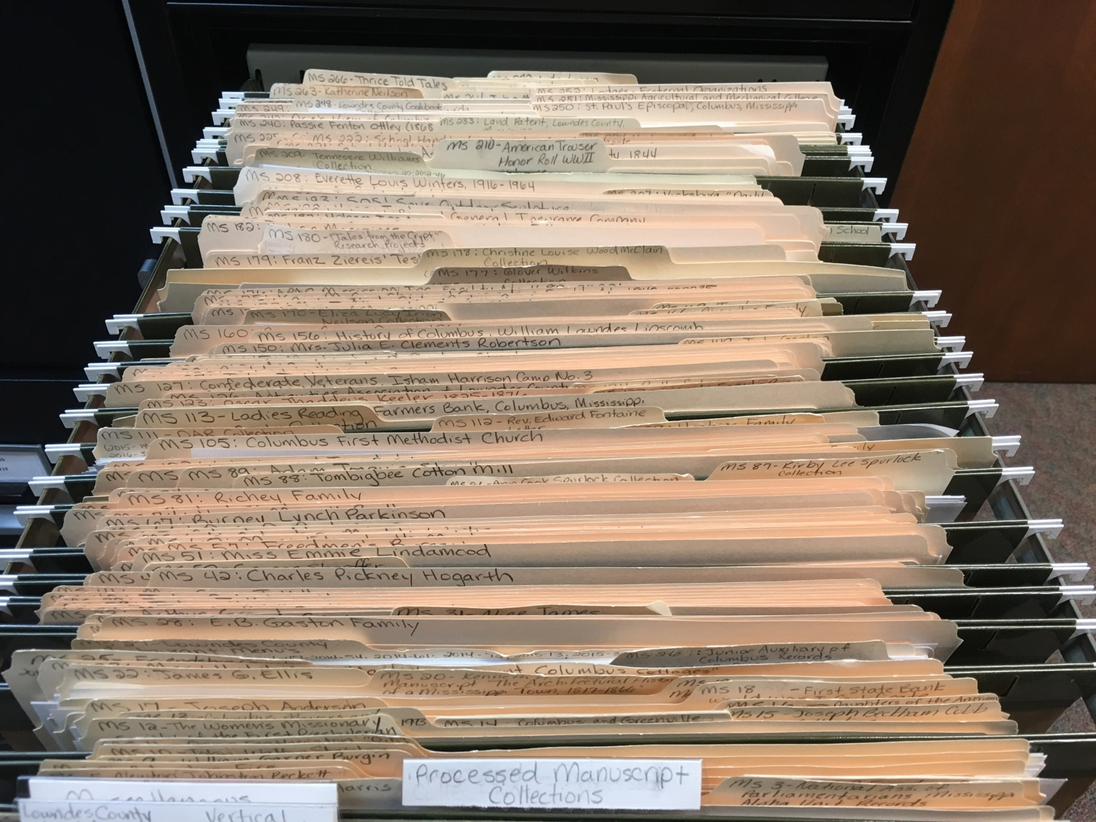
Methodology: Data Collection
Reviewed control files and inventories for evidence of keywords and phrases denoting race or relating to the Black experience.
Utilized physical collections, Archivist, and Ancestry.
Noted collection number, collection name, resource type, status (i.e., processed or unprocessed), date created, creator, and content notes in a spreadsheet.
Recorded data in spreadsheet.
Reviewed control files and inventories for evidence of keywords and phrases denoting race or relating to the Black experience. ​
Utilized physical collections, Archivist, Ancestry, and Google. ​
Noted collection number, collection name, resource type, status (i.e., processed or unprocessed), date created, creator, and content notes.​
Recorded data in spreadsheet.
Photograph of the Billups-Garth Archive’s control files, December 2017.

Slide 11
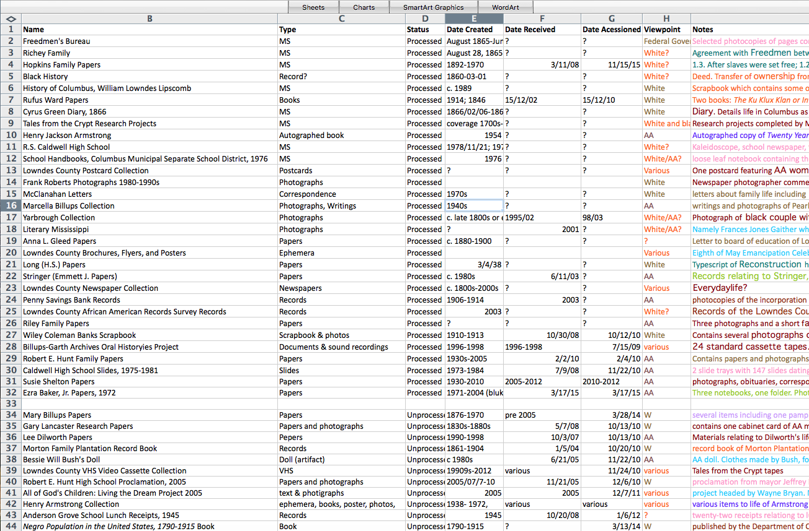
Methodology: Data Analysis
Compared number of relevant collections to the Archive’s total holdings.
Coded collections based on resource type:
  books/publications, ephemera, film/video, photographs, prints/paintings/drawings, sound recordings, textual documents, and three-dimensional objects.
Coded collections based on subject matter:
  church organizations, Civil Rights, education, Emancipation/Reconstruction, employment, everyday life, Jim Crow, legal/records, slavery, and sports & culture.
Coded collections based on origin of creation.
Screenshot of the spreadsheet used to organize data.

Slide 12
Methodology: Limitations
Not generalizable:
  Results reflect only one repository’s collections.
Manual data collection:
  No formal electronic resource management system.
  Control files and inventories manually searched for relevance.

Slide 13
Results
R1. What is the percentage of Black primary resources within the existing archival collection?
Total number of manuscript collections and record series compared to total number of Black primary resources.

Slide 14
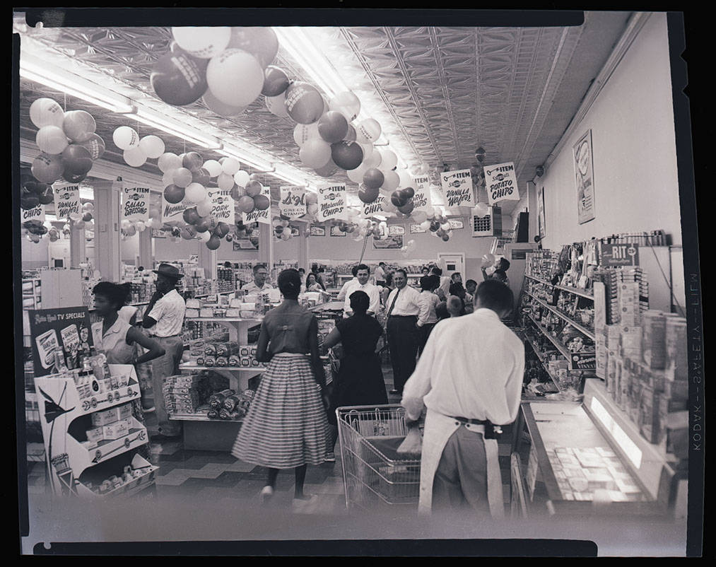
Implications
R1. What is the percentage of Black primary resources within the existing archival collection?
Black primary resources make up only 8% of the total collection.
2010 U.S. Census indicates that Black individuals make up approximately 43% of Lowndes County’s total population (USCB, 2010, Race section).
Competition from the R.E. Hunt Museum and Cultural Center?
  Opened in 2011.
Photograph of the National Food Store for WACR. From the Carl Brown Photographs Collection, Billups-Garth Archive.

Slide 15
Results
R2. What types of resources make up this percentage (e.g., textual documents, ephemera, sound recordings, etc.)?
Black primary resources broken down by resource type.

Slide 16
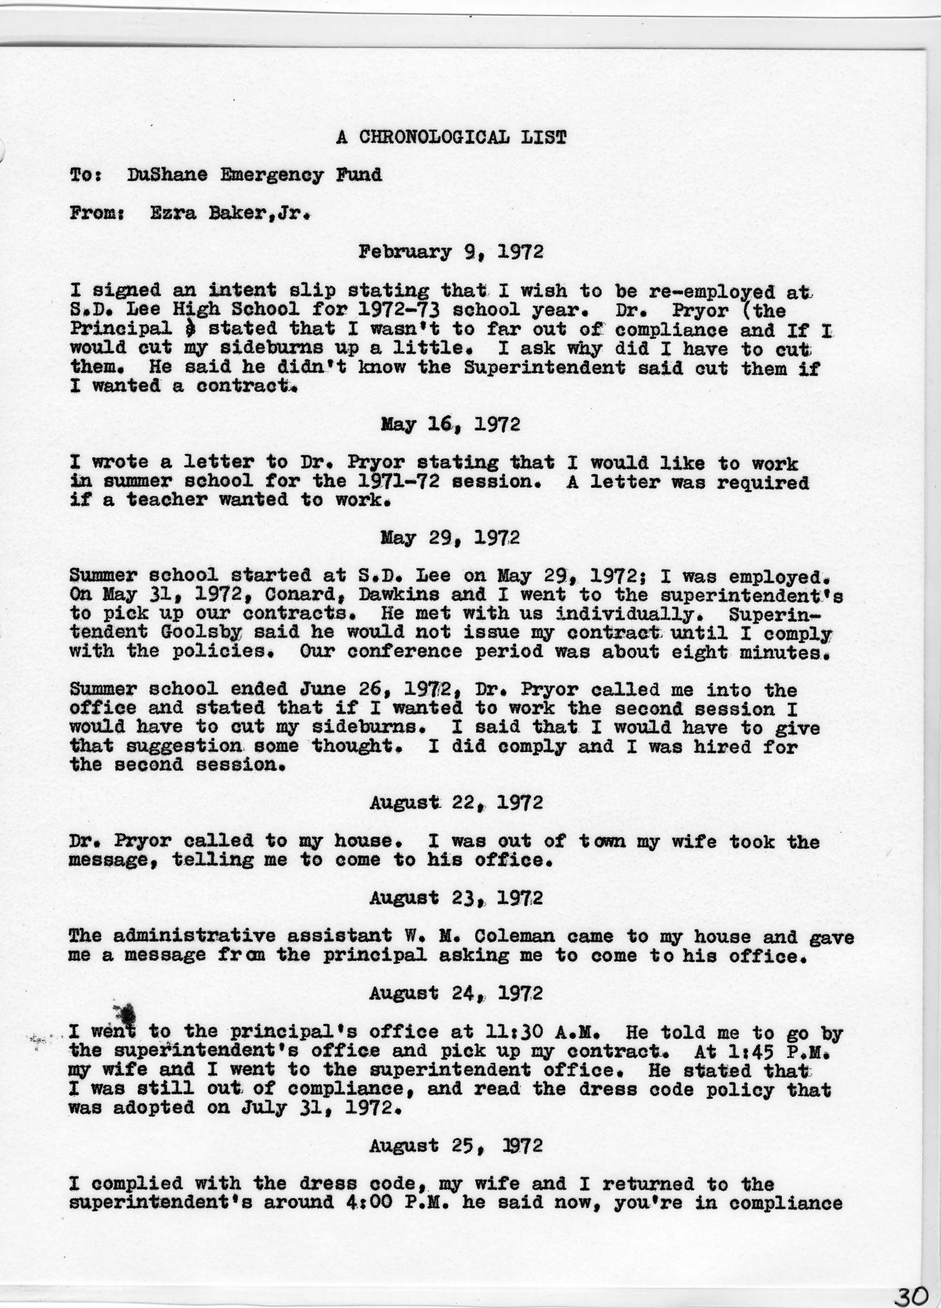
Implications
R2. What types of resources make up this percentage (e.g., textual documents, ephemera, sound recordings, etc.)?
Textual documents make up 60% of Black primary resources.
Results contrast White’s (1987) explanation that there are very few written resources documenting Black history.
While textual documents make up a significant portion of the repository’s Black primary resources, they are still small in number overall.
  Only 5% when compared to all holdings.
Chronological list of events according to Ezra Baker, Jr., 1972. From the Ezra Baker, Jr. Papers, Billups-Garth Archive.

Slide 17
Results
R3. What are the subjects or themes associated with these resources?
Thematic percentages making up relevant manuscript collections and record series.

Slide 18
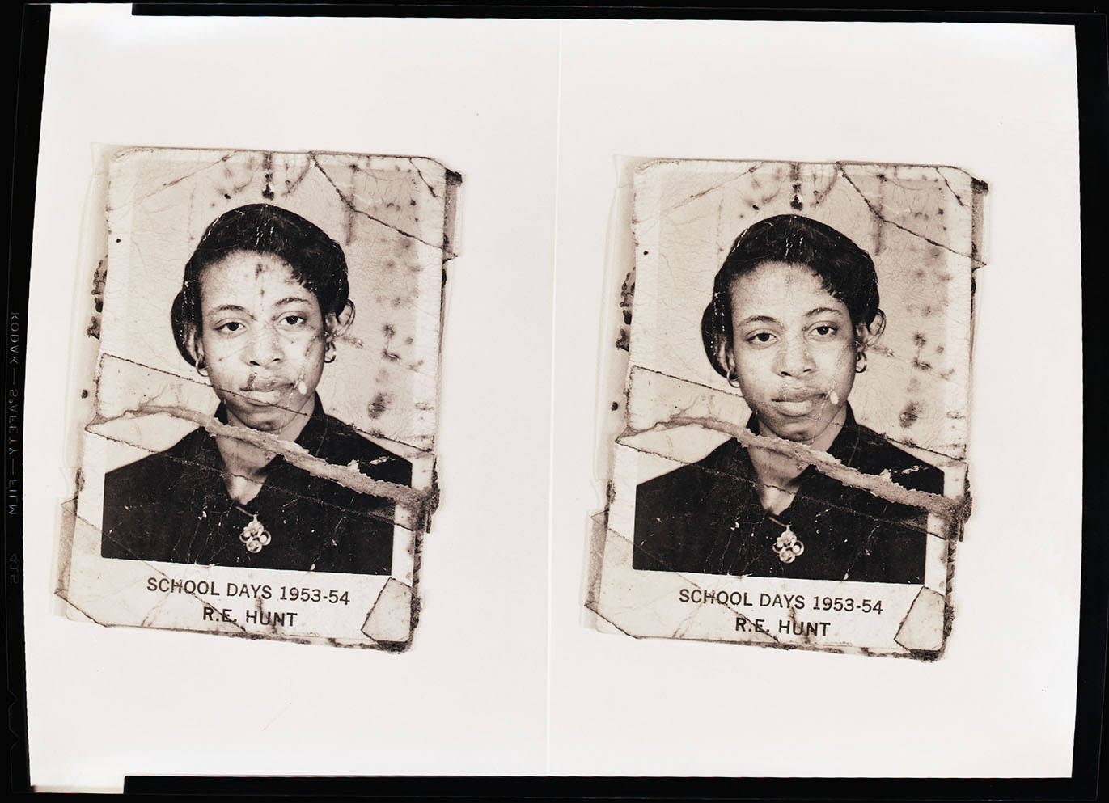
Implications
R3. What are the subjects or themes associated with these resources?
Repository holds similar resources noted by Gibbs (2012, p. 199).
  Civil Rights, entertainment, music, slavery, and sports.
However, the most heavily represented subjects relate to everyday life and education.
The literature’s grasp of subject coverage may be inaccurate or at least incomplete.
Copywork of Joe L. Durrah of portrait of R.E. Hunt student, 1953-54. From the Carl Brown Photographs Collection, Billups-Garth Archive.

Slide 19
Results
R4. What percentage of these resources originated from the Black community?
The percentage of resources created within the Black community.

Slide 20
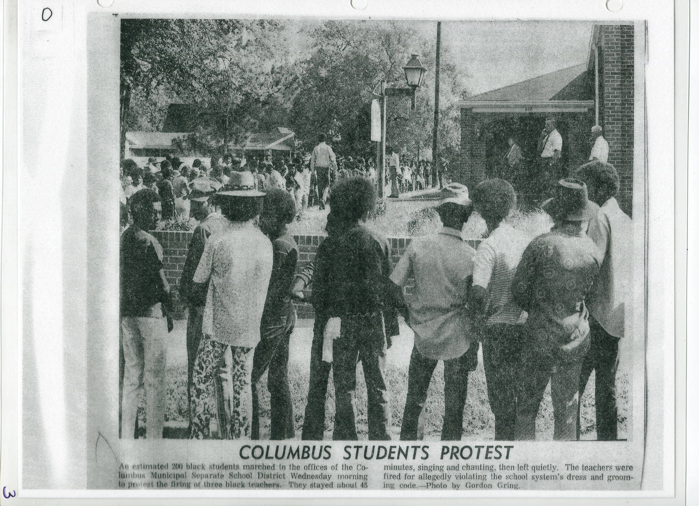
Implications
R4. What percentage of these resources originated from the Black community?
Only 21% of resources originated from the Black community.
Findings support assertions made by Flinn (2007) and Prescod (2017).
Findings may encourage archivists to be more aware of the origins of resources.
  Give agency to marginalized communities!
“Columbus Students Protest,” unidentified newspaper, October 1972. From the Ezra Baker, Jr. Papers, Billups-Garth Archive.

Slide 21
Significance
The study, while not generalizable, supports previous findings in that there is a dearth of materials related to Black history.
There is a need for more studies related to this subject:
  More comprehensive data collection and analysis.
  Examination of other marginalized communities.
Hopefully, archivists will be encouraged to undertake similar projects to:
  Grow the collective understanding of this issue.
  Create collections that better represent the communities they serve.

Slide 22
References
  Flinn, A. (2007). Community histories, community archives: Some opportunities and challenges. Journal of the Society of Archivists, 28(2), 151-176.
  Gibbs, R. (2012). The heart of the matter: The developmental history of African American archives. The American Archivist, 75(1), 195-204.
  Goggin, J. (1985). Carter G. Woodson and the collection of source materials for Afro-American history. The American Archivist, 48(3), 261-271.
  Heidelberg, S. J. (2013). A collection analysis of the African-American poetry holdings in the de Grummond Collection. SLIS Connecting, 2(1), 1-14.
  Holton, A. (2007). Decolonizing history: Arthur Schomburg’s Afrodiasporic Archive,” The Journal of African American History, 92(2), 218-238.
Johnson, P. (2014). Collection development and management (3rd ed.). Chicago, IL: American Library Association.
Johnson, T. K. (2017). African American archival resources: Representations in North Carolina, South Carolina, and
  Georgia. SLIS Connecting, 6(1), 1-18.
Johnston, I. (2001). Whose history is it anyway? Journal of the Society of Archivists, 22(2), 213-229.
McDaniel, K. R. (2011). A survey of the African American records in UK’s Special Collections. Kentucky Libraries, 75(4), 8-12.
Porter, D. B. (1976). Bibliography and research in Afro-American scholarship. The Journal of Academic Librarianship, 2(2), 77-81.
  Prescod, C. (2017). Archives, race, class and rage. Race & Class, 58(4), 76-84.
  White, D. G. (1987). Mining the forgotten: Manuscript sources for Black women’s history. The Journal of American History, 74(1), 237-242.
  Vance-Ali, M. (2013). Local history. Retrieved from http://www.lowndeslibrary.org/client/en_US/clpl/?rm=LOCAL+HISTORY+0%7C%7C%7C1%7C%7C%7C1%7C%7C%7Ctrue
  Zinn, H. (2009). The Zinn reader: Writings on disobedience and democracy. New York: Seven Stories Press.

Slide 23
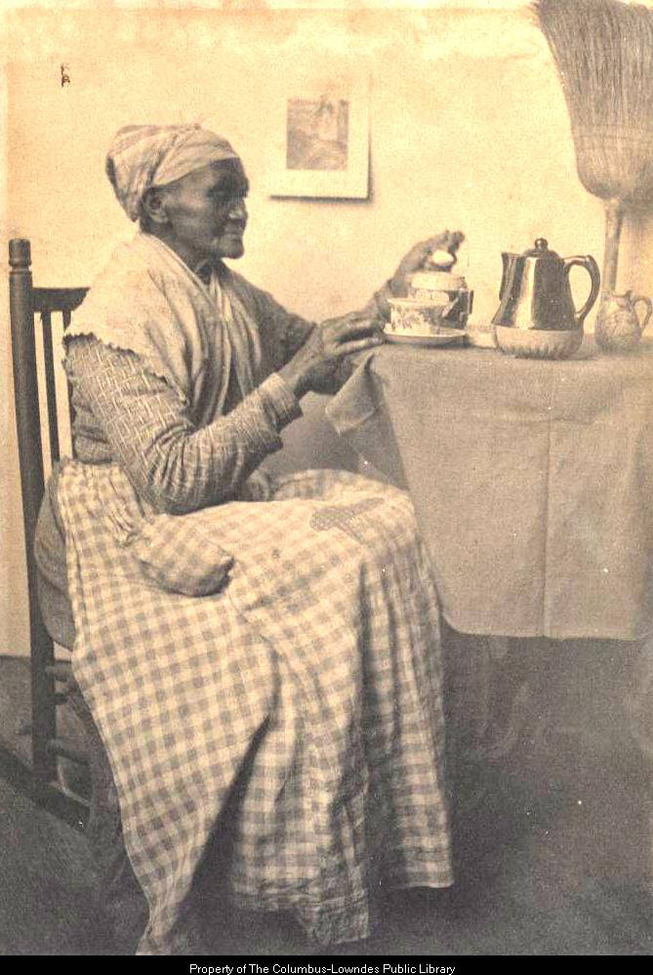
Thank you for your time and attention.
Questions? Comments?
Carrie P. Mastley
cmastley@library.msstate.edu
Interested in viewing materials from the Columbus-Lowndes Public Library’s Billups-Garth Archive?
Check out their holdings at the Mississippi Digital Library!
https://msdiglib.org/columbus
Photograph of a Black woman drinking tea at a table while sitting in a rocking chair, circa 1890s. From the Marion Stark Gaines Photograph Collection, Billups-Garth Archive.

